Slide 1
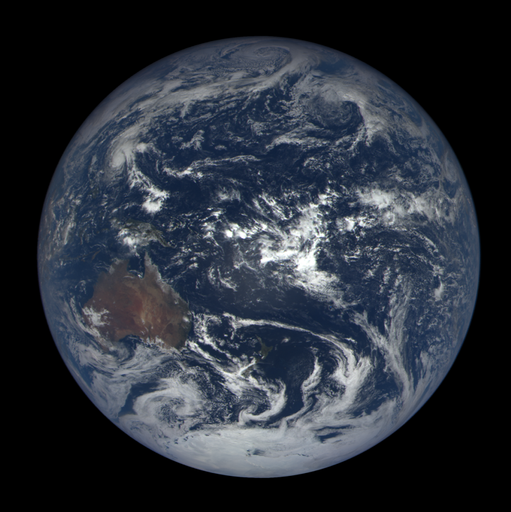
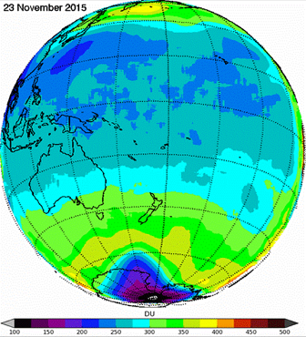
Validation of Ozone Derived from EPIC Measured Radiances
J. Herman, L. Huang, and R. McPeters
23 November 2015

Slide 2
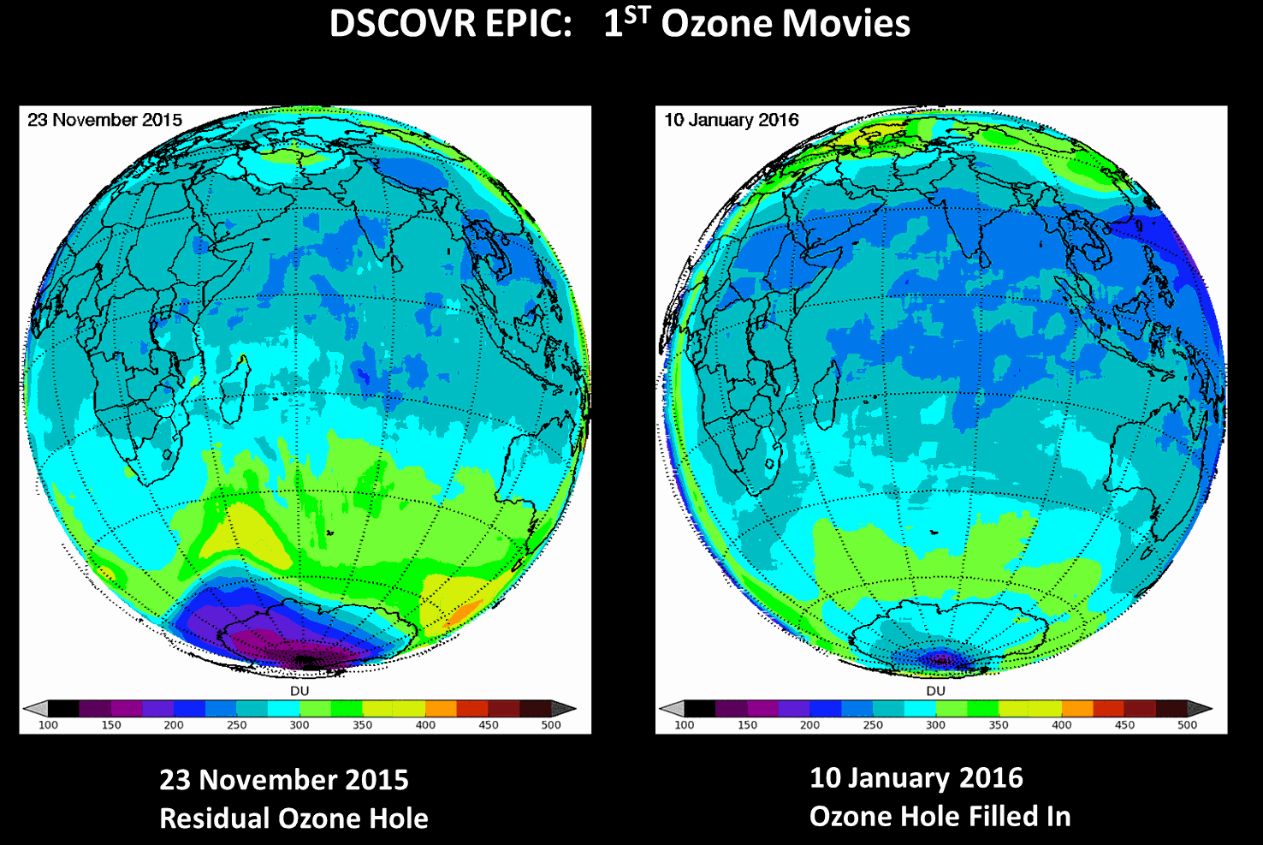

Slide 3
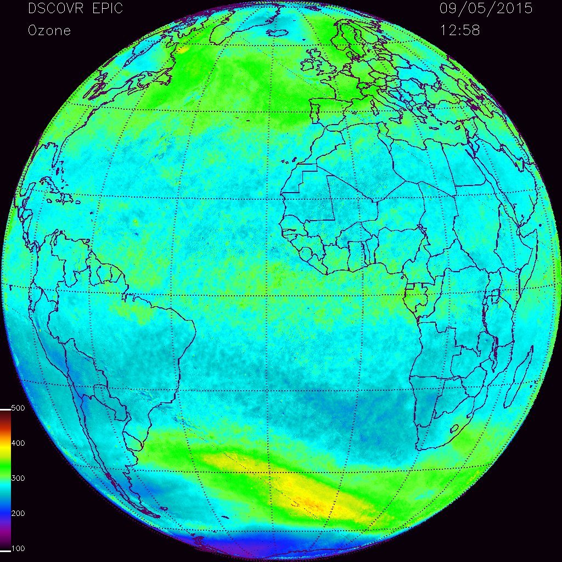
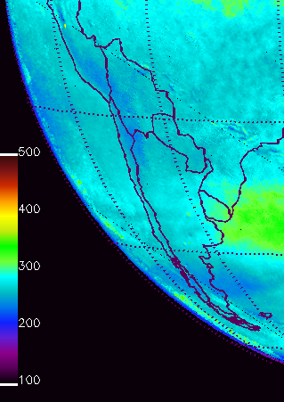
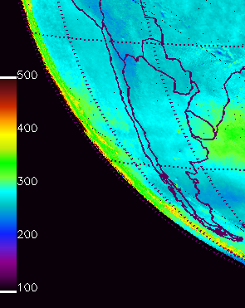
Effect of New Geolocation on Ozone Retrieval
New
Old

Slide 4
Validation Methods
Direct satellite to satellite comparison (EPIC compared to OMPS)
EPIC ozone compared to ground-based observations (EPIC compared to Pandora)
Why Pandora?
Pandora measures every 80 seconds from sunrise to sunset
Pandora has been validated against OMI and OMPS satellites and against a traditional ground-based Dobson and Brewer spectroradiometers.
At a fixed site EPIC measures a maximum of 10 times per day in the summer and 8 times in the winter at varying local times each day.
Useful EPIC ozone measurements are for Solar Zenith and Satellite Zenith angles less than 70^{O}. This reduces the number per day.

Slide 5
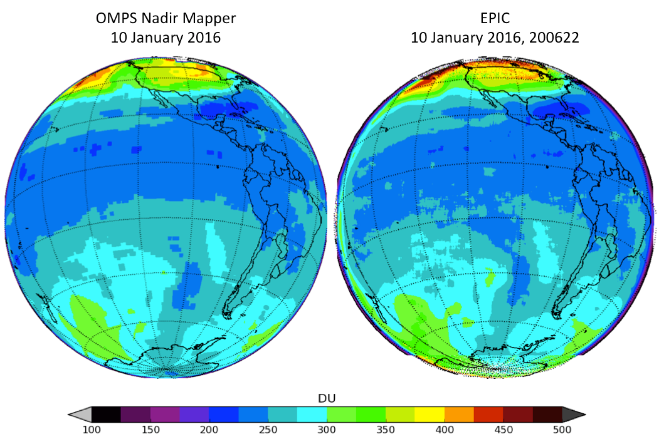
Comparison between OMPS and EPIC Ozone

Slide 6
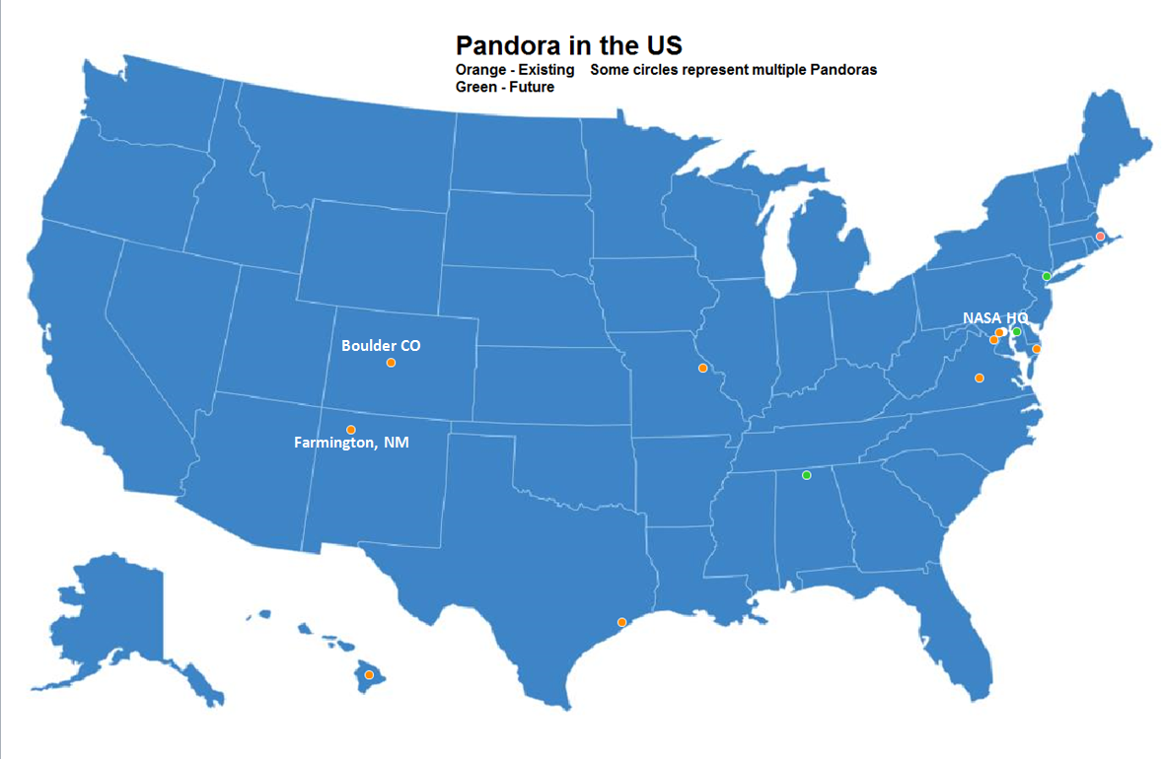
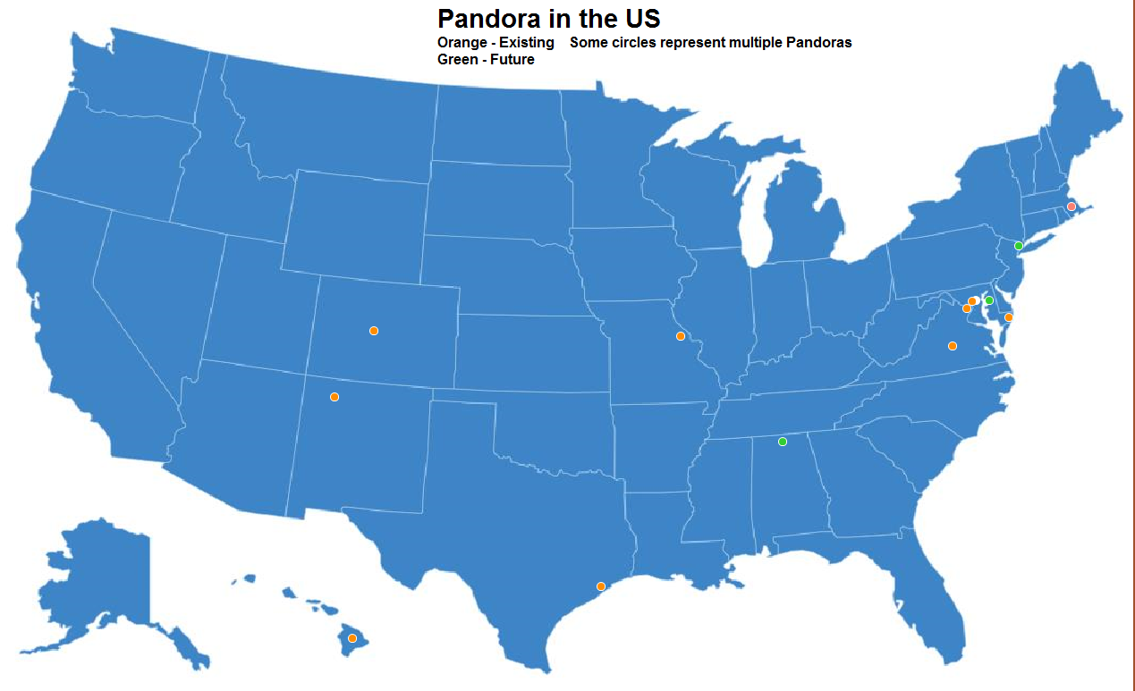
Pandora Sites in the US
Four Corners, NM
NASA HQ
NASA HQ
Boulder CO
Boulder, CO
Farmington, NM

Slide 7
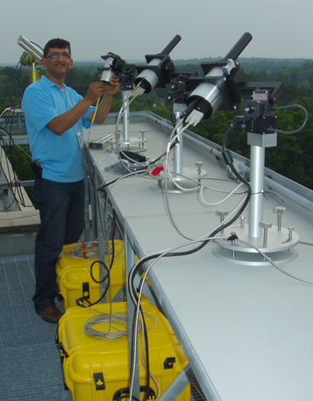
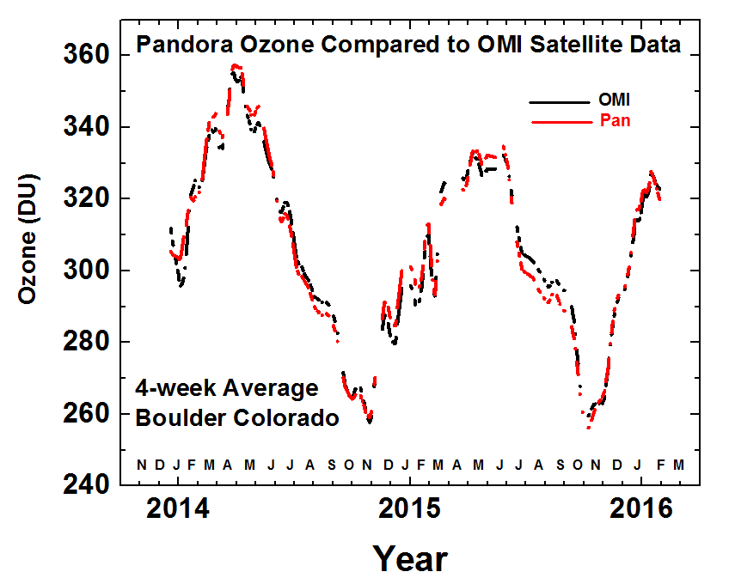
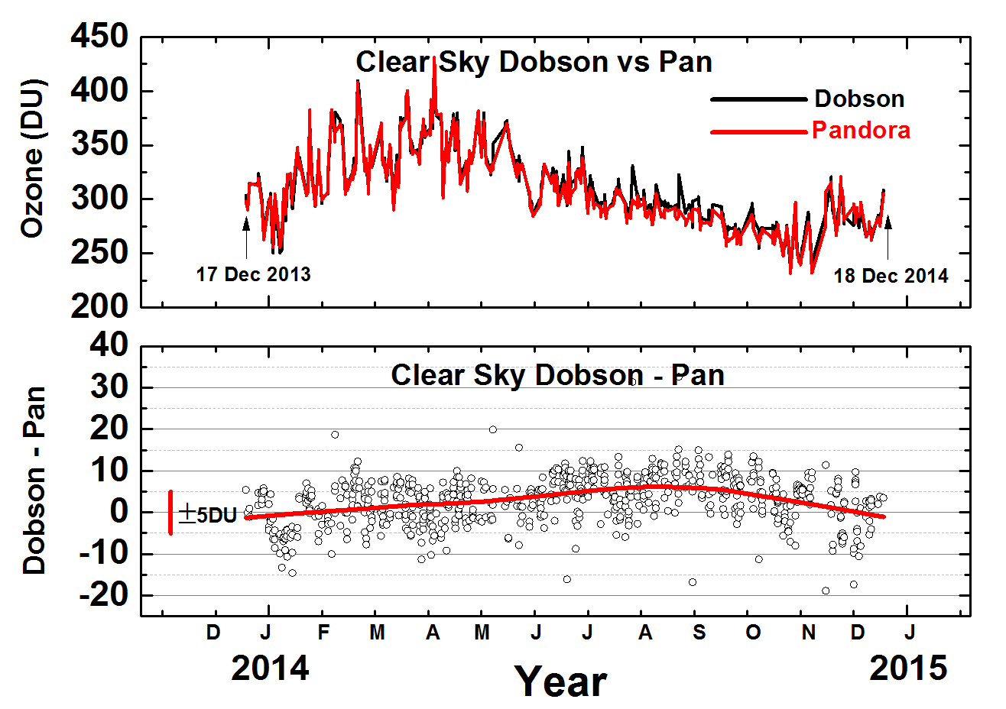
Pandora Spectrometer Instrument Compared with OMI and Dobson
Boulder, Colorado
OMI
Pandora Spectrometer
Instrument views the sun or sky to derive the amounts of Ozone, NO₂, Formaldehyde, and BrO
Dobson

Slide 8
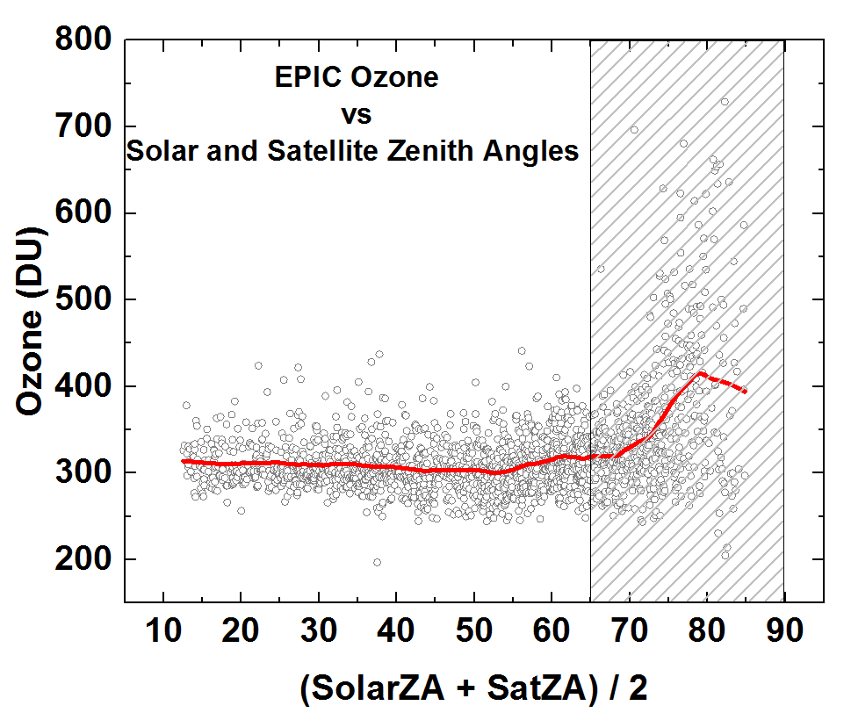
One Year of EPIC Ozone Data
Four Corners, New Mexico

Slide 9
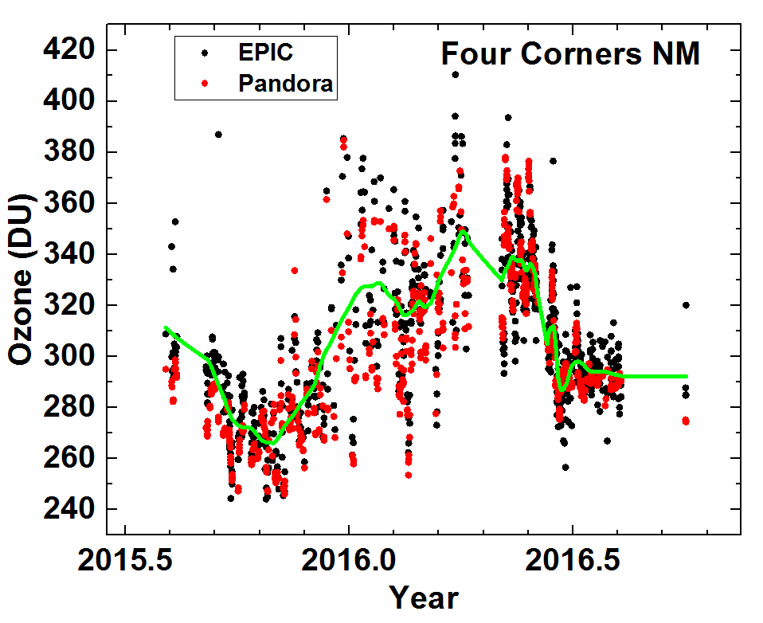
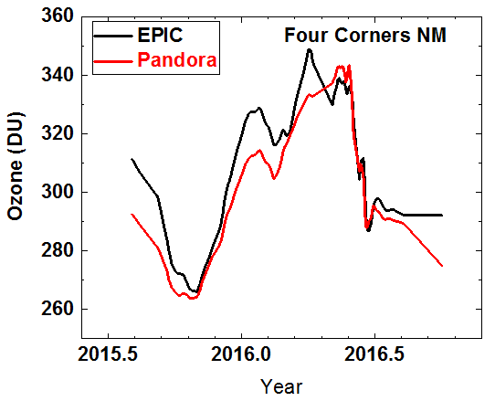
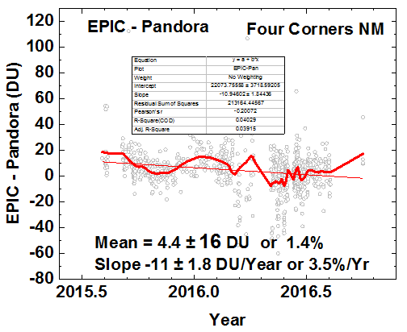
EPIC comparison at Four Corners New Mexico
Daily
Monthly Average
EPIC ozone data follows the monthly variations
and has a small difference in the annual average ozone amount (1.4%).
However, the differences on a monthly average basis are still too large.

Slide 10
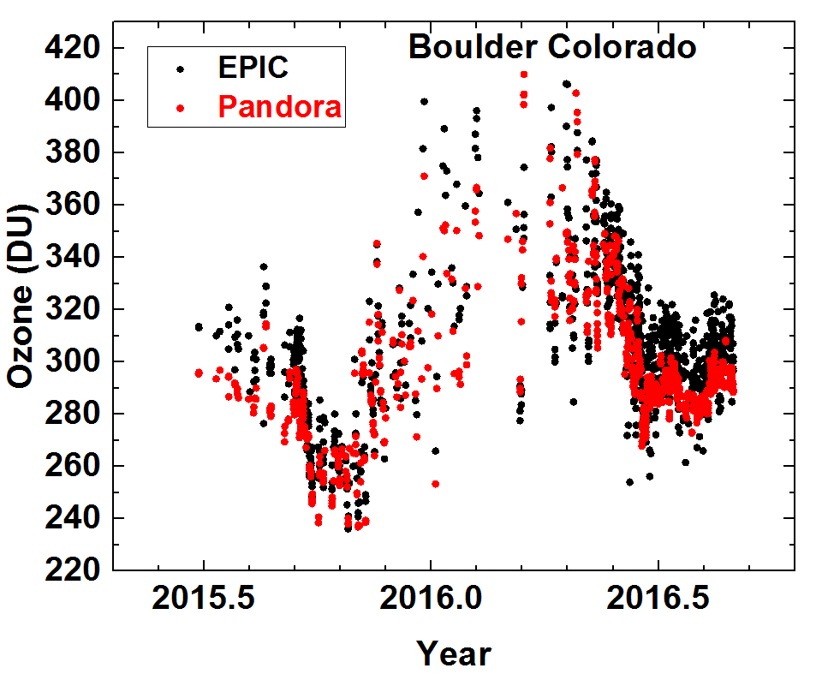
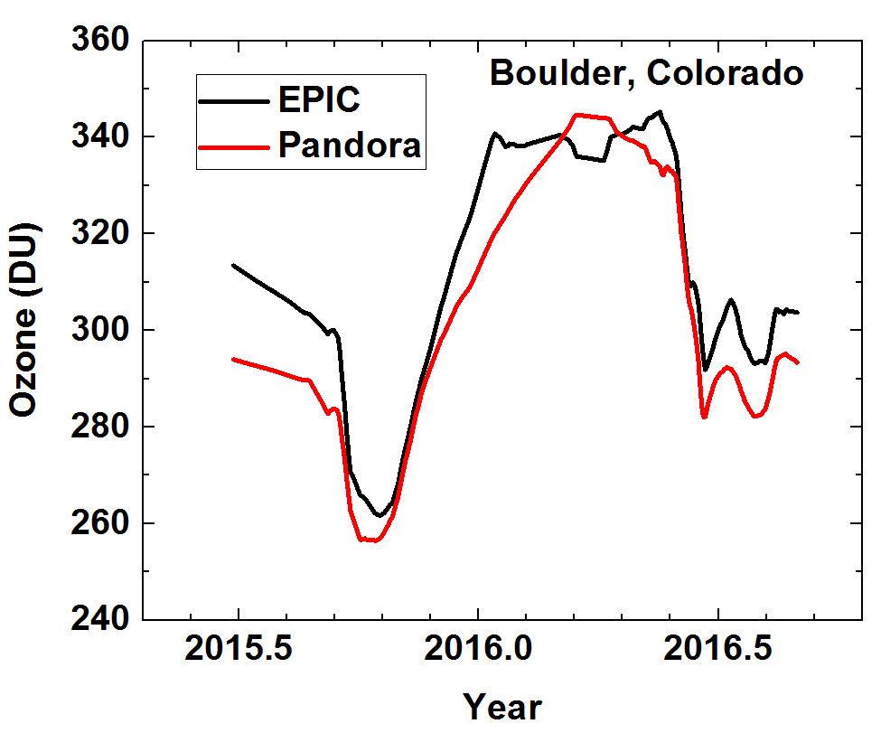
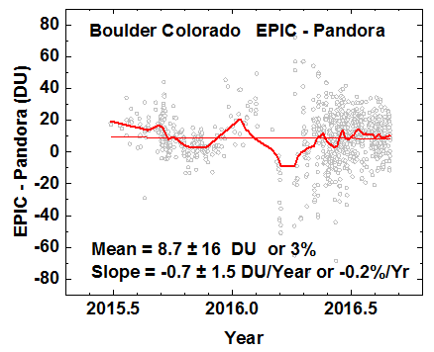
EPIC comparison at Boulder, Colorado
Daily
Monthly Average
EPIC ozone data follows the monthly variations
and has a small difference in the annual average ozone amount (3%).
However, the differences on a monthly average basis are still too large.

Slide 11
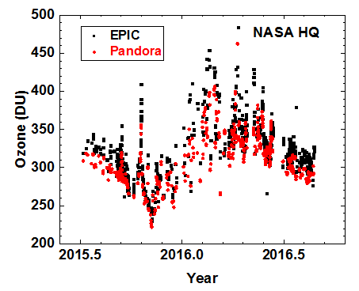
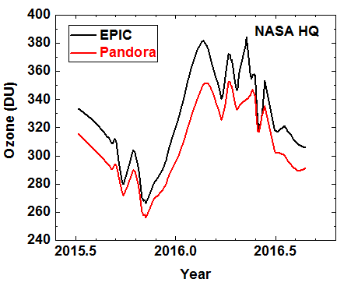
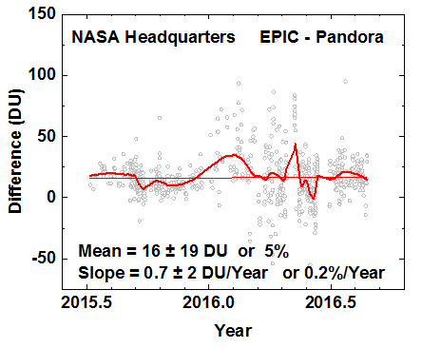
EPIC comparison at NASA Headquarters
EPIC ozone data follows the monthly variations
and has a small difference in the annual average ozone amount (5%).
However, the differences on a monthly average basis are still too large.

Slide 12
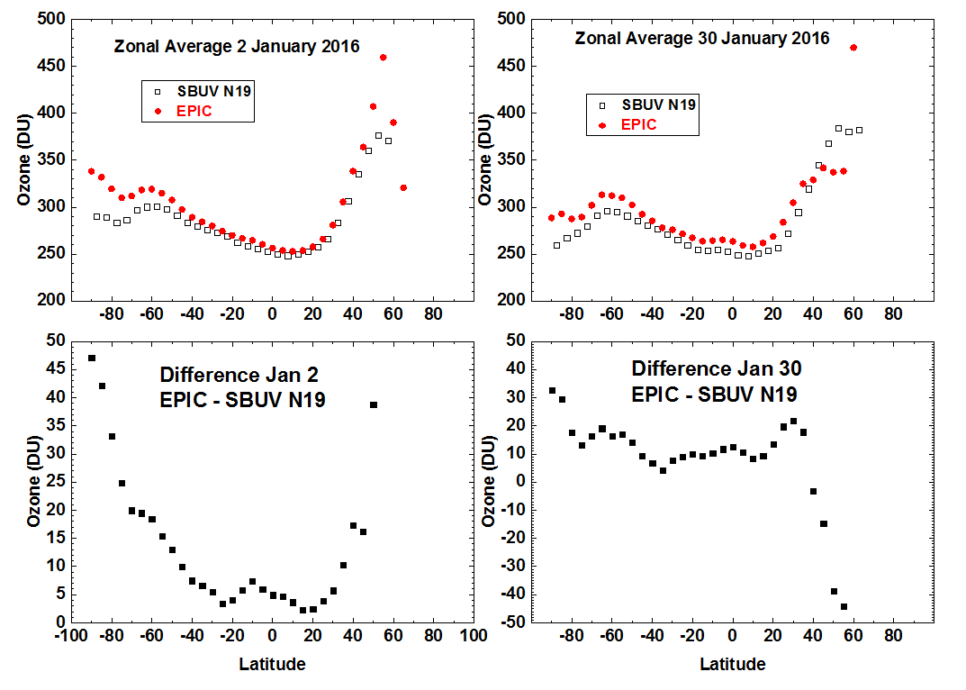
EPIC Zonal Average Ozone Compared with NOAA-19 SBUV-2

Slide 13
Summary
Validation of EPIC with ground-based instruments requires nearly continuous measurements because of the varying local time throughout each day.
Low latitude comparison with LEO satellite data is only possible for a narrow strip of EPIC data centered around the equator crossing time ± ~ 1 hour.
High latitude comparisons with LEO satellite data require a latitude dependent time shift of the central time ± ~ 1 hour.
Comparison of EPIC preliminary Ozone data shows reasonably good agreement with satellite and ground-based measurements
Boulder Colorado: Mean Difference = 8.7 ± 16 DU or 3%
Slope = -0.7 ± 1.5 DU/Year or -0.2%/Yr
Four Corners New Mexico: Mean = 4.4 ± 16 DU or 1.4%
Slope = -11 ± 1.8 DU/Year or 3.5%/Yr
NASA HQ Washington DC: Mean = 16 ± 19 DU or 5%
Slope = 0.7 ± 2 DU/Year or 0.2%/Yr

