Slide 1
DSCOVR Science Operations Center & EPIC Geolocation
Karin Blank
NASA/GSFC Code 586
October 31st, 2016

Slide 2
Status
EPIC
Reprocessing finished of version 01
Public data released in July
NISTAR
L1A/L1B processed
L1A publically released in October
L1B pending

Slide 3
Upcoming
EPIC
Version 02 (Winter)
New flat fielding
Stray light correction
Updated geolocation
NISTAR
Version 02

Slide 4
Now Under New Management
Carl Hostetter (carl.f.hostetter@nasa.gov)

Slide 5
Geolocation

Slide 6
Algorithm Progress
Focus | Algorithm Version | Features
Simulator | Revision 0 | Pre-launch simulator
Relative Geolocation | Revision 1 | First geolocation; website pictures
 | Revision 2 | Mitigation of issues with optical artifacts
 | Revision 3 | Improved cross-band registration
 | Revision 4 | Subpixel registration L1b (Kai Yang’s algorithm)
Absolute Geolocation | Revision 5 | Initial fixes for absolution geolocation

Slide 7
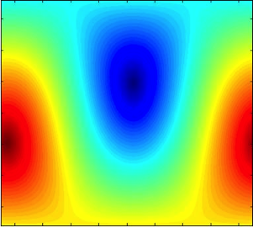
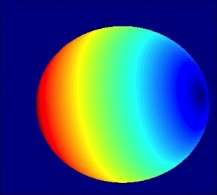
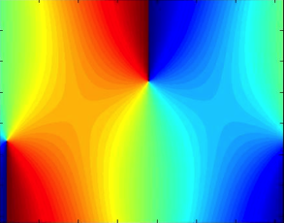
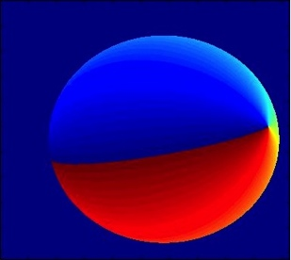
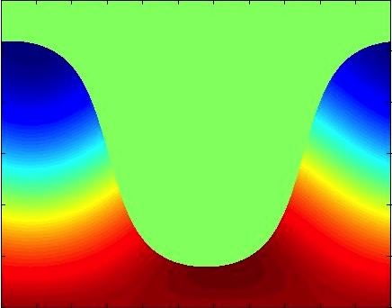
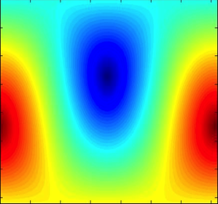
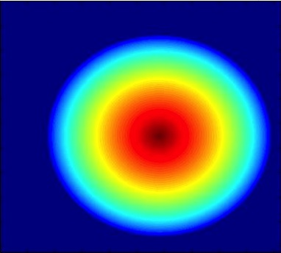
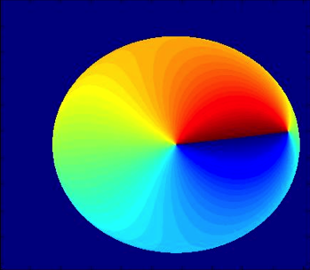
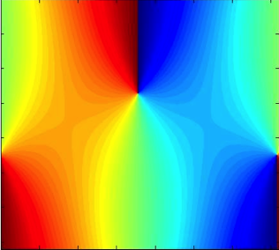
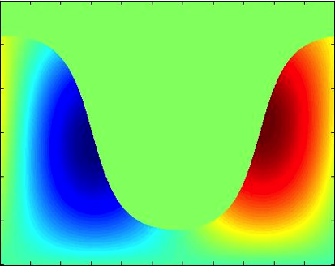
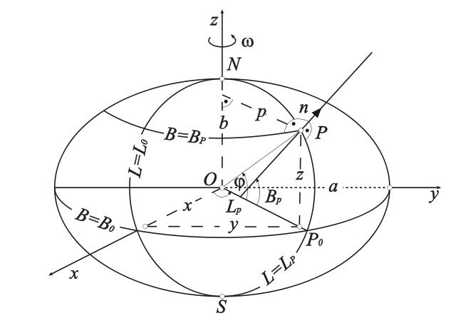
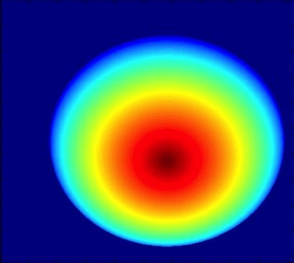
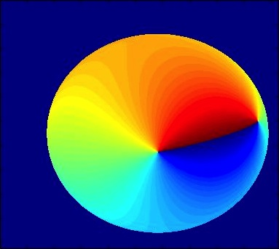
Input
3D Model
2D Transform
2D Model
L1A
Ephemerides
Time
View angles
Geodetic coordinates
X transform
Astronomical
Model
Sun angles
View angles
Y transform
Ellipsoidal Model
Ellipsoidal Coordinates
Instrument Model
Sun angles
Registration

Slide 8
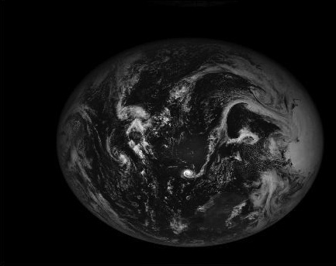
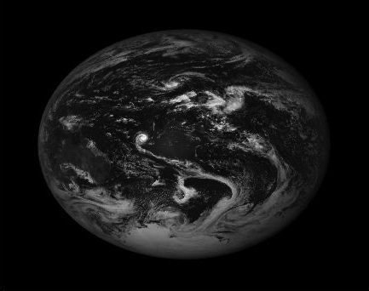
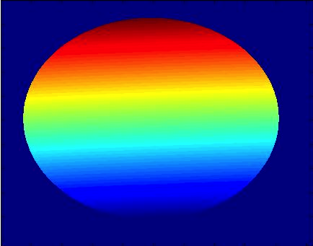
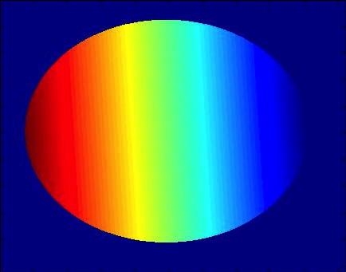
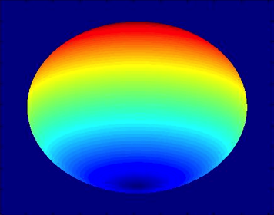
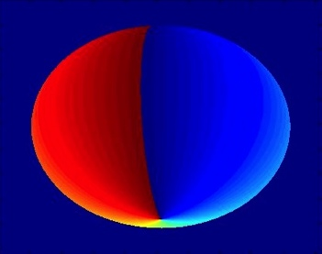
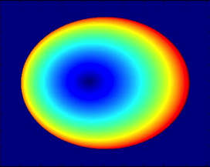
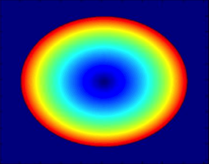
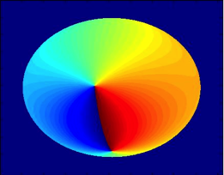
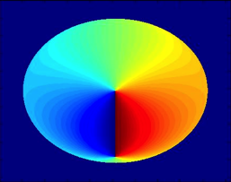
Input
3D Model
2D Transform
2D Model
L1B
Instrument Model
Image
X transform
Geodetic
coordinates
Y transform
Common Reference Grid
Reference Geometry
Ellipsoidal Model
Ellipsoidal
Coordinates
Per-image Angles
On Reference Grid

Slide 9
Algorithm from revision 4 to 5

Slide 10
Problem: Africa is too small
Credit: Dong Huang

Slide 11
Projection size issue

Slide 12
Focal Length
Focal length
Projection size

Slide 13
Results
Manufacturer focal length: 286.2 cm
Estimated focal length: 283.82 cm
Difference: 2.38 cm

Slide 14
Projection size after

Slide 15
Problem: Inconsistent size
Issues
Error is lower in the center of projection and increases towards outer edges
Error is less along the equatorial axis than the polar axis
“Once you eliminate the impossible, whatever remains, no matter how improbable, must be the truth”
Sherlock Holmes (via Arthur Conan Doyle)

Slide 16
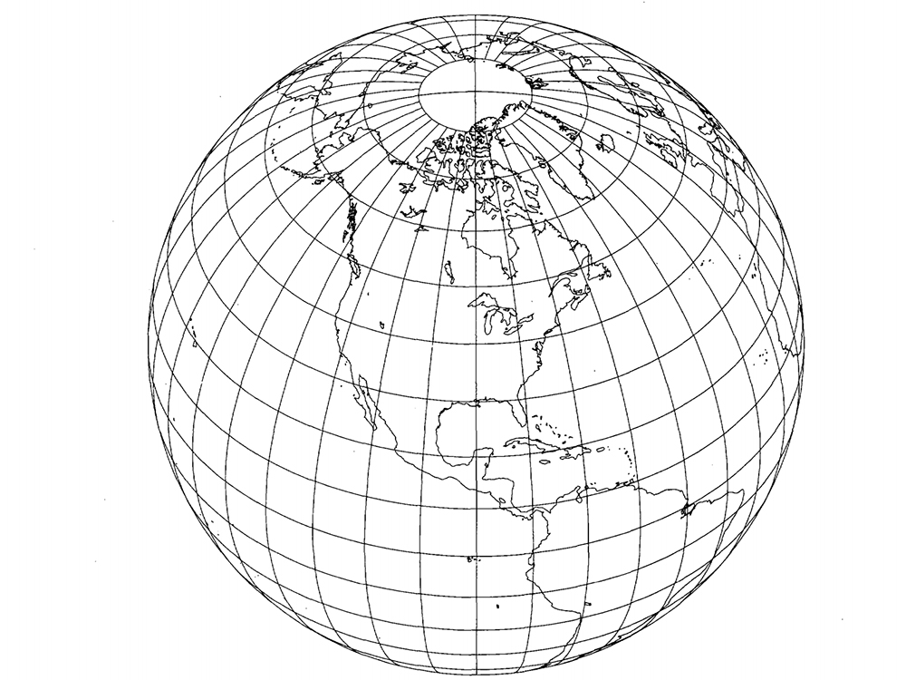
3D->2D transformation
Perspective Azimuthal Projection
For space or aerial based photograph (photogrammetry)
Accurate to e²
2 formulations

Slide 17
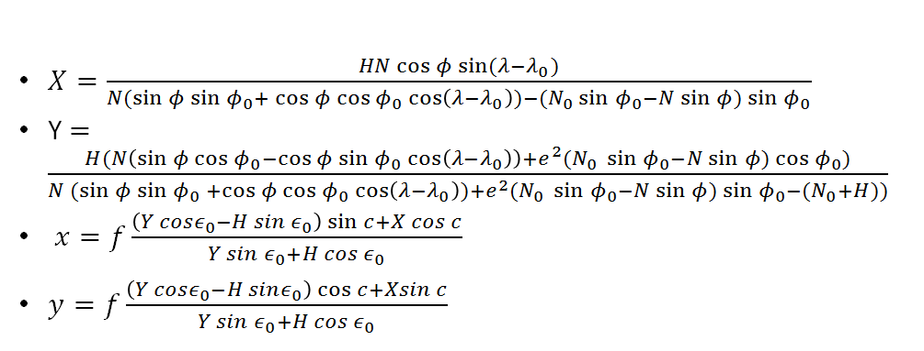
Perspective Azimuthal Projection

Slide 18
Model effect

Slide 19
“EPIC” Projection
Calculate XYZ coordinates for model using ellipsoid, geoid, & datum (ECEF)
Rotate model into EPIC’s reference frame
Convert to pixels by dynamically scaling each point as a function of…
Distance
EPIC’s perspective distortion (focal length effect)
EPIC’s sensor format
Clip points outside of line of sight
Draw model
Notes:
Earth Perspective, Includes Curvature

Slide 20
Other changes
Anti-aliasing filter
Reduce aliasing artifacts in 3D->2D transformation
Improved geoid model

Slide 21
Future Revisions

Slide 22
Refraction Correction

Slide 23
Refraction Calculation
Simplified ray tracer (Hohenkerk & Sinclair)
Stratosphere limit
Stratosphere/Troposphere boundary
Troposphere limit
Algorithm Input
Viewing angle
Wavelength
Temperature
Humidity
Pressure
Elevation

Slide 24
Angular delta at different wavelengths
Refraction at 780nm
Refraction at 317nm

Slide 25
Difference between 780nm and 317nm

Slide 26
Future Work (r06)
Refraction correction
Backpropagation, part 1
Time correction
Determining optical distortion (barrel/keystone)

Slide 27
Future Work (r07)
Backpropagation, part 2
Attitude correction
Ephemeris correction?
Control point correction

Slide 28
R04 results
Image with overlay
Error in pixels

Slide 29
R05 results
Image with overlay
Error in pixels

