Slide 1
EPIC Calibration UV channels
Jay Herman and Liang Huang
Goals:
Produce O₃ with 1 – 2% accuracy
Produce Cloud reflectivity (LER)
Calculate Erythemal Irradiance
Progress:
Current O₃ processing is within 2% over most of the earth
LER is available for the entire data record
Erythemal Irradiance is available for the entire data record

Slide 2
Outline of Calibration Method
Select OMPS LEO footprints with viewing angles nearly identical to EPIC’s (within 1º in backscatter angle and 2^{O} degrees in solar zenith angle).
Use OMPS calibrated measured backscattered radiances as a reference
EPIC’s backscatter angle varies with latitude and longitude by less than 0.25º, since the angular size of the earth varies from 0.45^{O} to 0.53^{O} to 0.45^{O} every 6 months depending on the location of DSCOVR in its orbit.
The orbit varies from 4^{O} to 15^{O} away from the Earth-Sun line.
Spacecraft ephemeris includes changes from orbital correction maneuvers and lunar perturbation of the orbit to give angles and distances.
Small differences in observing geometry are corrected in the atmospheric radiative transfer model calculations resulting in corrections less than 2 %

Slide 3
Outline of Calibration Method
EPIC albedo calibration coefficients K_{M}
$$α_{M}={\int{α\left(λ\right)S\left(λ\right)}T_{M}(λ) dλ}/{\int{S\left(λ\right)}T_{M}(λ) dλ}$$
EPIC albedo measurements are derived from
$$A_{M}\left(EPIC\right)=K_{M}C_{M}(EPIC)D_{E }^{2}$$
A_{M}(OMPS) = OMPS albedo measurement in the EPIC channel-M wavelength band
a_{M}(EPIC) and α_{M}(OMPS) are computed albedo values for EPIC and OMPS coincident geometry,
C_{M}(EPIC) is the average measured count rate over the pixels matching OMPS,
D_{E} is the sun-earth distance in AU.
α(λ) is the computed high resolution normalized radiance spectrum,
S(λ) is the referenced measured high resolution solar irradiance spectrum,
T_{M}(λ) is the measured EPIC filter transmission profile or the OMPS slit function.

Slide 4
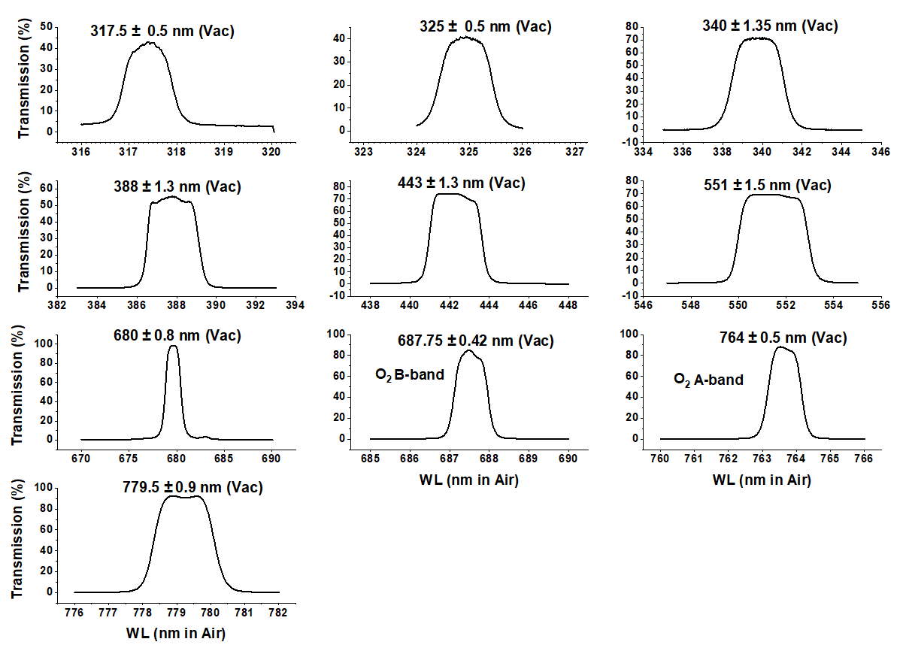
Outline of Calibration Method
T_{M} = :

Slide 5
Outline of Calibration Method
The radiometric calibration for each wavelength channel in terms of EPIC counts/second can be converted to earth normalized radiances or reflectances (backscattered at approximately 172^{O}). ${ A}_{M}= \frac{I_{M}}{{S_{M}}/{D_{E}^{2}}}$
I_{M} (W/(m² nm sr)) earth upwelling normalized radiance at the top of the atmosphere (TOA) is defined in terms of
A_{M} earth albedo for wavelength bands M=1 to 4,
S_{M} is the incident solar irradiance (W/(m² nm)) weighted with the filter function for band M at 1 AU and
D_{E} is the sun-earth distance in AU (astronomical units).

Slide 6
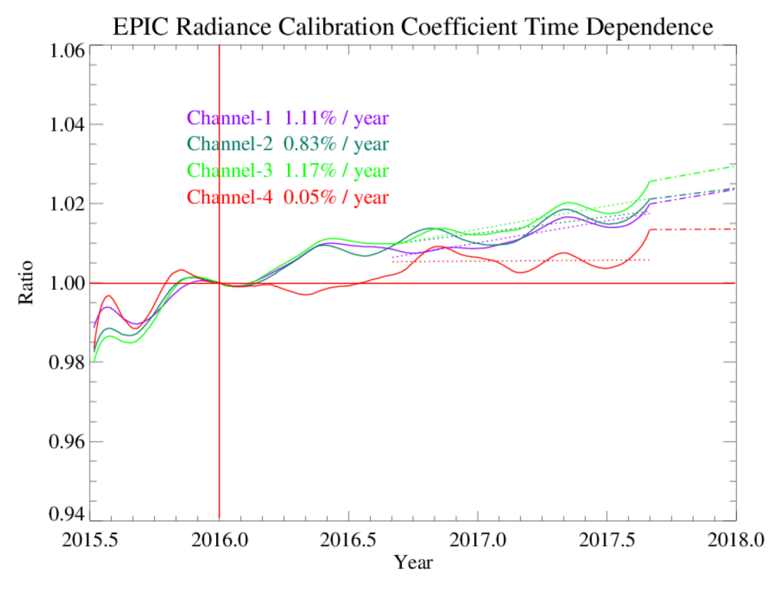
Outline of Calibration Method
Wavelength Radiance* Reflectance
Channel | Wavelength | A0 (V1) | K1=pi*A0/SF | A0 (V2) | Ratio (V2/V1) | SF(mW/m²/nm) | K2=pi*A0/SF
1 | 317.478 | 0.03172 | 1.22E-04 | 0.03125 | 0.9852 | 819.00 | 1.20E-04
2 | 325.035 | 0.02857 | 1.11E-04 | 0.02819 | 0.9868 | 807.70 | 1.10E-04
3 | 339.858 | 0.00626 | 1.98E-05 | 0.0062 | 0.9909 | 995.80 | 1.96E-05
4 | 387.923 | 0.00857 | 2.69E-05 | 0.00854 | 0.9957 | 1003.30 | 2.67E-05
5 | 442.397 | 0.00524 | 8.42E-06 | 0.00527 | 1.0057 | 1956.00 | 8.46E-06
*Radiance (mW/(m²nm sr)

Slide 7
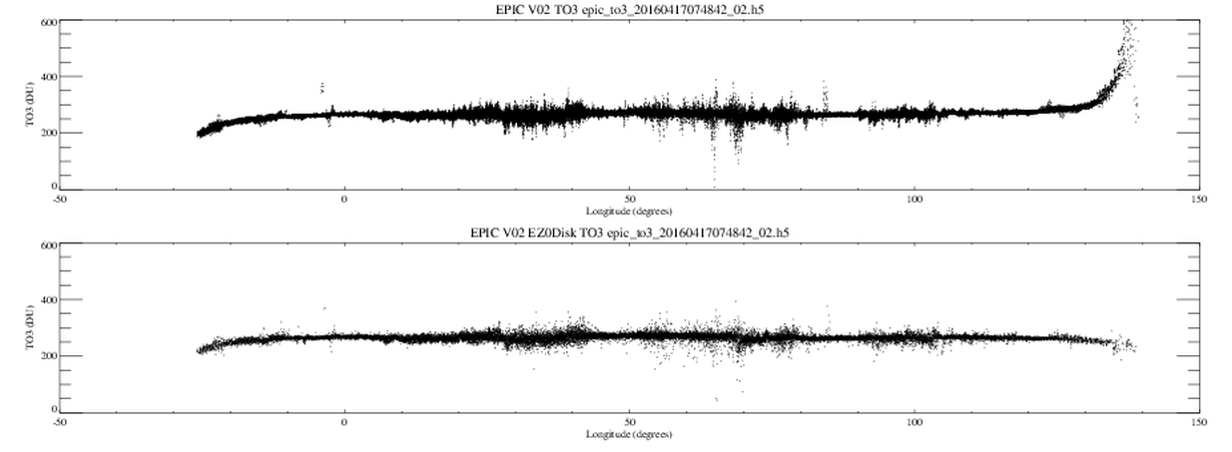
Possible Geolocation Validation for Version 3
A geolocation method devised by Huang is based on finding the edge of the earth by distinguishing the atmosphere from the solid earth based on the results from the OMPS limb sounder
This method is needed for the UV and 443 nm channels where Rayleigh scattering is important. Although less important, the method should also be used for the green and red channels.
An improved production method of geolocation is being developed for all channels that will be validated using Huang’s method
V2 - Current
V2 - Huang
Longitude

Slide 8
Ozone Correction from Huang’s Improved Limb Location
For small angles, the geolocation correction is minor, but becomes significant as the SZA and VZA become larger
-50 0 50 100 150
Longitude

Slide 9
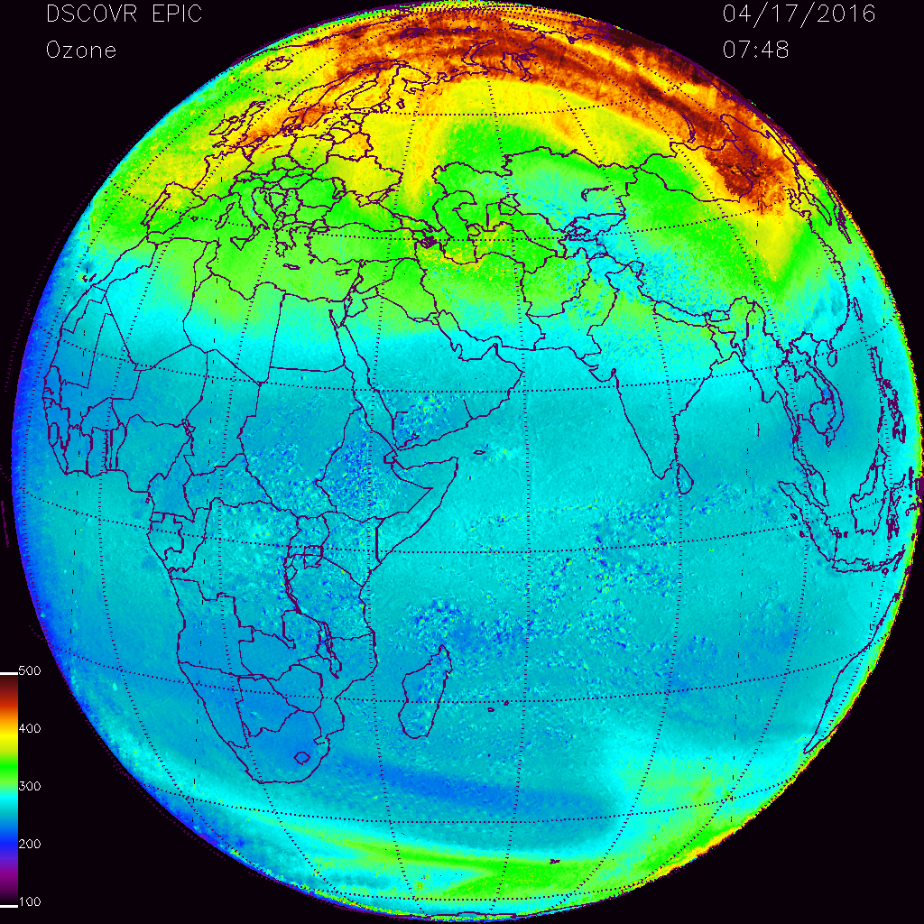
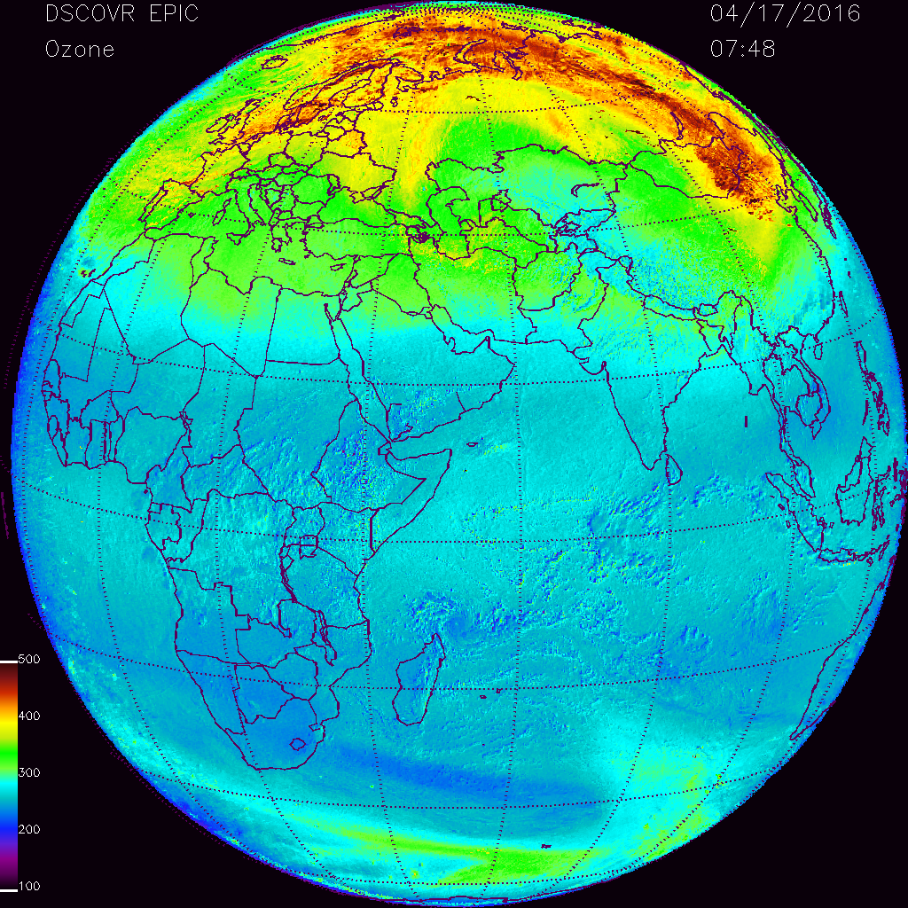
Geolocation Change in Retrieved Ozone
V2 - standard
V2 - Huang

