Slide 1


Inferring iron-oxide species content in atmospheric mineral dust from DSCOVR EPIC observations
Sujung Go^{1,2}, Myungje Choi^{1,2}, Alexei Lyapustin², Gregory L. Schuster³
1) UMBC GESTAR-II, 2) NASA GSFC, 3) NASA Langley
DSCOVR Science Team Meeting, Sep. 27-29, 2022
Notes:
Thank you for the introduction.
Today my topic is about “Inferring iron-oxide species content in atmospheric mineral dust from DSCOVR EPIC observations”.

Slide 2
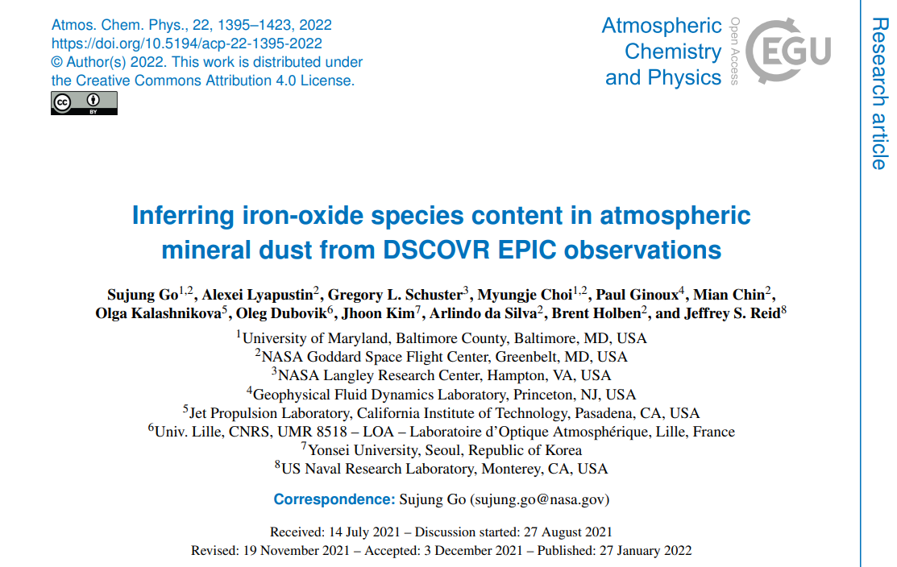
Notes:
This paper is already published in ACP early in this year.
I would like to thank all my co-authors helping me to get these results.

Slide 3
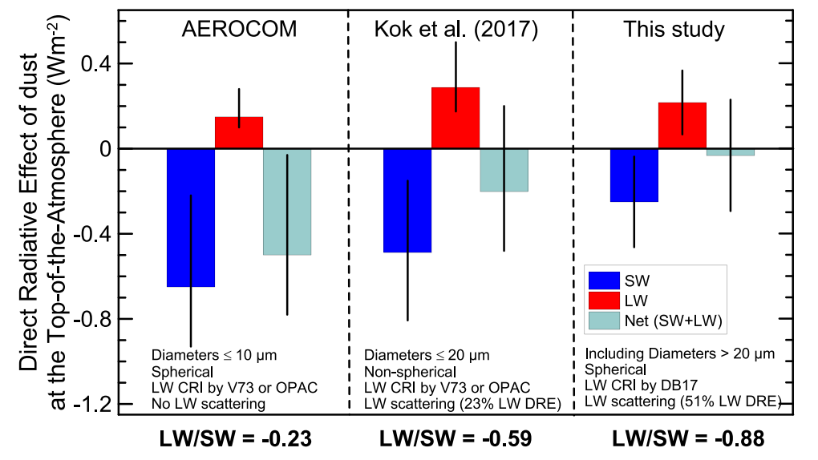
Brief introduction
The dust direct radiative effect (DRE) at the top of the atmosphere is still controversial in both sign and magnitude. To resolve the issue, many previous studies primarily pointed out that current climate models are using globally invariant spectral complex refractive index (and therefore spectral SSA), which implicitly assumes the same dust mineralogical composition on a global scale.
A few Earth system models, which is a coupled climate model, have adopted a regionally and temporally variable spectral refractive index of dust by parameterization with common soil mineralogy component (Scanza et al 2015; Perwidtz et al 2015a, b). The rationale for this is that dust aerosols are soil particles suspended in the atmosphere (Scanza et al., 2015).
SW: 0.185-4.0 μm
LW: 3.33-1,000 μm
(Di Biagio et al., 2020)
Li et al. (2021) recently quantified the importance of soil mineralogical content uncertainty on the dust DRE estimate. They concluded that the iron-oxide fraction in dust represents 97 % of the uncertainty in their estimated total dust DRE using CAM5 only and 85% across multiple climate models. It highlights the importance of distinguishing goethite from hematite for the shortwave dust DRE estimate. Otherwise, the model tends to underestimate dust warming at the TOA by ~56%, because the absorption magnitudes of hematite and goethite are up to an order of magnitude different at UV and Vis wavelengths.
Notes:
As you know, // direct radiative effect of dust // at top of the atmosphere // is still controversial. (오른쪽 그림 가리키면서)
This is particularly due to the uncertainty of the SW part, which is blue box here, where wavelength range between 185nm – 4 micron.
To resolve the issue, // many previous studies primarily pointed out the current climate models are using globally invariant spectral complex refractive index.
A few Earth system models is parameterizing the spectral refractive index // into common soil mineralogy.
And, among those soil mineralogy // the recent study highlights the importance of distinguishing goethite from hematite for the shortwave DRE estimate.

Slide 4
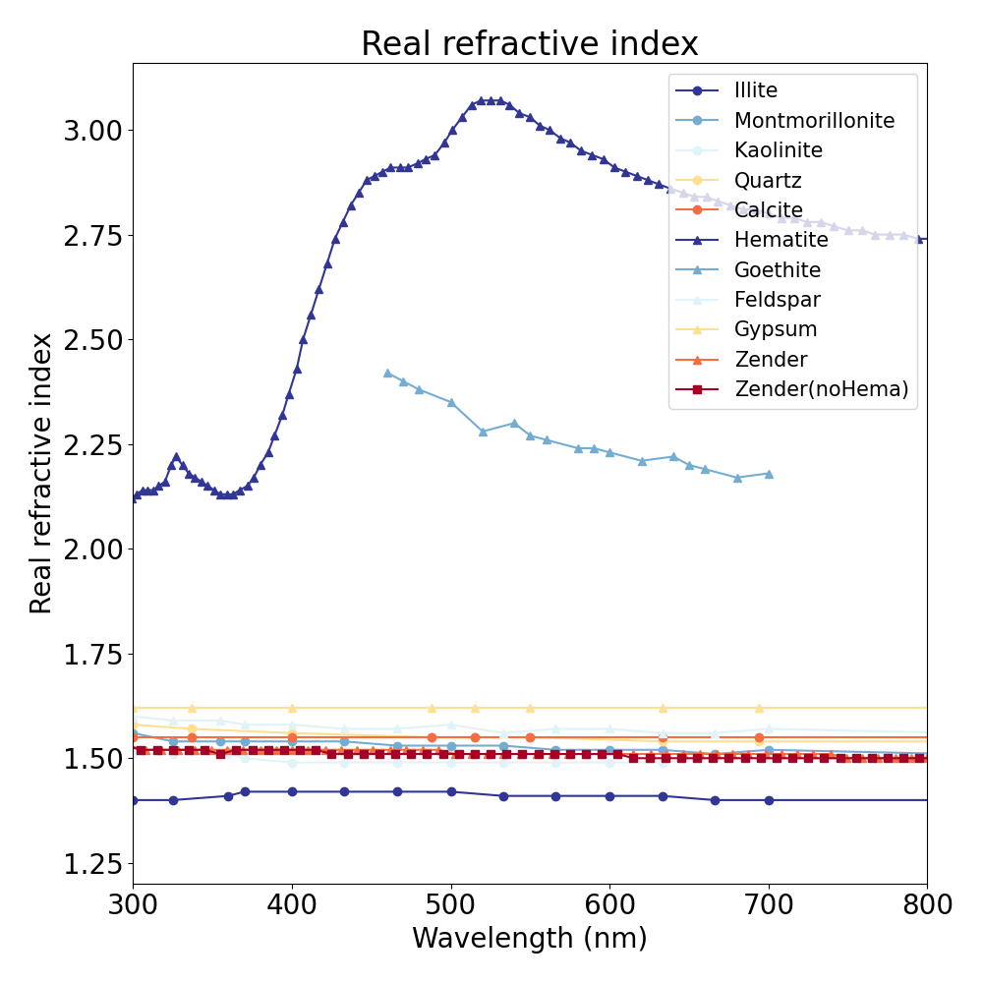
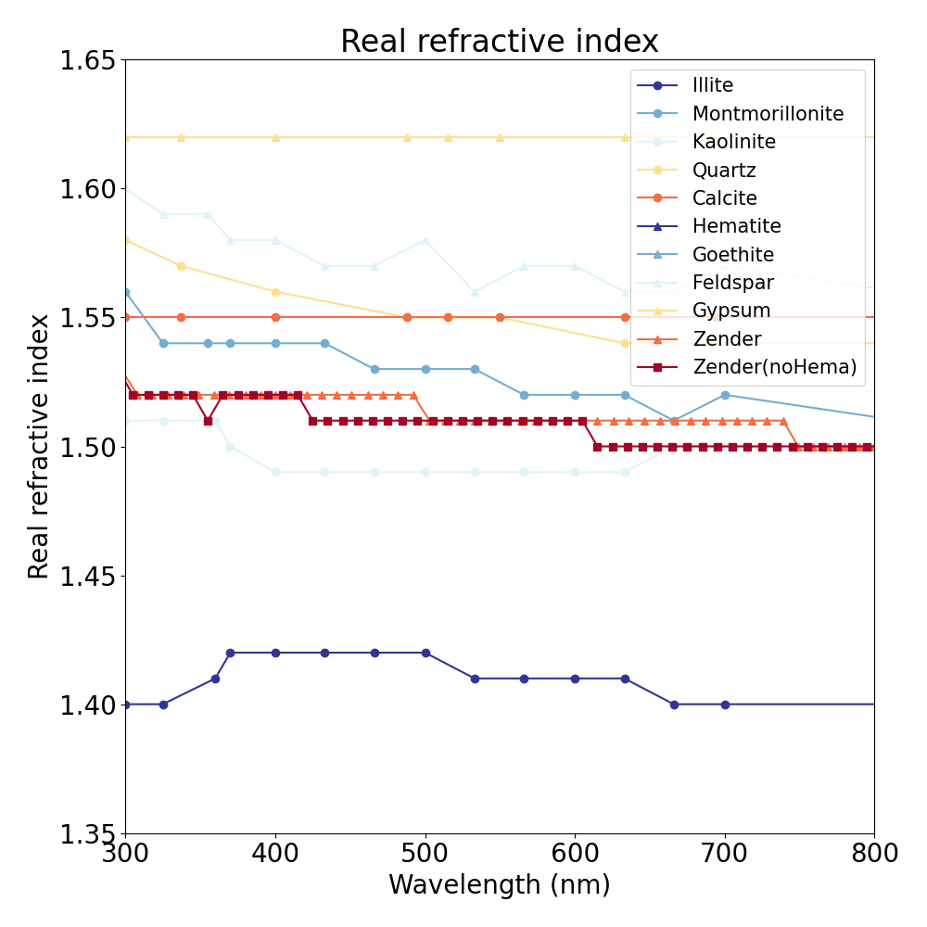
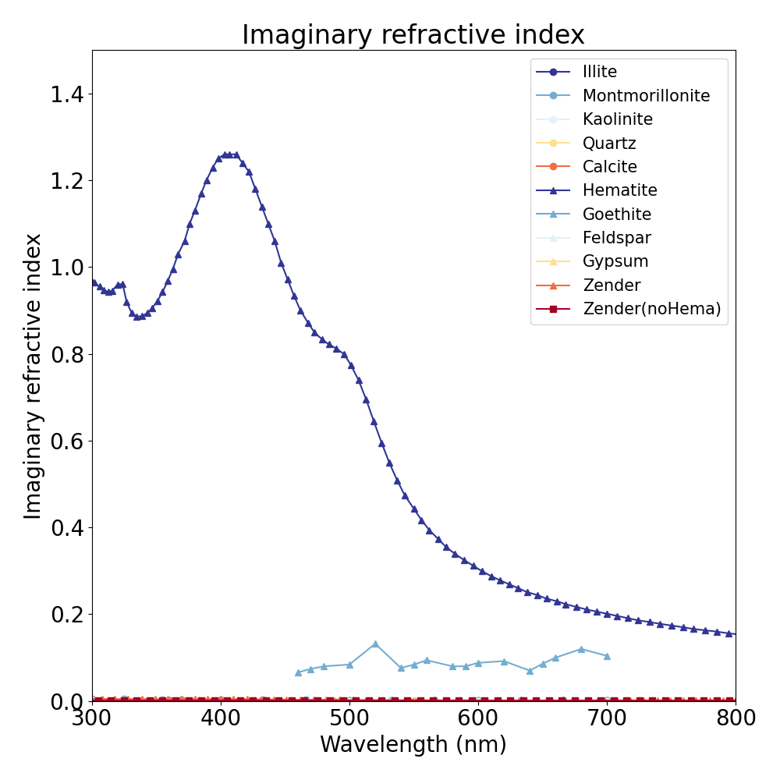
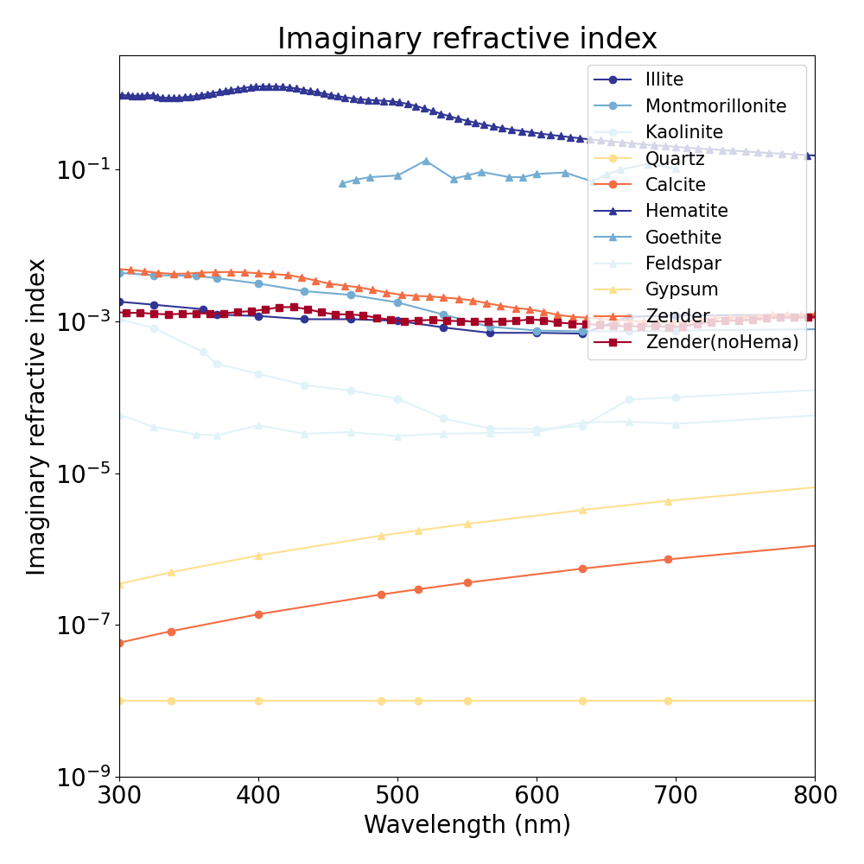
Refractive index of soil mineralogy – Scanza et al. (2015)
Hematite
Hematite
x 100
Goethite (extrapolated to UV (340, 388 nm) in retrieval)
(Bedidi and Cerville, 1993)
Goethite (extrapolated to UV in retrieval)
Hematite (α-Fe₂O₃) and goethite (α-FeOOH), both in the Fe(Ⅲ) oxidation state, are the major iron oxides species in mineral dust (Torrent et al., 1983). They are major components controlling the absorption signal magnitude of pure dust toward SW radiation [e.g., Sokolik and Toon,1999; Moosmüller et al., 2012; Lafon et al., 2006; Formenti et al., 2014], as can be inferred from their complex refractive index imaginary part characteristics (Fig.1).
We inferred hematite (α-Fe₂O₃) / goethite (α-FeOOH) content over main global dust source regions from MAIAC EPIC L2 products.
Notes:
This figure shows the refractive index of soil mineralogy.
From the very left, real refractive index as a function of wavelength, imaginary index, and imaginary index but with the log-scale of y-axis.
We can clearly see that hematite and goethite have nearly 100 times higher imaginary index in magnitude compared to the other mineralogy.
Indeed, these two minerals are the major iron oxides species controlling the most absorbing signal toward SW radiation.
Based on their distinctive absorbing (or physical) properties. ~~~~

Slide 5


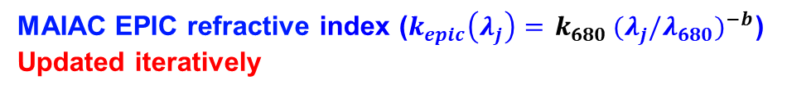


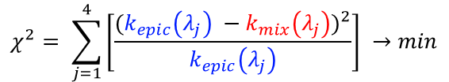
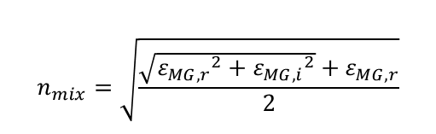
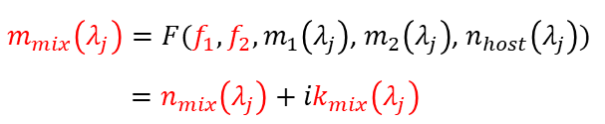
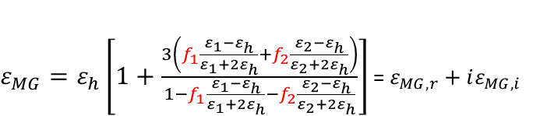
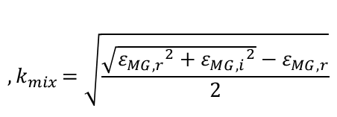
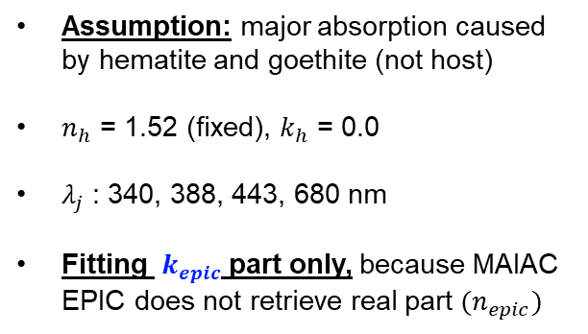
Methodology - (Forward)
Illustration of Maxwell Garnett effective medium approximation (pure dust)
(1) With known refractive index ($n,k$) or complex dielectric function (𝜺_{𝒓}, 𝜺_{i})
(Bohren and Huffman, 1987; Schuster et al., 2016)
$$ε_{1}=ε_{1,r}+{iε}_{1,i}={(n}_{1}^{2}−k_{1}^{2})+i(2n_{1}k_{1})$$
Electromagnetic interaction
$$ε_{2}=ε_{2,r}+{iε}_{2,i}={(n}_{2}^{2}−k_{2}^{2})+i(2n_{2}k_{2})$$
Hm
Host
, where 1, 2, h indicates
inclusion 1 (hematite), inclusion 2 (goethite), and host
$$ε_{h}=ε_{h,r}+{iε}_{h,i}={(n}_{h}^{2}−k_{h}^{2})+i(2n_{h}k_{h})$$
Gt
Atmospheric Aerosol
2 inclusions
Homogeneous
matrix
Randomly
inhomogeneous
mixture
(2) Maxwell Garnett effective medium approximation ($f_{1}$, $f_{2}$: volume fraction of inclusions)
$ε_{MG}=ε_{h}\left[1+\frac{3\left(f_{1}\frac{ε_{1}−ε_{h}}{ε_{1}+{2ε}_{h}}+f_{2}\frac{ε_{2}−ε_{h}}{ε_{2}+{2ε}_{h}}\right)}{1−f_{1}\frac{ε_{1}−ε_{h}}{ε_{1}+{2ε}_{h}}−f_{2}\frac{ε_{2}−ε_{h}}{ε_{2}+{2ε}_{h}}}\right]$ = $ε_{MG, r}+iε_{MG, i}$
Assumption: major absorption caused by hematite and goethite (not host)
$n_{h}$ = 1.52 (fixed), $k_{h}$ = 0.0
$λ_{j}$ : 340, 388, 443, 680 nm
Fitting ${ k}_{epic}$ part only, because MAIAC EPIC does not retrieve real part ${(n}_{epic})$
$$n_{mix}=\sqrt{\frac{\sqrt{{ε_{MG, r}}^{2}+{ε_{MG, i}}^{2}}+ε_{MG, r}}{2}}$$
$${,k}_{mix}=\sqrt{\frac{\sqrt{{ε_{MG, r}}^{2}+{ε_{MG, i}}^{2}}−ε_{MG, r}}{2}}$$
$m_{mix}\left(λ_{j}\right)=F(f_{1},f_{2},m_{1}\left(λ_{j}\right)$, $m_{2}\left(λ_{j}\right)$, $n_{host}\left(λ_{j}\right))$
$=n_{mix}\left(λ_{j}\right)+{ik}_{mix}\left(λ_{j}\right)$
- (Inversion)
$$χ^{2}= \sum_{j=1}^{4}{\left[\frac{{(k_{epic}\left(λ_{j}\right) −k_{mix}\left(λ_{j}\right))}^{2}}{k_{epic}\left(λ_{j}\right)}\right]} →min$$
MAIAC EPIC refractive index ($k_{epic}\left(λ_{j}\right)={ k}_{680}{(λ_{j}/λ_{680})}^{−b}$)
Updated iteratively
Notes:
As a methodology, we use Maxwell Garnett effective medium approximation
The right-side figure shows the concept of this theory.
It assumes that atmospheric aerosols are inhomogeneous particle mixtures having different complex dielectric functions,
The THEORY characterizes the average dielectric function because of the interaction of an electromagnetic wave between inhomogeneous particles
So, If we know the refractive index (or complex dielectric function) of two inclusions and host.
We can calculate the dielectic function of Mixture as a function of volume fraction of two inclusions.
And the inversion process minimize the cost function by iteratively updating those two volume fractions of inclusions. //3.18
Here, we assume major absorption caused by hematite and goethite.
And, we only fit the imaginary index part, because MAIAC EPIC does not retrieve real part of the refractive index.
;;--------------------------------------------------------------------------------
Although internal mixing is clearly assumption for minerals, as minerals are generally externally mixed—other than iron oxides (hematite, goethite) (Formenti et al., 2014a), Earth system model and AERONET retrieval also assume internal mixing, so the retrieval can be directly fitted into the Earth system model or compared with AERONET data in the future.

Slide 6
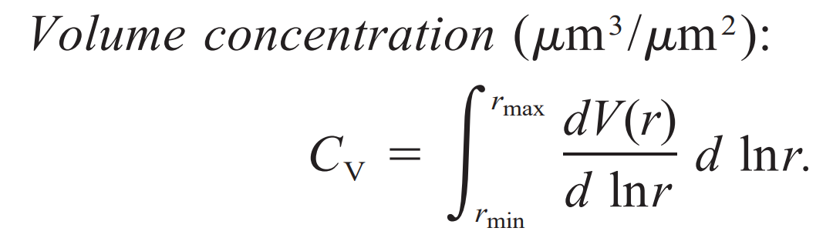
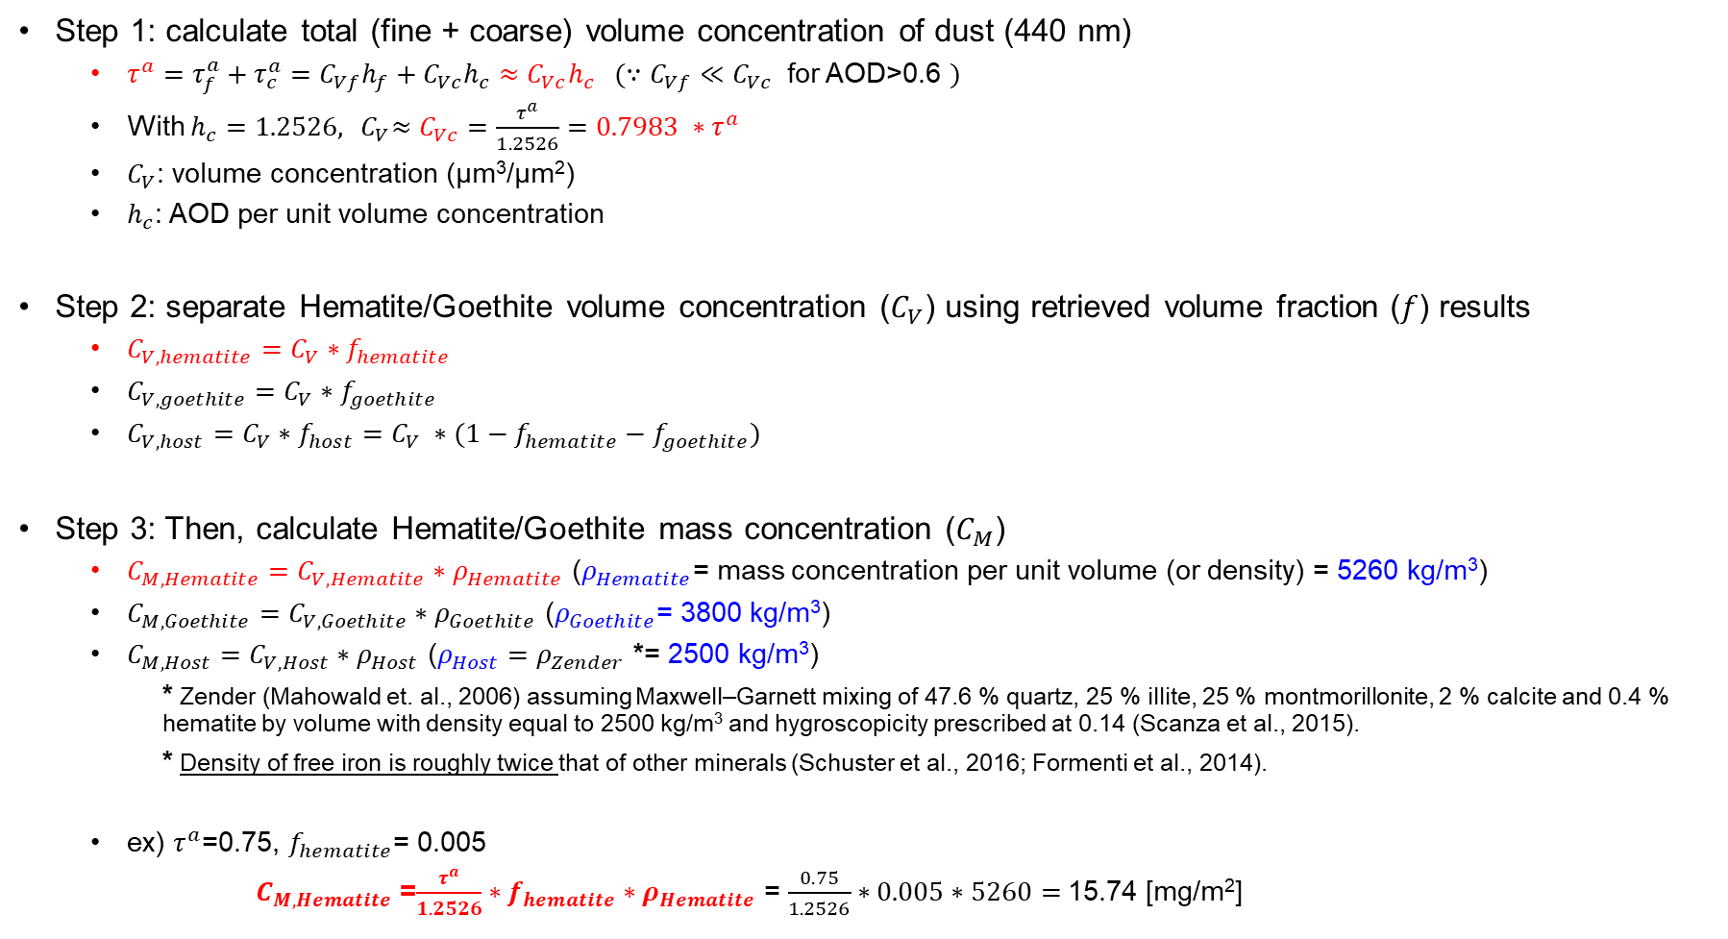
From EPIC AOD to composition mass concentration
Step 1: calculate total (fine + coarse) volume concentration of dust (440 nm)
  $τ^{a}=τ_{f}^{a}+τ_{c}^{a}=C_{Vf}h_{f}+C_{Vc}h_{c}≈C_{Vc}h_{c} (∵C_{Vf}≪C_{Vc}$ for AOD>0.6 $)$
  With $h_{c}=1.2526, {{ C}_{V}≈C}_{Vc}=\frac{τ^{a}}{1.2526}=0.7983 ∗τ^{a}$
  $C_{V}$: volume concentration (µm³/µm²)
  $h_{c}$: AOD per unit volume concentration
Step 2: separate Hematite/Goethite volume concentration ($C_{V}$) using retrieved volume fraction ($f$) results
  $C_{V, hematite}=C_{V}∗f_{hematite}$
  $C_{V, goethite}=C_{V}∗f_{goethite}$
  $C_{V, host}=C_{V}∗f_{host}=C_{V} ∗(1−f_{hematite}−f_{goethite})$
Step 3: Then, calculate Hematite/Goethite mass concentration ($C_{M}$)
  $C_{M, Hematite}=C_{V, Hematite}∗ρ_{Hematite}$ ($ρ_{Hematite}$= mass concentration per unit volume (or density) = 5260 kg/m³)
  $C_{M, Goethite}=C_{V, Goethite}∗ρ_{Goethite}$ ($ρ_{Goethite}$= 3800 kg/m³)
  $C_{M, Host}=C_{V, Host}∗ρ_{Host}$ ($ρ_{Host}=ρ_{Zender}$ *= 2500 kg/m³)
    * Zender (Mahowald et. al., 2006) assuming Maxwell–Garnett mixing of 47.6 % quartz, 25 % illite, 25 % montmorillonite, 2 % calcite and 0.4 % hematite by volume with density equal to 2500 kg/m³ and hygroscopicity prescribed at 0.14 (Scanza et al., 2015).
    * Density of free iron is roughly twice that of other minerals (Schuster et al., 2016; Formenti et al., 2014).
  ex) $τ^{a}$=0.75, $f_{hematite}$= 0.005
    $C_{M, Hematite}$ =$\frac{τ^{a}}{1.2526}∗f_{hematite}∗ρ_{Hematite}$ = $\frac{0.75}{1.2526}∗0.005∗5260=$15.74 [mg/m²]
Notes:
This slide is about how we convert the retrieved volume fraction to mass concentration.
The AOD, which is a summation of fine mode and coarse mode, can be a coarse mode part only because we only apply this algorithm to AOD over 0.6.
Here, Cv is volume concentration, and h is AOD per unit volume concentration.
So, volume concentration can be a function of AOD.
Then, the volume concentration of hematite can be obtained by multiplying volume fraction of hematite.
And it can be converted to mass concentration by multiplying its density.
So, In short, the mass concentration of hematite can be a function of TOTAL AOD and the retrieved volume fraction with its density. //4.19

Slide 7
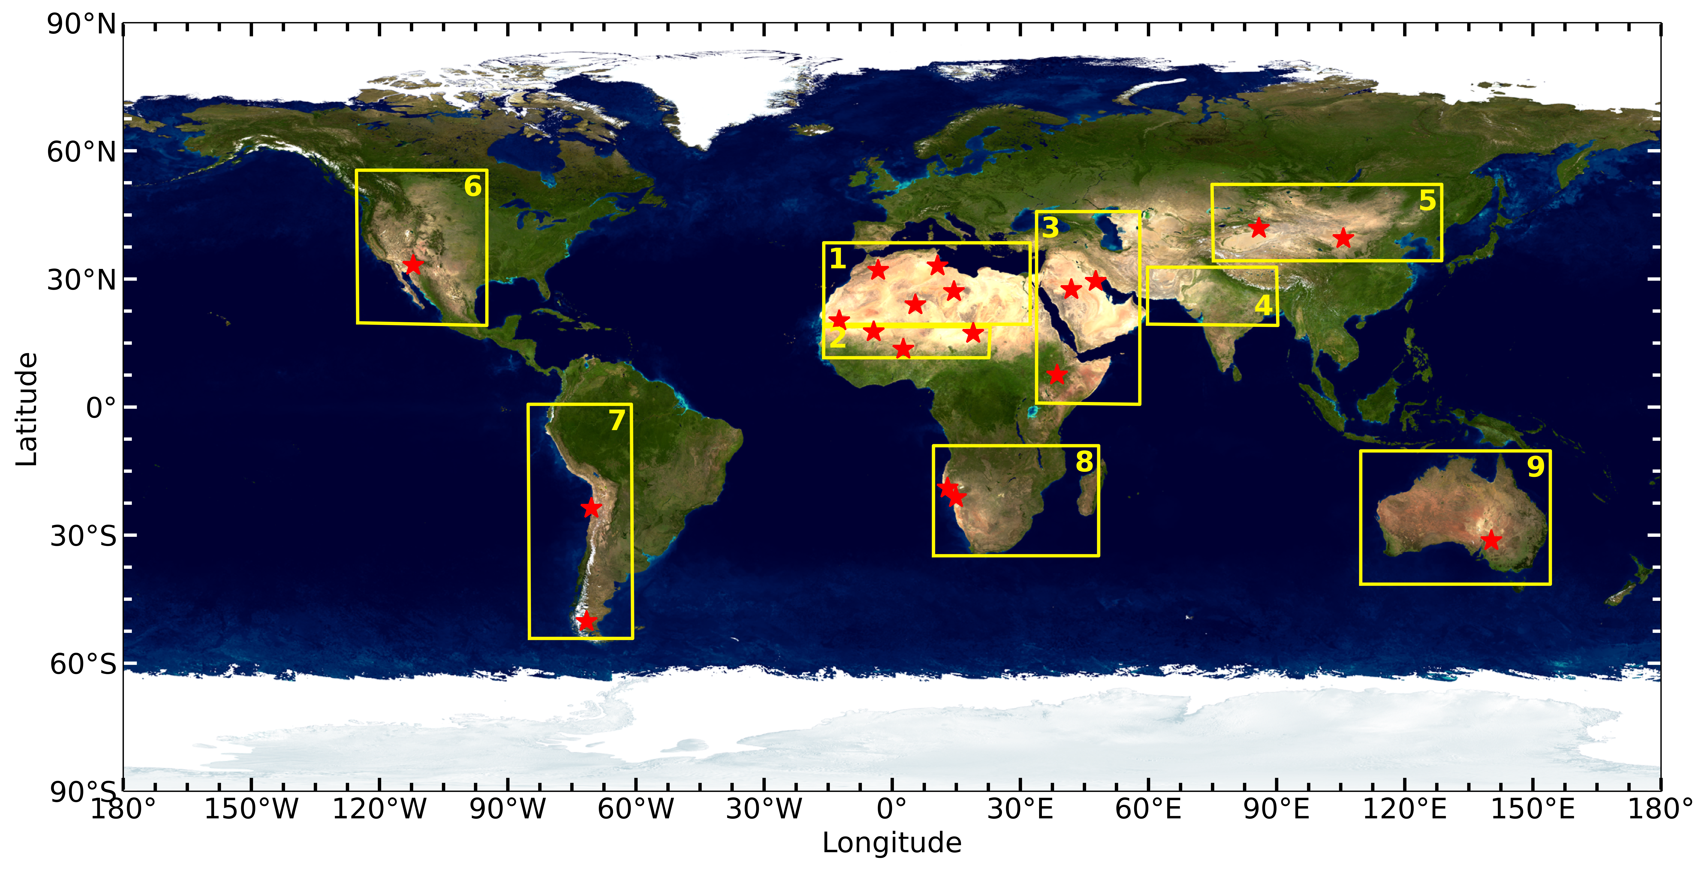
Algeria
Saudi Arabia
Taklimakan
Gobi
Libya
Kuwait
Morocco
Tunisia
Arizona
Mauritania
Mali
Niger
Bodele
Ethiopia
Atacama
Namib-2
Namib-1
Patagonia
Australia
Yellow rectangular - 9 different global main dust source regions (Ginoux et al., 2012; Di Biagio et al., 2017)
((1) northern Africa, (2) the Sahel, (3) eastern Africa and Middle East, (4) central Asia, (5) eastern Asia,
(6) North America, (7) South America, (8) southern Africa, and (9) Australia)) – (7), (8) MAIAC EPIC do not provide dust
Red star – Soil samples collected by Di Biagio et al. (2019).
Di Biagio et al. (2019) sampled the 19 sites of source soil and investigated their properties including iron oxides contents, spectral complex refractive indices and spectral SSA.
Notes:
We have tested the algorithm for several different pure dust cases.
Here, the Yellow rectangular is 9 different dust source region listed by Ginoux.
, and the Red star is the sites where the soil samples collected by Di Biagio paper.
This paper - sampled the 19 sites of source soil and investigated their properties including iron oxides contents, spectral complex refractive indices and spectral SSA.
I’m going to show the comparison results with Di Biagio paper’s later on.

Slide 8
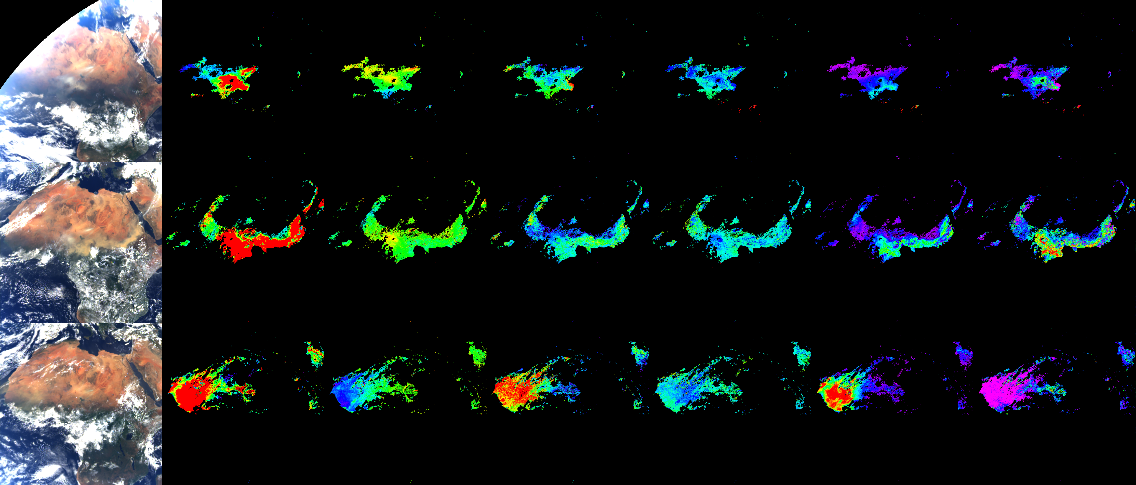
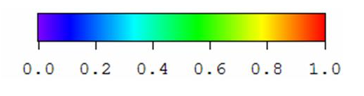
Dust episodes - Sahara / Sahel
TOA RGB
(0-0.55)
AOD₄₄₃
(0-2)
SSA₄₄₃
(0.85-0.98)
b
(0-4)
k₀
(0-0.003)
C_{M, hematite}
(0-150) [mg/m²]
C_{M, goethite}
(0-150) [mg/m²]
~0.001 (Todd et al., 2007)
Jan-1-2018
Mar-30-2018
May-30-2018
Notes:
This slide shows three different dust cases over Sahara ([sehaere]) and Sahel ([sehell]).
From the left, it is RGB image, AOD, SSA, b, k0 of MAIAC L2, and retrieved hematite and goethite mass content.
The first row shows the Bodélé depression episode on January 1st
It is known to the most intense single dust source (Prospero et al. 2002) with the low iron oxides content because of its diatomaceous sediments.
We clearly have high AOD with high SSA but very lack of hematite content.
At the bottom, we have more yellowish dust storm and, there are more hematite coming out.
And the last two row is the severe dust storm cases.
It is generally known that prevalence of Goethite over Sahara and Sahel,
But sometimes had hematite dominant cases.

Slide 9
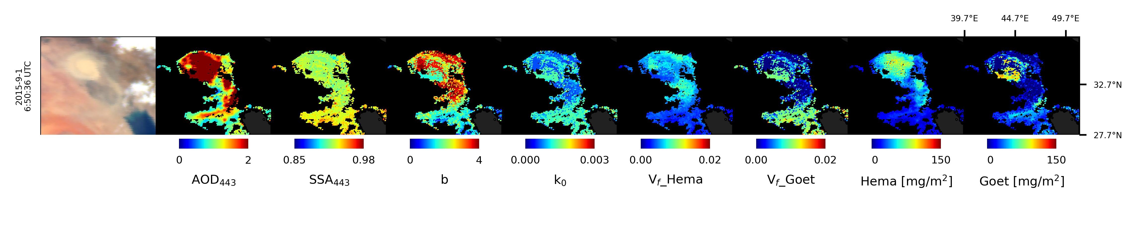
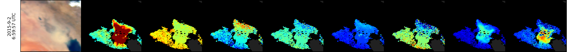
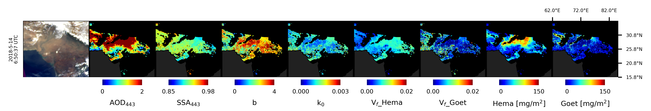
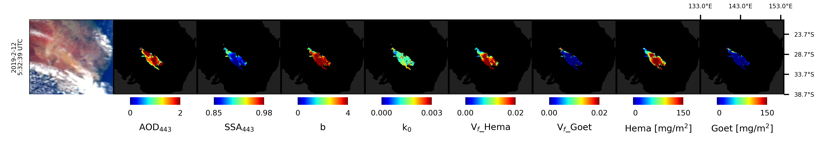
Dust episodes
Middle East – Shamal (+haboob) in late Summer (September 1st, 2015)
India – premonsoon season (May 14th, 2018), Arabian Peninsula and Thar desert (Sarkar et al., 2019)
May have bias over mixture source area (e.g., Kanpur, Eck et al., 2010)
Australia - near Lake Eyre (February 12th, 2019), salt lake, most active dust source in Australia (Ginoux et al., 2012)
Notes:
Here another dust episodes,
1) The first two row is ---- Shamal case in late summer
This dust was triggered by low-pressure system // at the border of Syria-Iraq (iraek) // and moved across Persian Gulf.
On the first day, it seemed the core of the dust mostly composed of hematite, but the next day, now goethite increased, though the SSA is almost not changed.
2) India SUFFER SEVERE DUST STORM over premonsoon (3-5) season primarily originated from the Arabian Peninsula and Thar desert.
Our analysis is showing this is mostly composed of hematite.
3) Australia is known to have reddish soil with high absorbing aerosol.
This is the dust case near Lake Eyre (aer), which is a salt pan and most active dust source in Australia (pointed by Ginoux).
On this day, we had very high absorbing SSA “with over 150 mg/m2 “of hematite. // 7.07

Slide 10
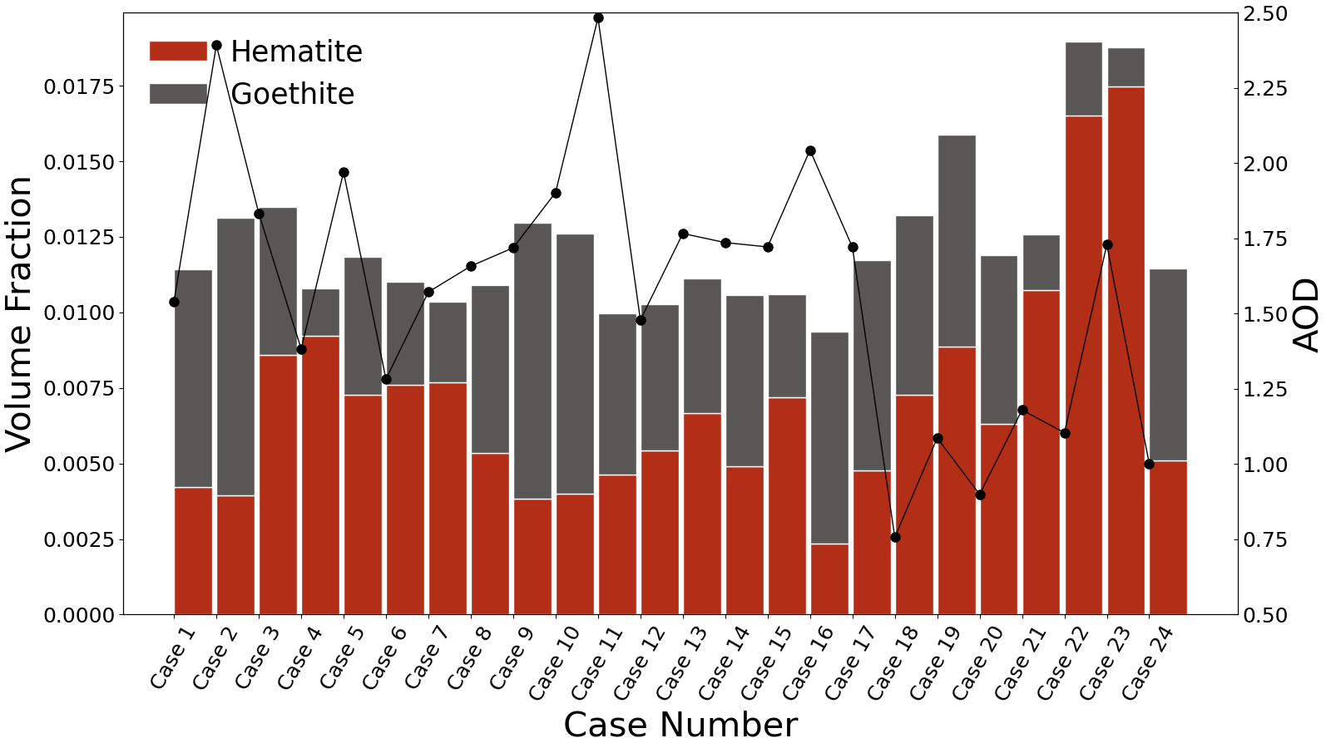
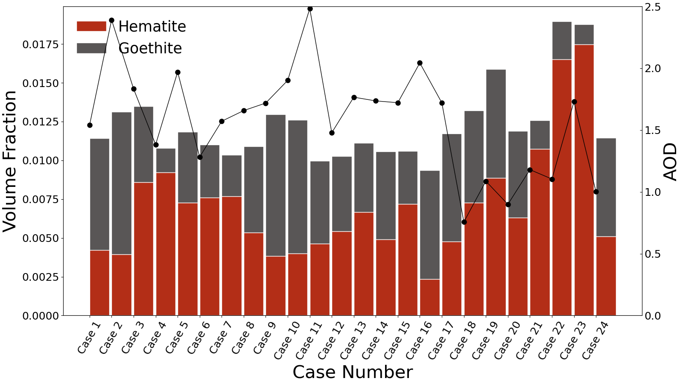

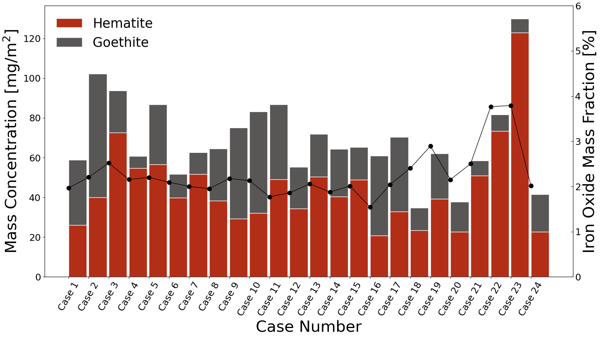
Sahara, Sahel
Middle East
India
East Asia
Conus
Australia
Bar plot for each cases
Mean of each case studies (1 case/1 scene)
Mass Concentration:
Australia, Africa >> Middle East > India, EA > Conus
→ A few cases, therefore, cannot generalize here
(Australia) low mean AOD, high volume fraction
→ high mass concentration
(Africa) high AOD, low volume fraction (than Australia)
→ high mass concentration
Iron oxide mass fraction (2~4 wt%) to the total dust
Notes:
So, I cannot go over all the cases in this presentation, but collected 24 representative dust cases over different continental area.
The top panel is the mean of each cases of volume fraction of hematite/goethite, and AOD on the right axis.
The bottom is same figure but converted to mass concentration and Iron Oxide Mass Fraction.
1) In Australia, though their AOD was low, it has high volume fraction, therefore later it showed high mass concentration of iron oxides.
2) On the other hand, Africa had lower volume fraction but had high AOD, therefore had higher mass concentration of iron oxides. compared to that of different area. //7.53
3) The mass concentration of iron oxides (were relatively low) over India, East Asia, and Conus (was relatively low).

Slide 11
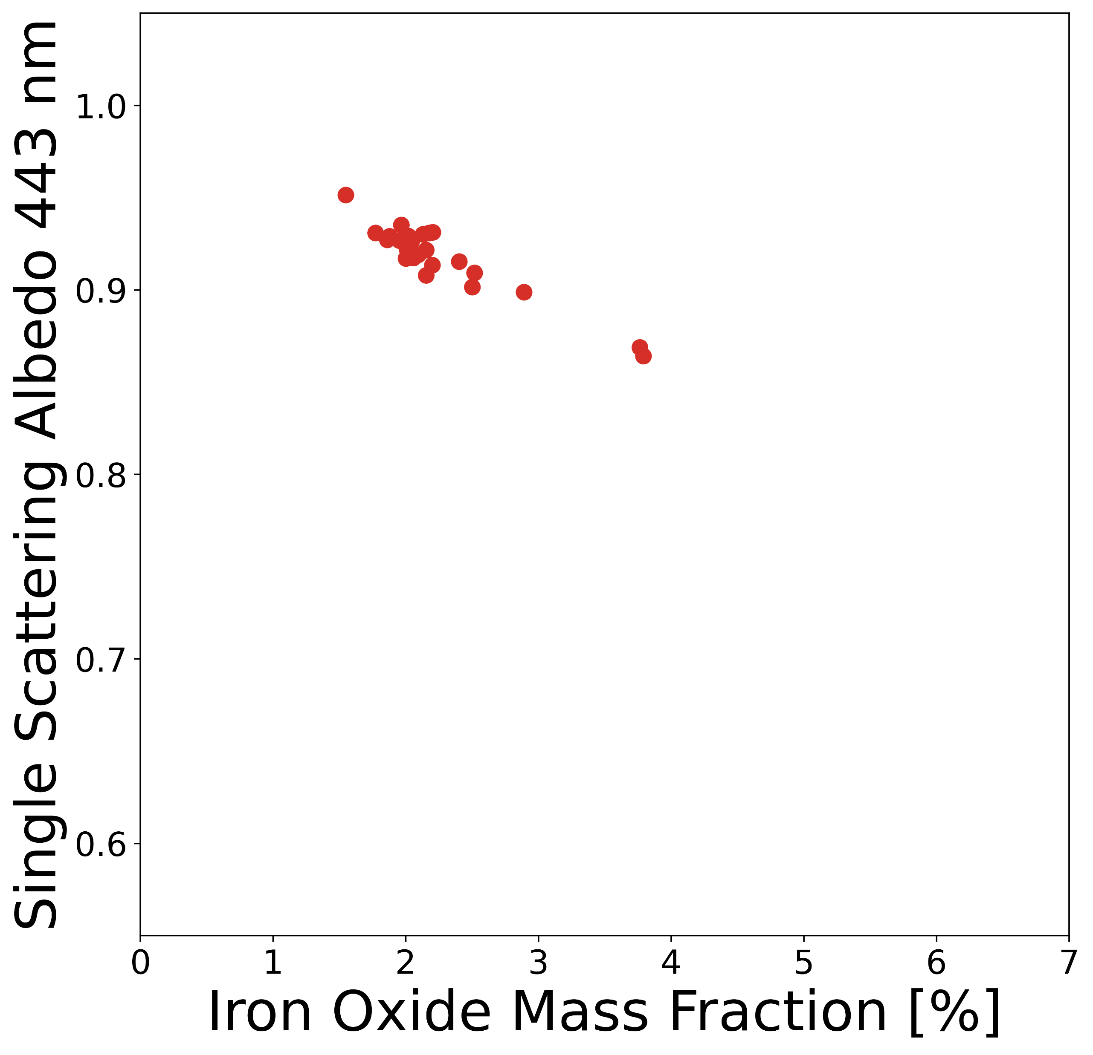
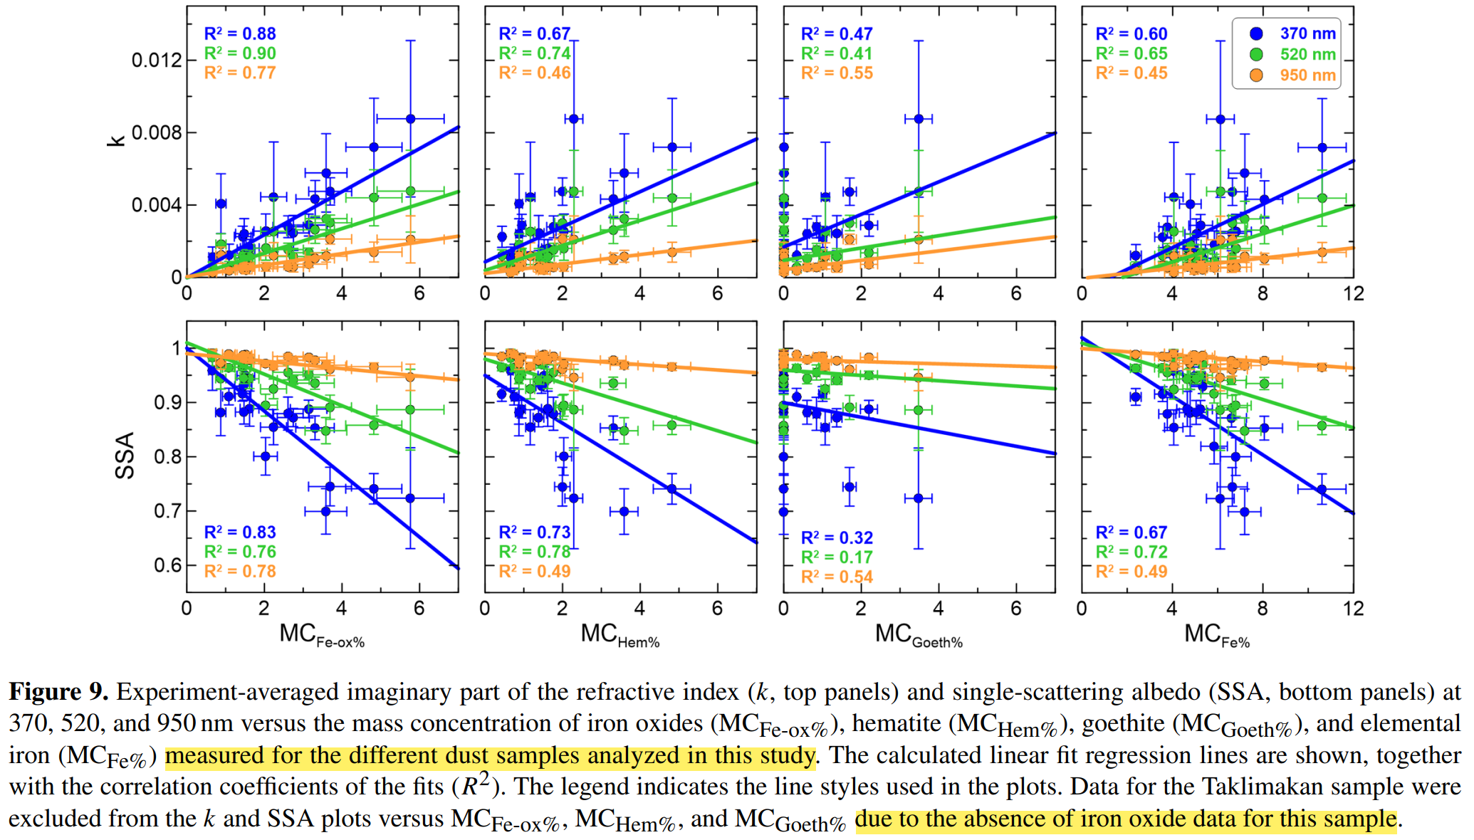
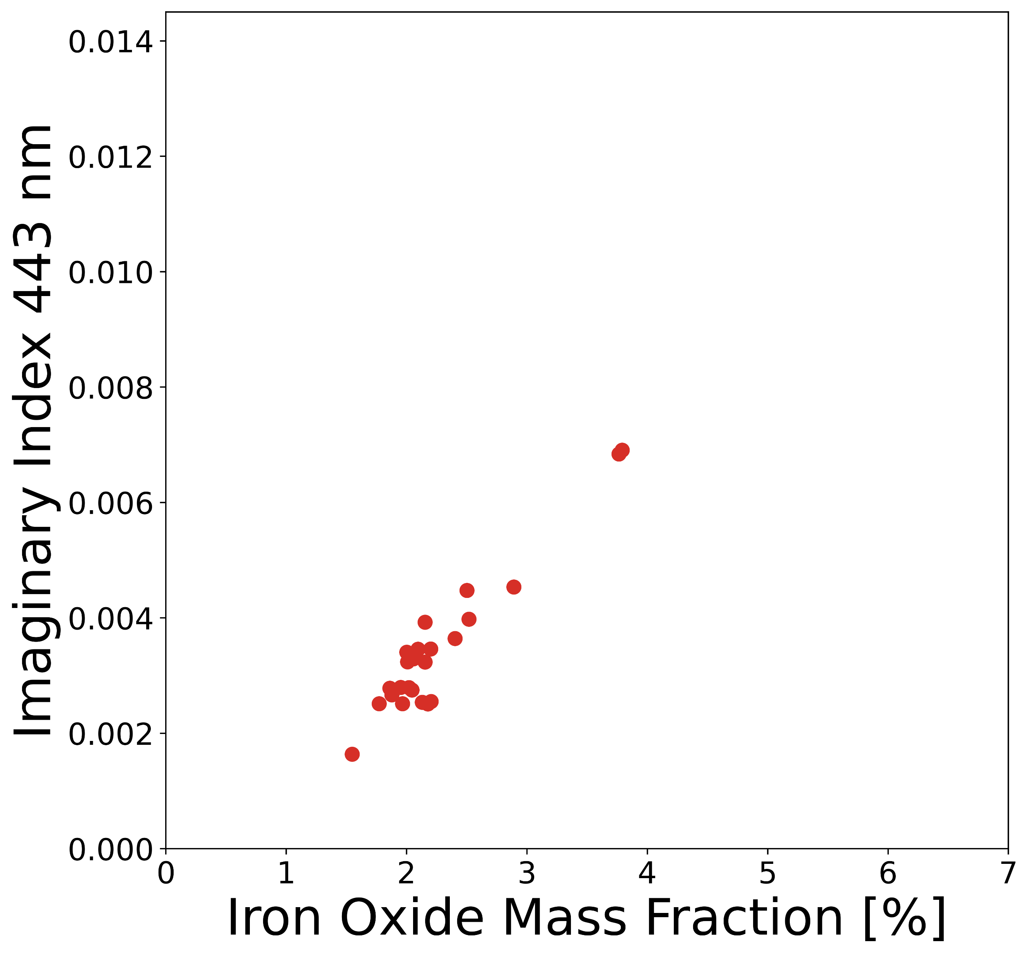
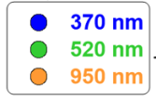
Comparison with
Di Biagio et al. (2019)
Retrieval from EPIC
Di Biagio et al. (2019)
mean of each case of EPIC
Moosmüller et al. (2012); Di Biagio et al. (2019)
found the relationships between k, SSA, and the iron oxide or elemental iron content in dust create an opportunity to establish predictive rules to estimate the spectrally resolved SW absorption of dust based on composition.
Di Biagio et al. (2019)
Refractive index are estimated by “Mie” calculation : from optical, size data
SSA are estimated directly from “scattering and absorption” coefficient.
SSA(or k) linearly decrease(or increase)
SSA 443 nm
443 nm estimate
from Di Biagio et al. (2019)
Iron oxides mass fraction (%)
Iron oxide mass fraction (%)
Iron oxide mass fraction (%)
Discrepancy likely due to spherical vs spheroid calculation
Imaginary refractive index (k) 443 nm
Imaginary refractive index (k)
Iron oxides mass fraction (%)
Iron oxide mass fraction (%)
Iron oxide mass fraction (%)
Notes:
This slide is for // the same 24 cases // but showing the relationship between SSA and Iron oxide mass fraction // or Imaginary index and iron oxide mass fraction.
The previous study of Di Biagio and Moosmuller dealt with this relationship, to estimate the spectrally resolved SW absorption of dust // based on composition.
So, Based on This figure, // we can estimate the linear relationship line at 443 nm, // and EPIC is following very well with this linear estimated line.
However, when it comes to the Imaginary index.
There was discrepancy between EPIC and the estimated line likely due to spherical and spheroid calculation. //8.46

Slide 12
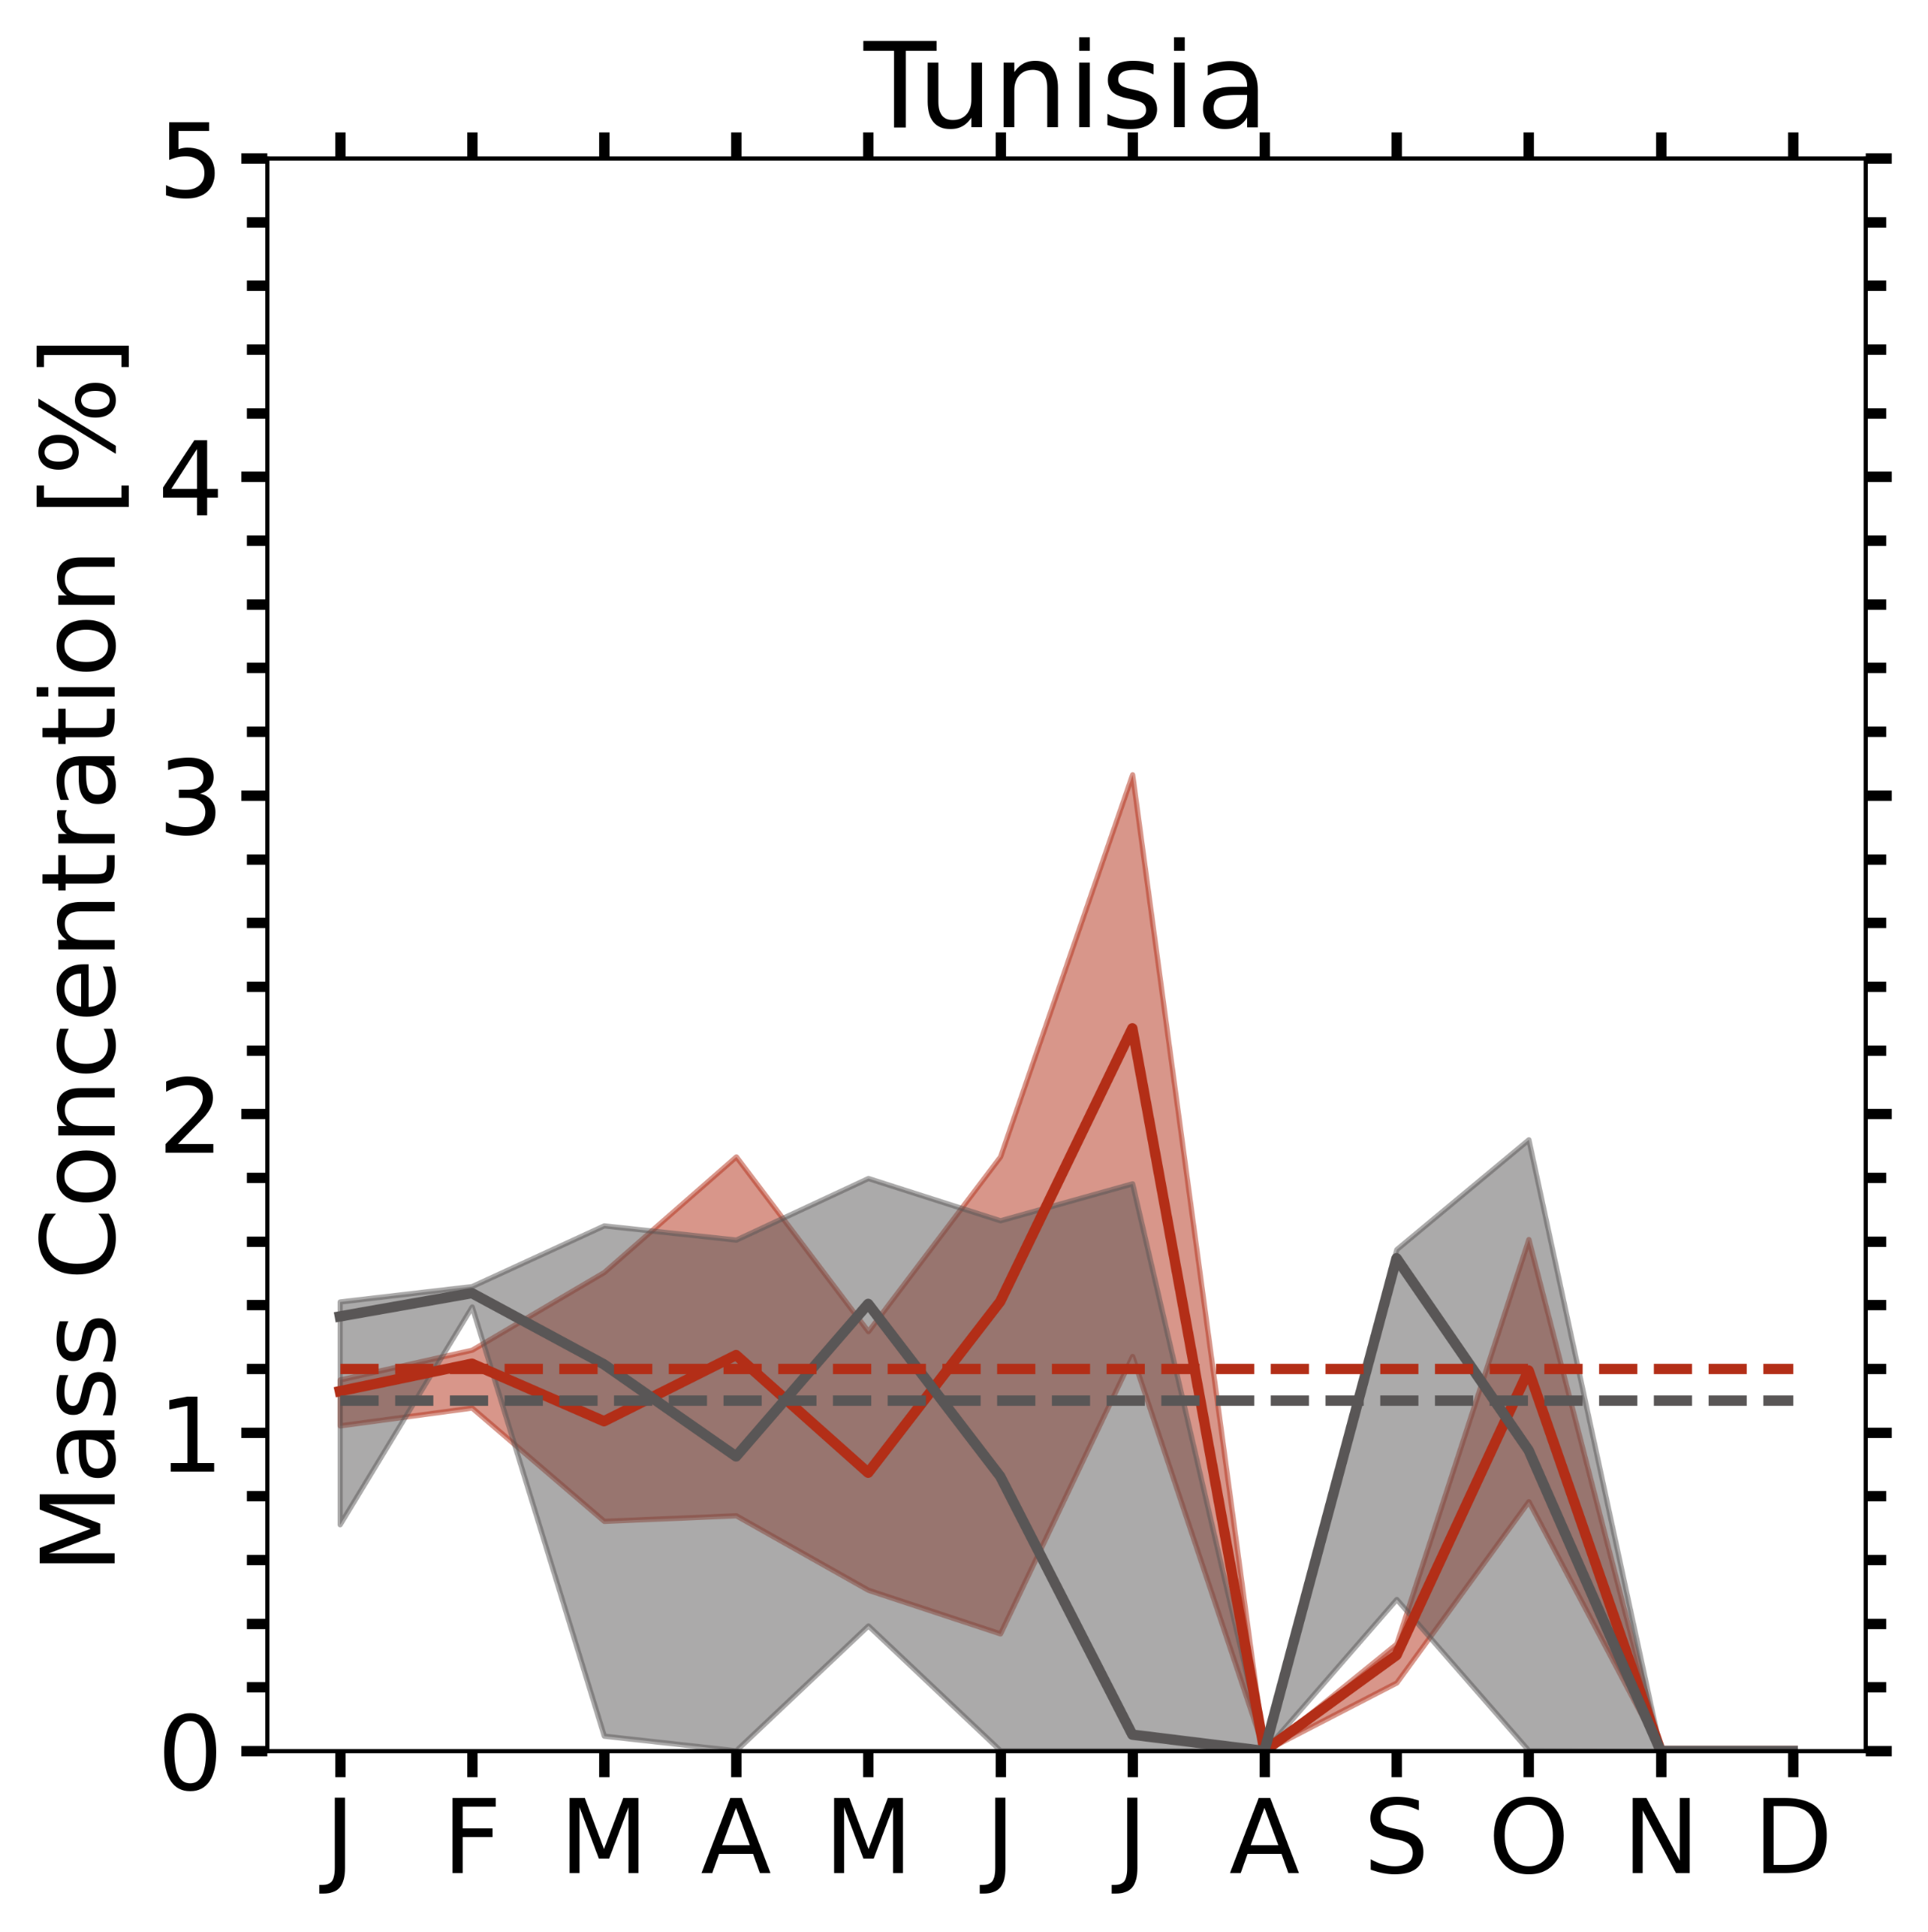
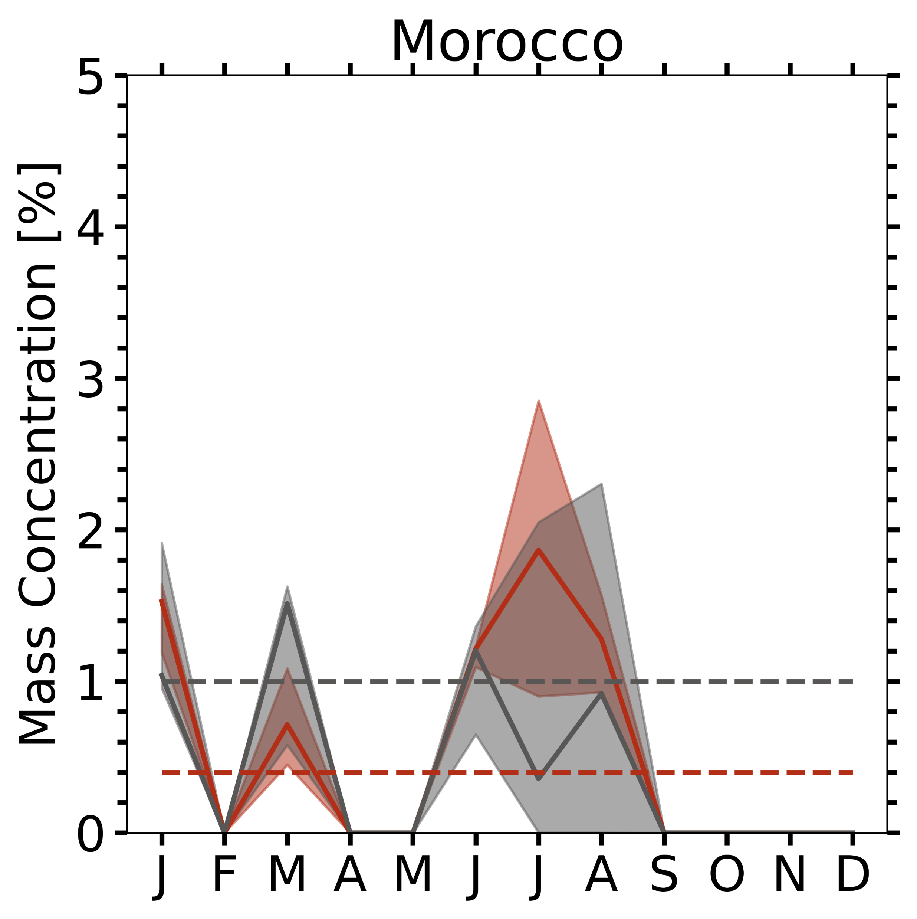
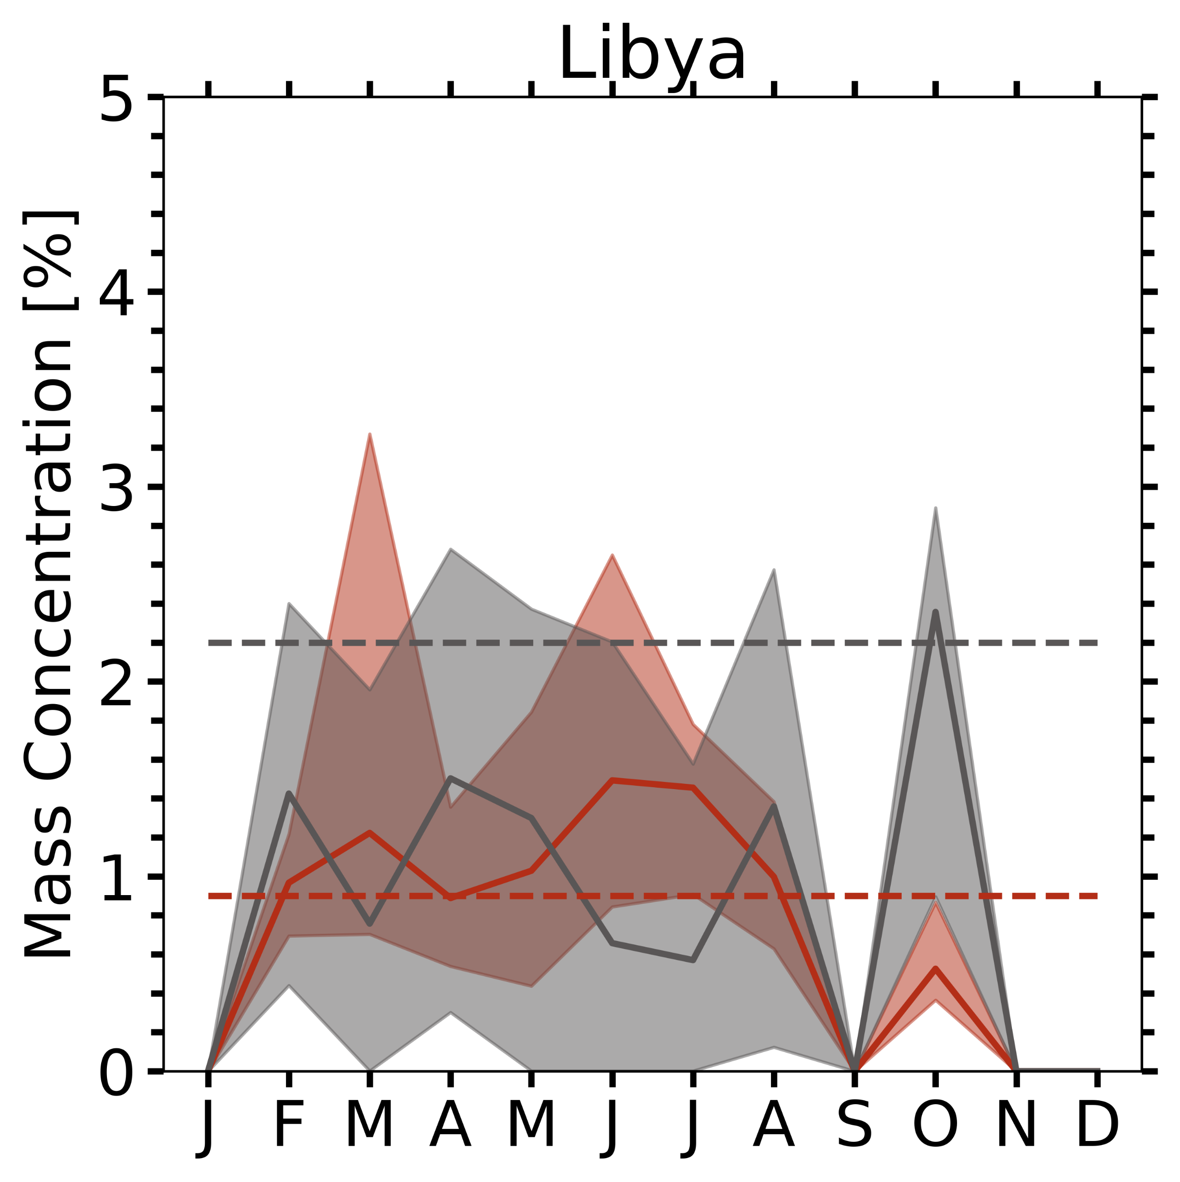
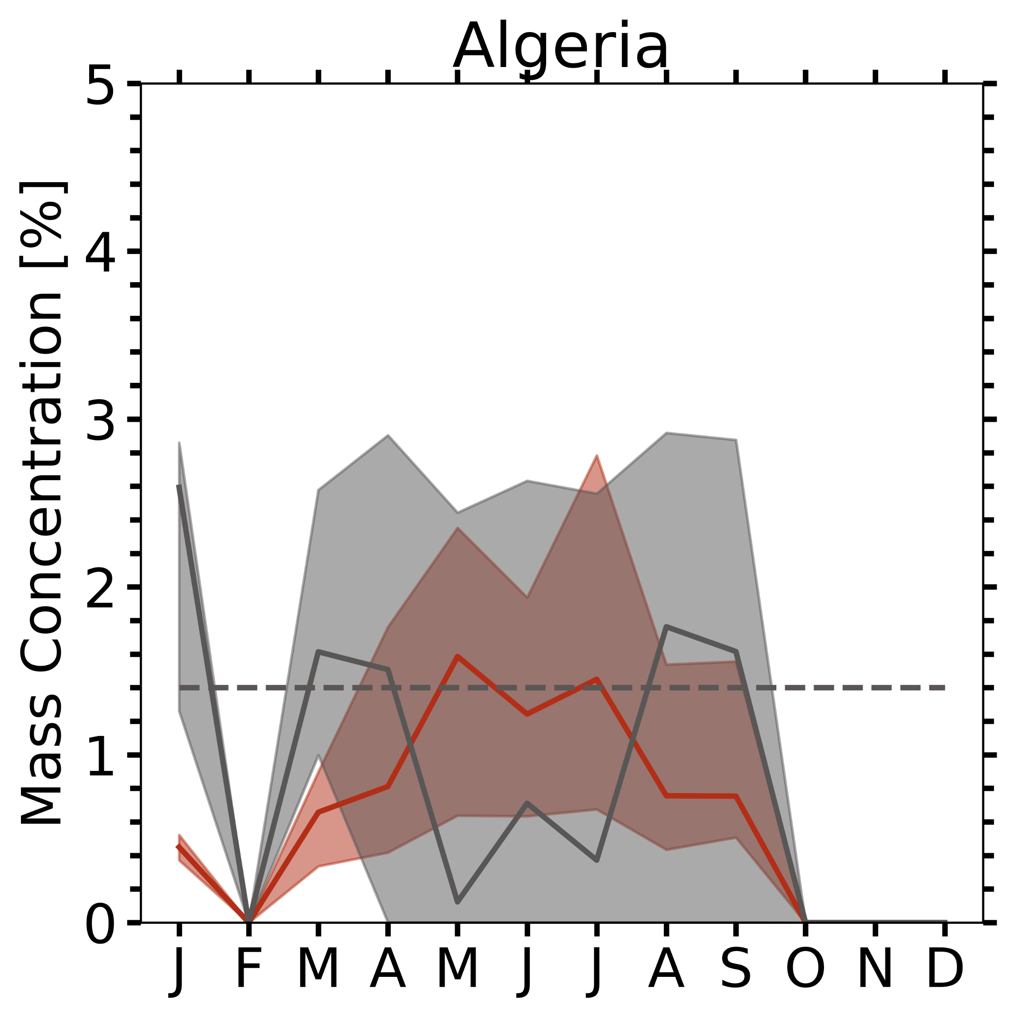
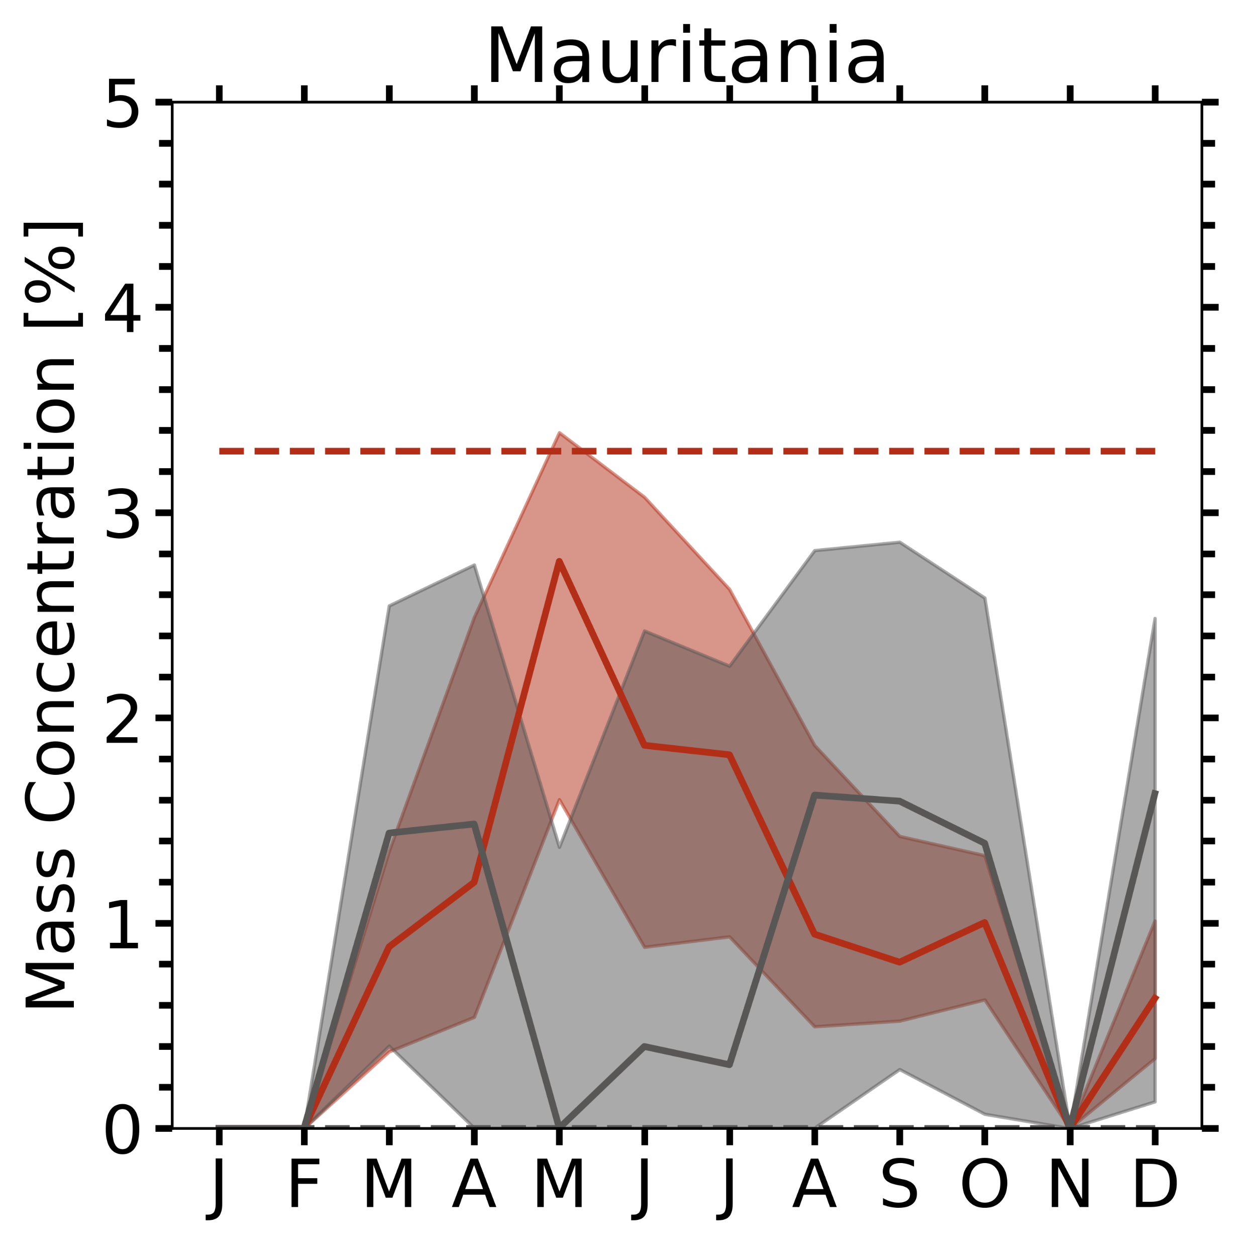
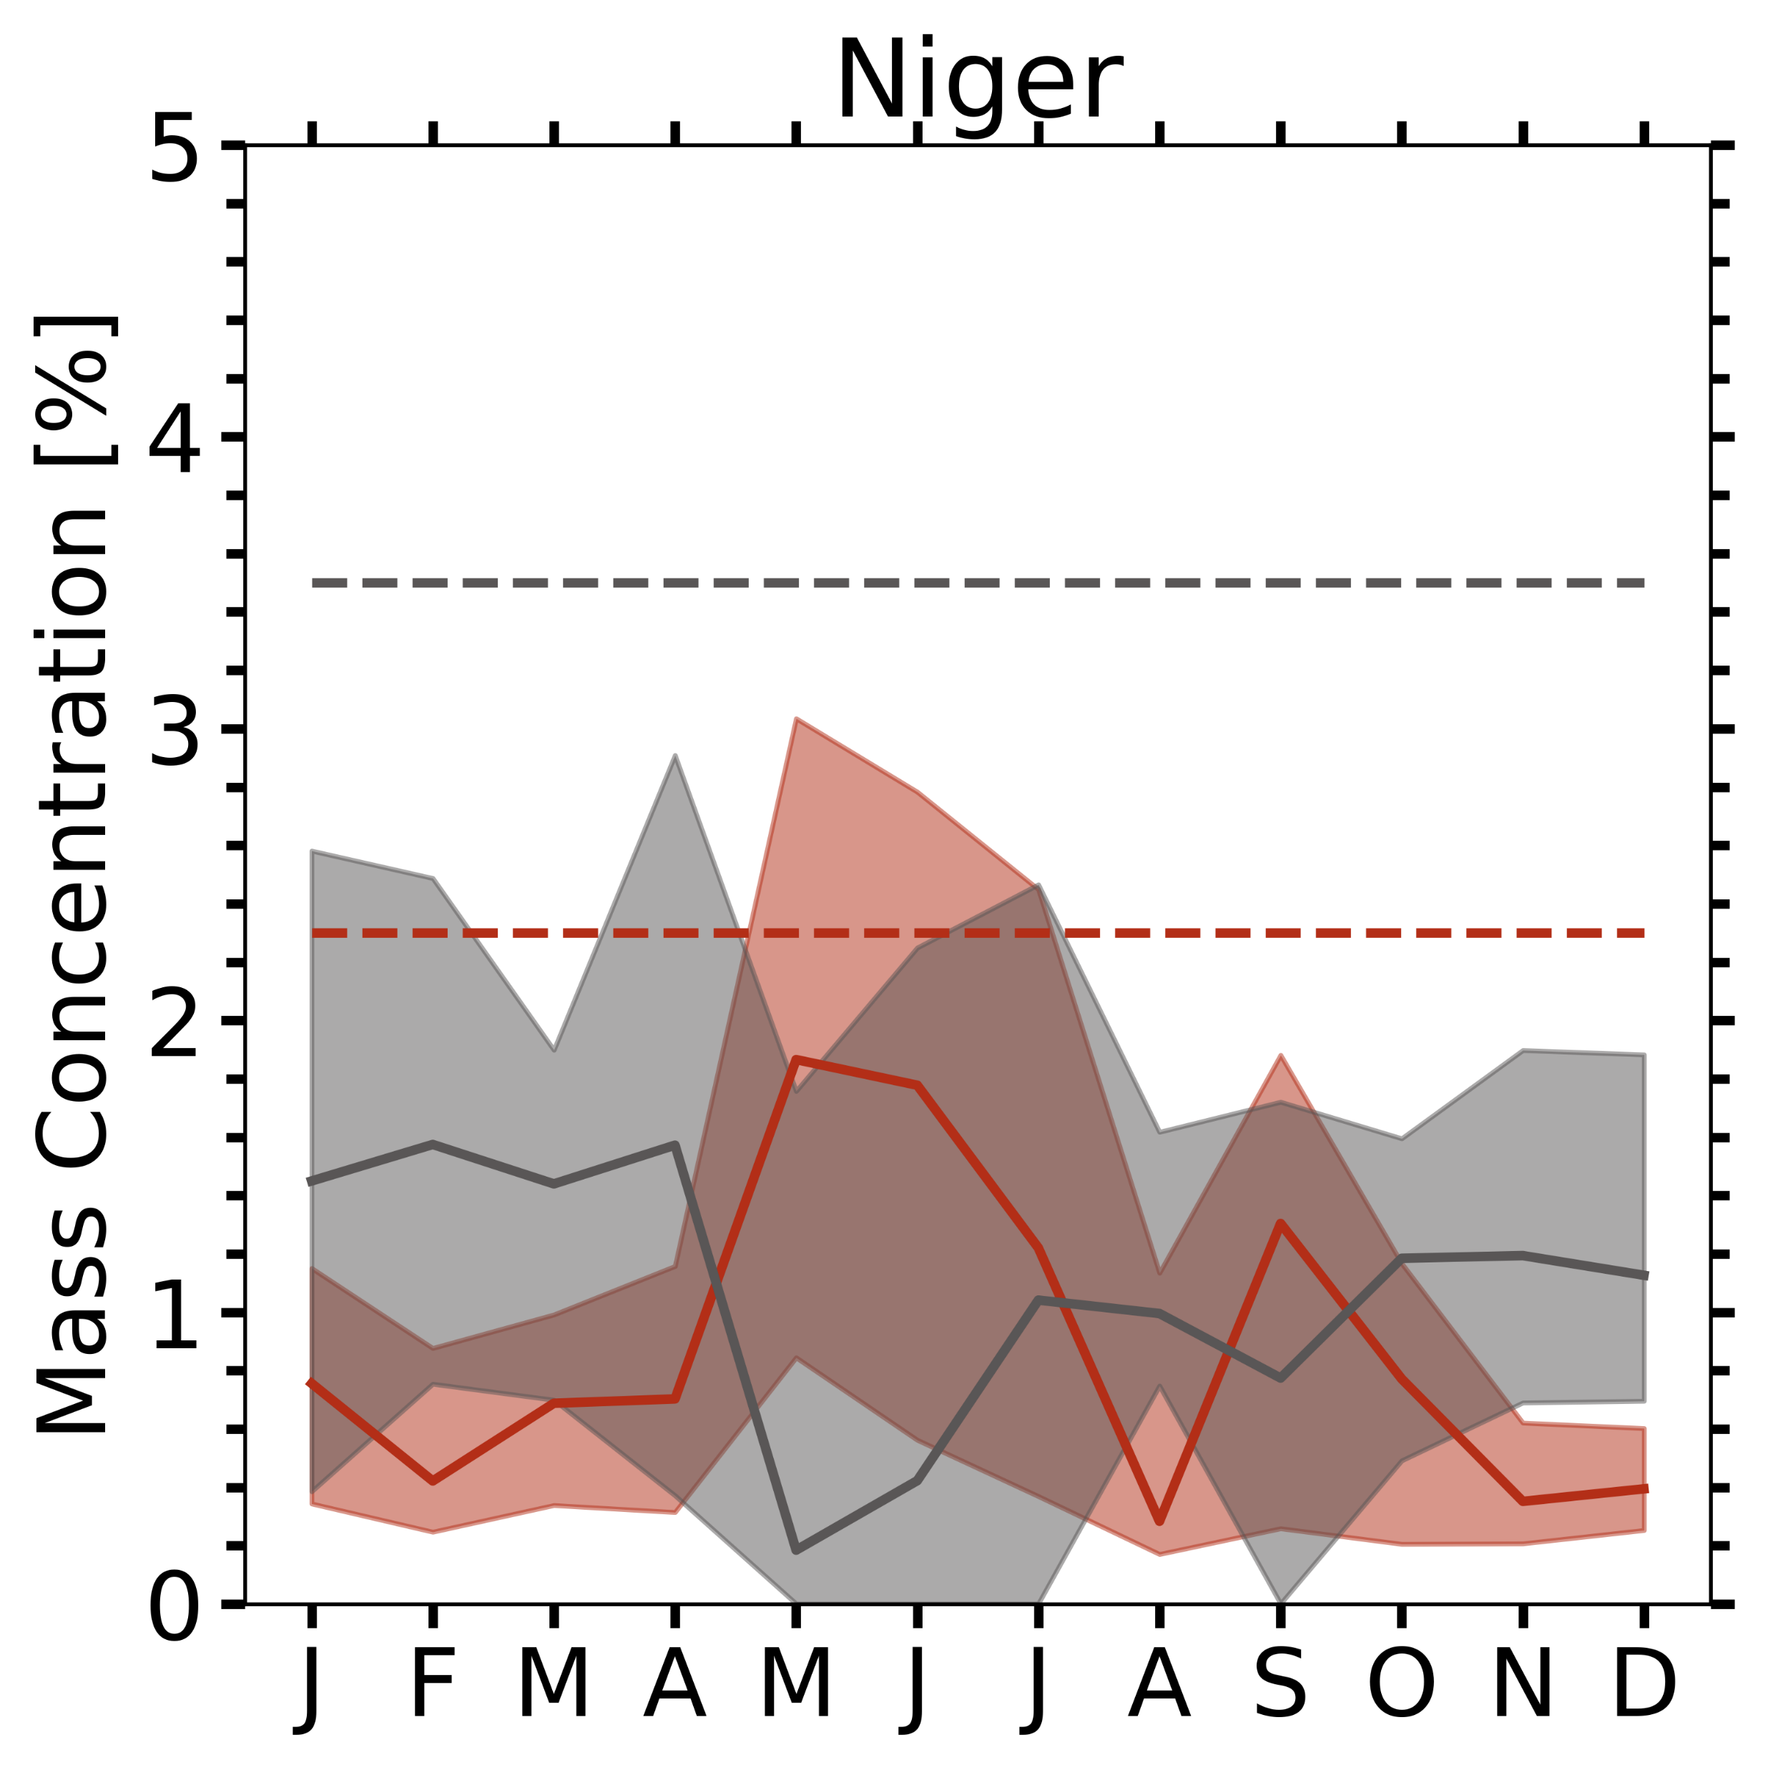
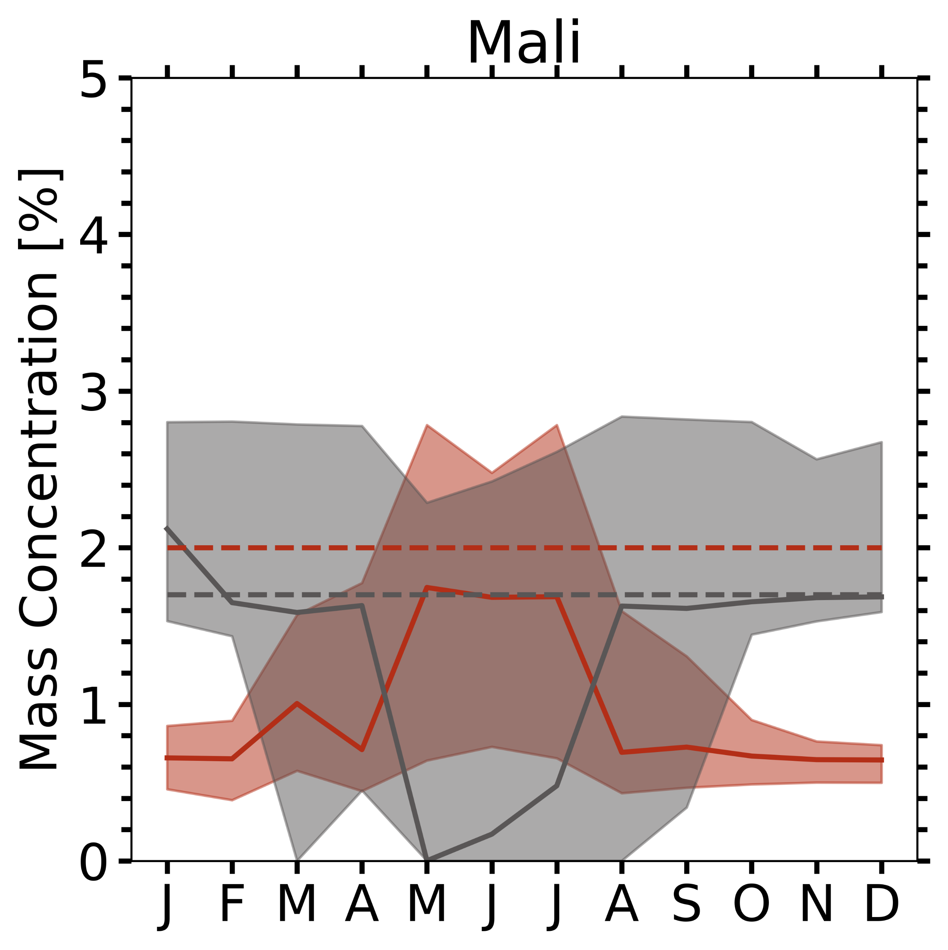
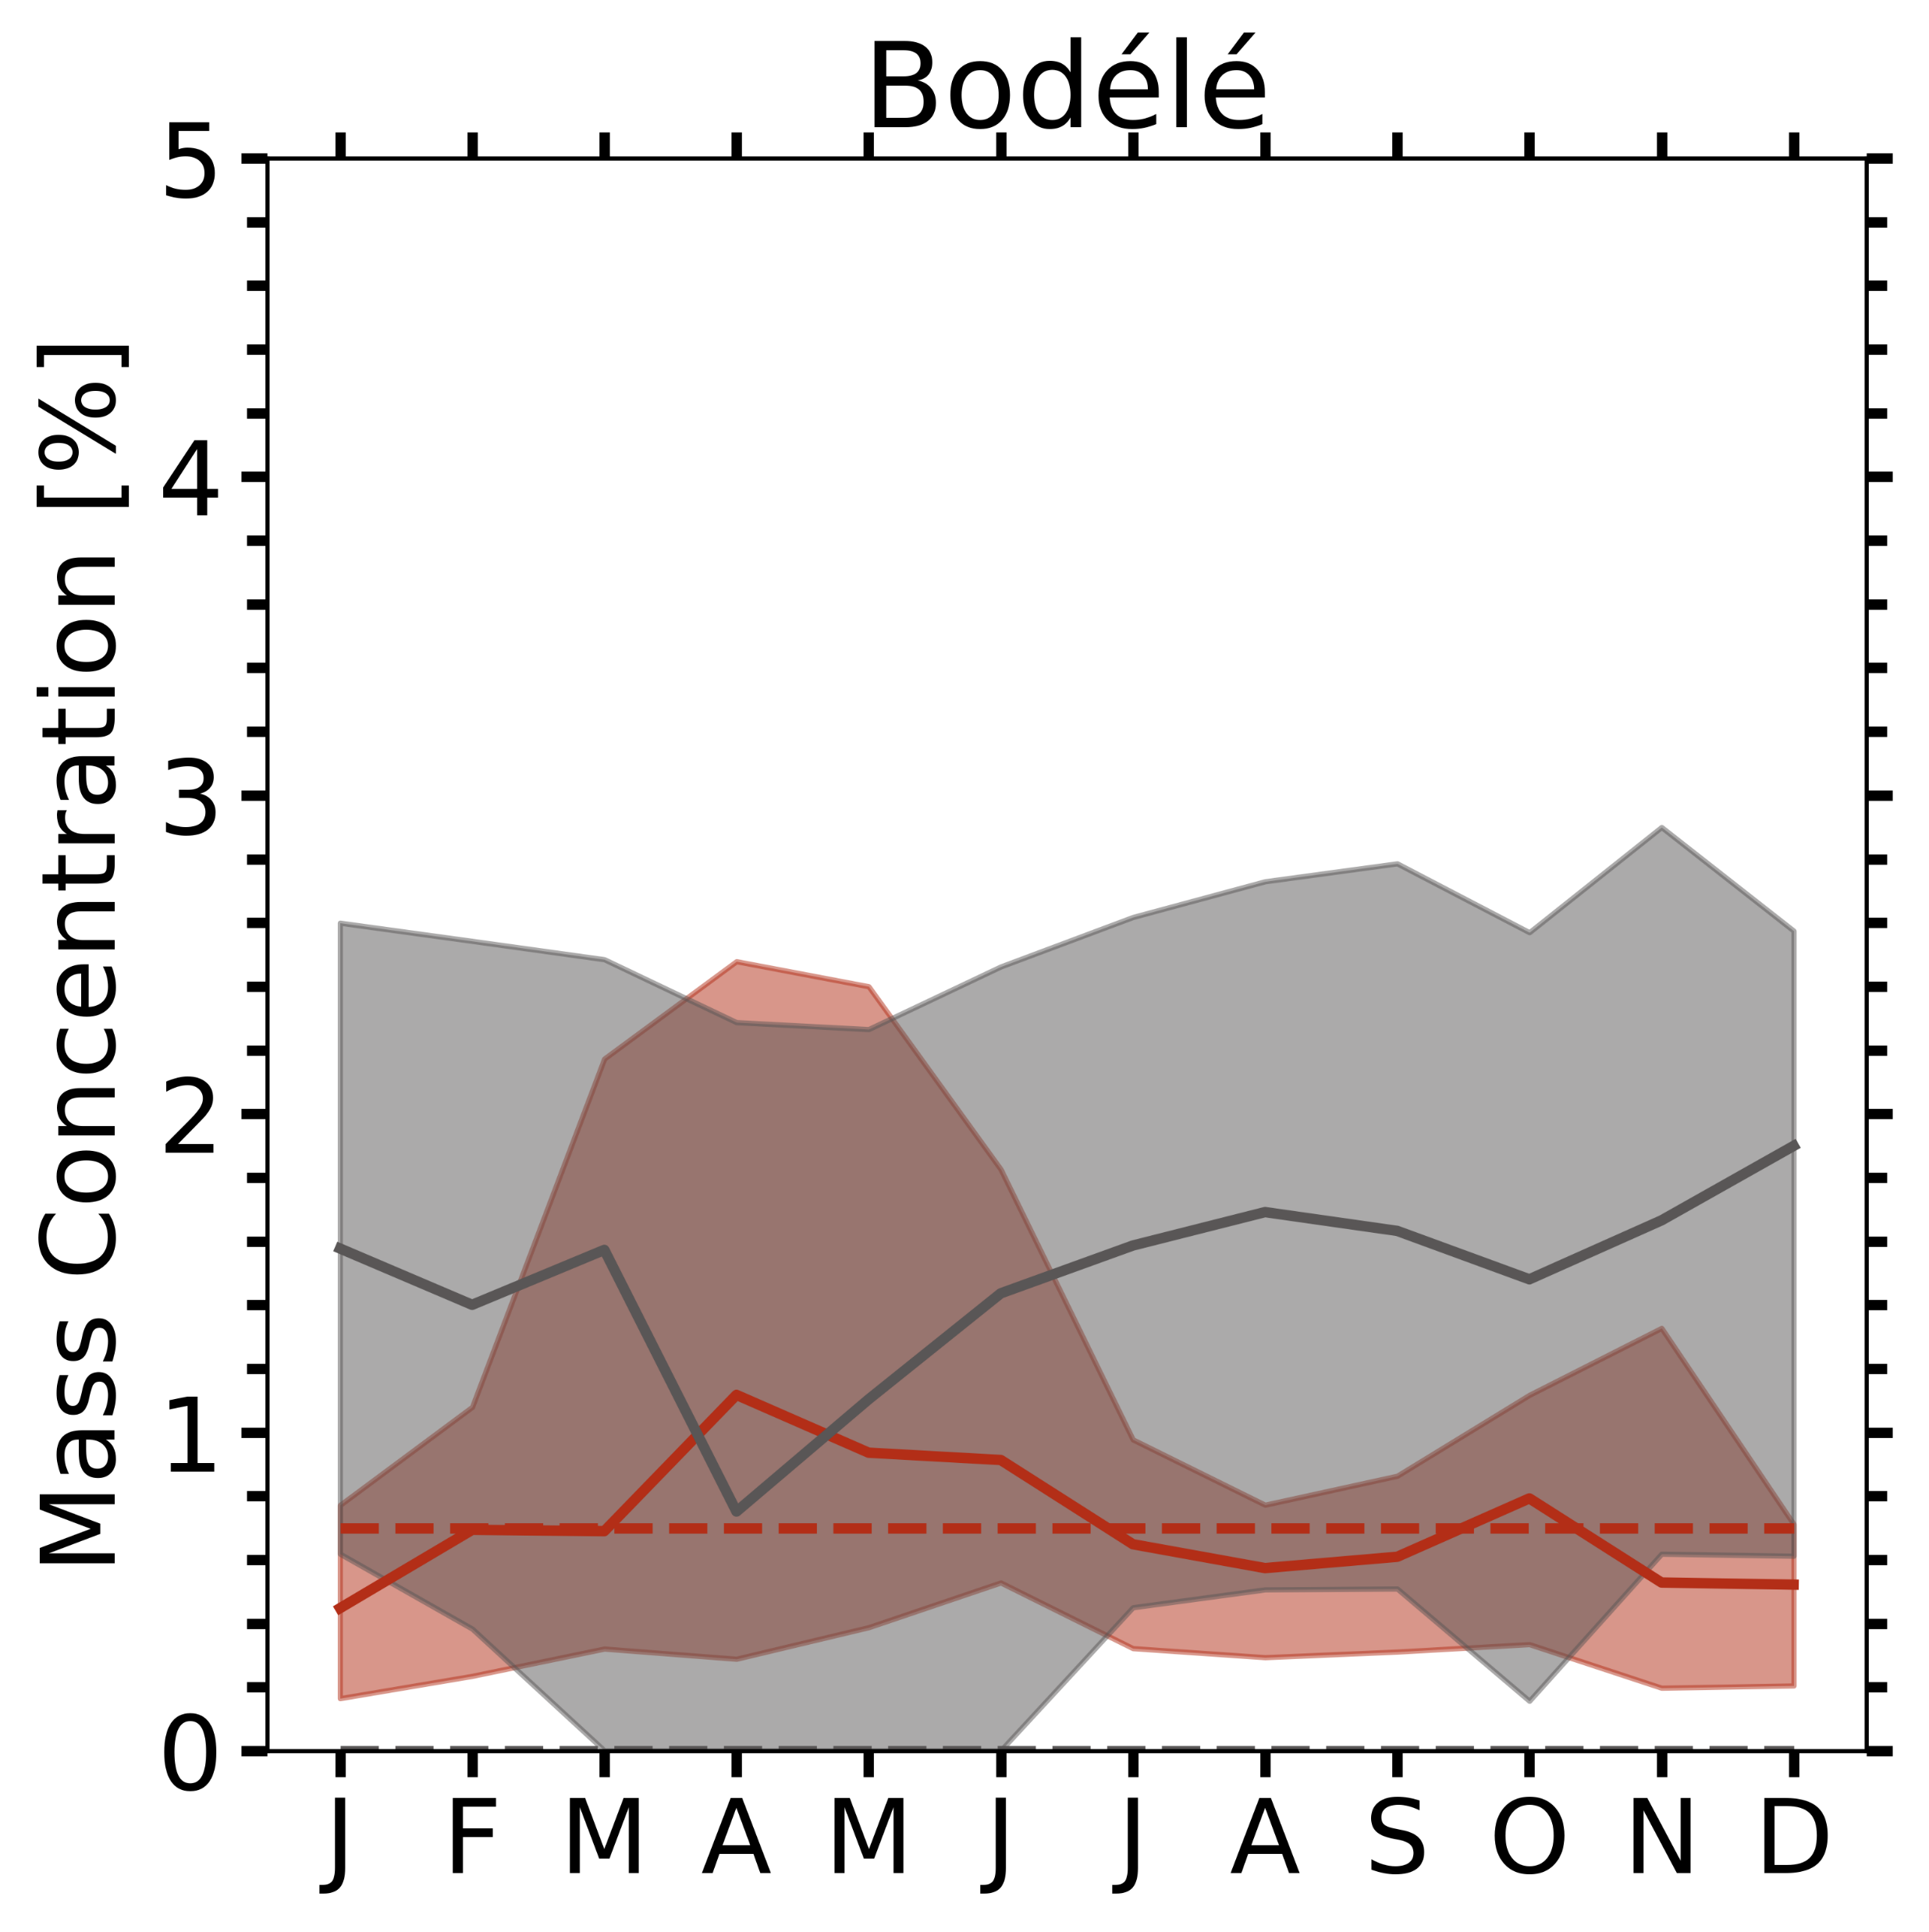
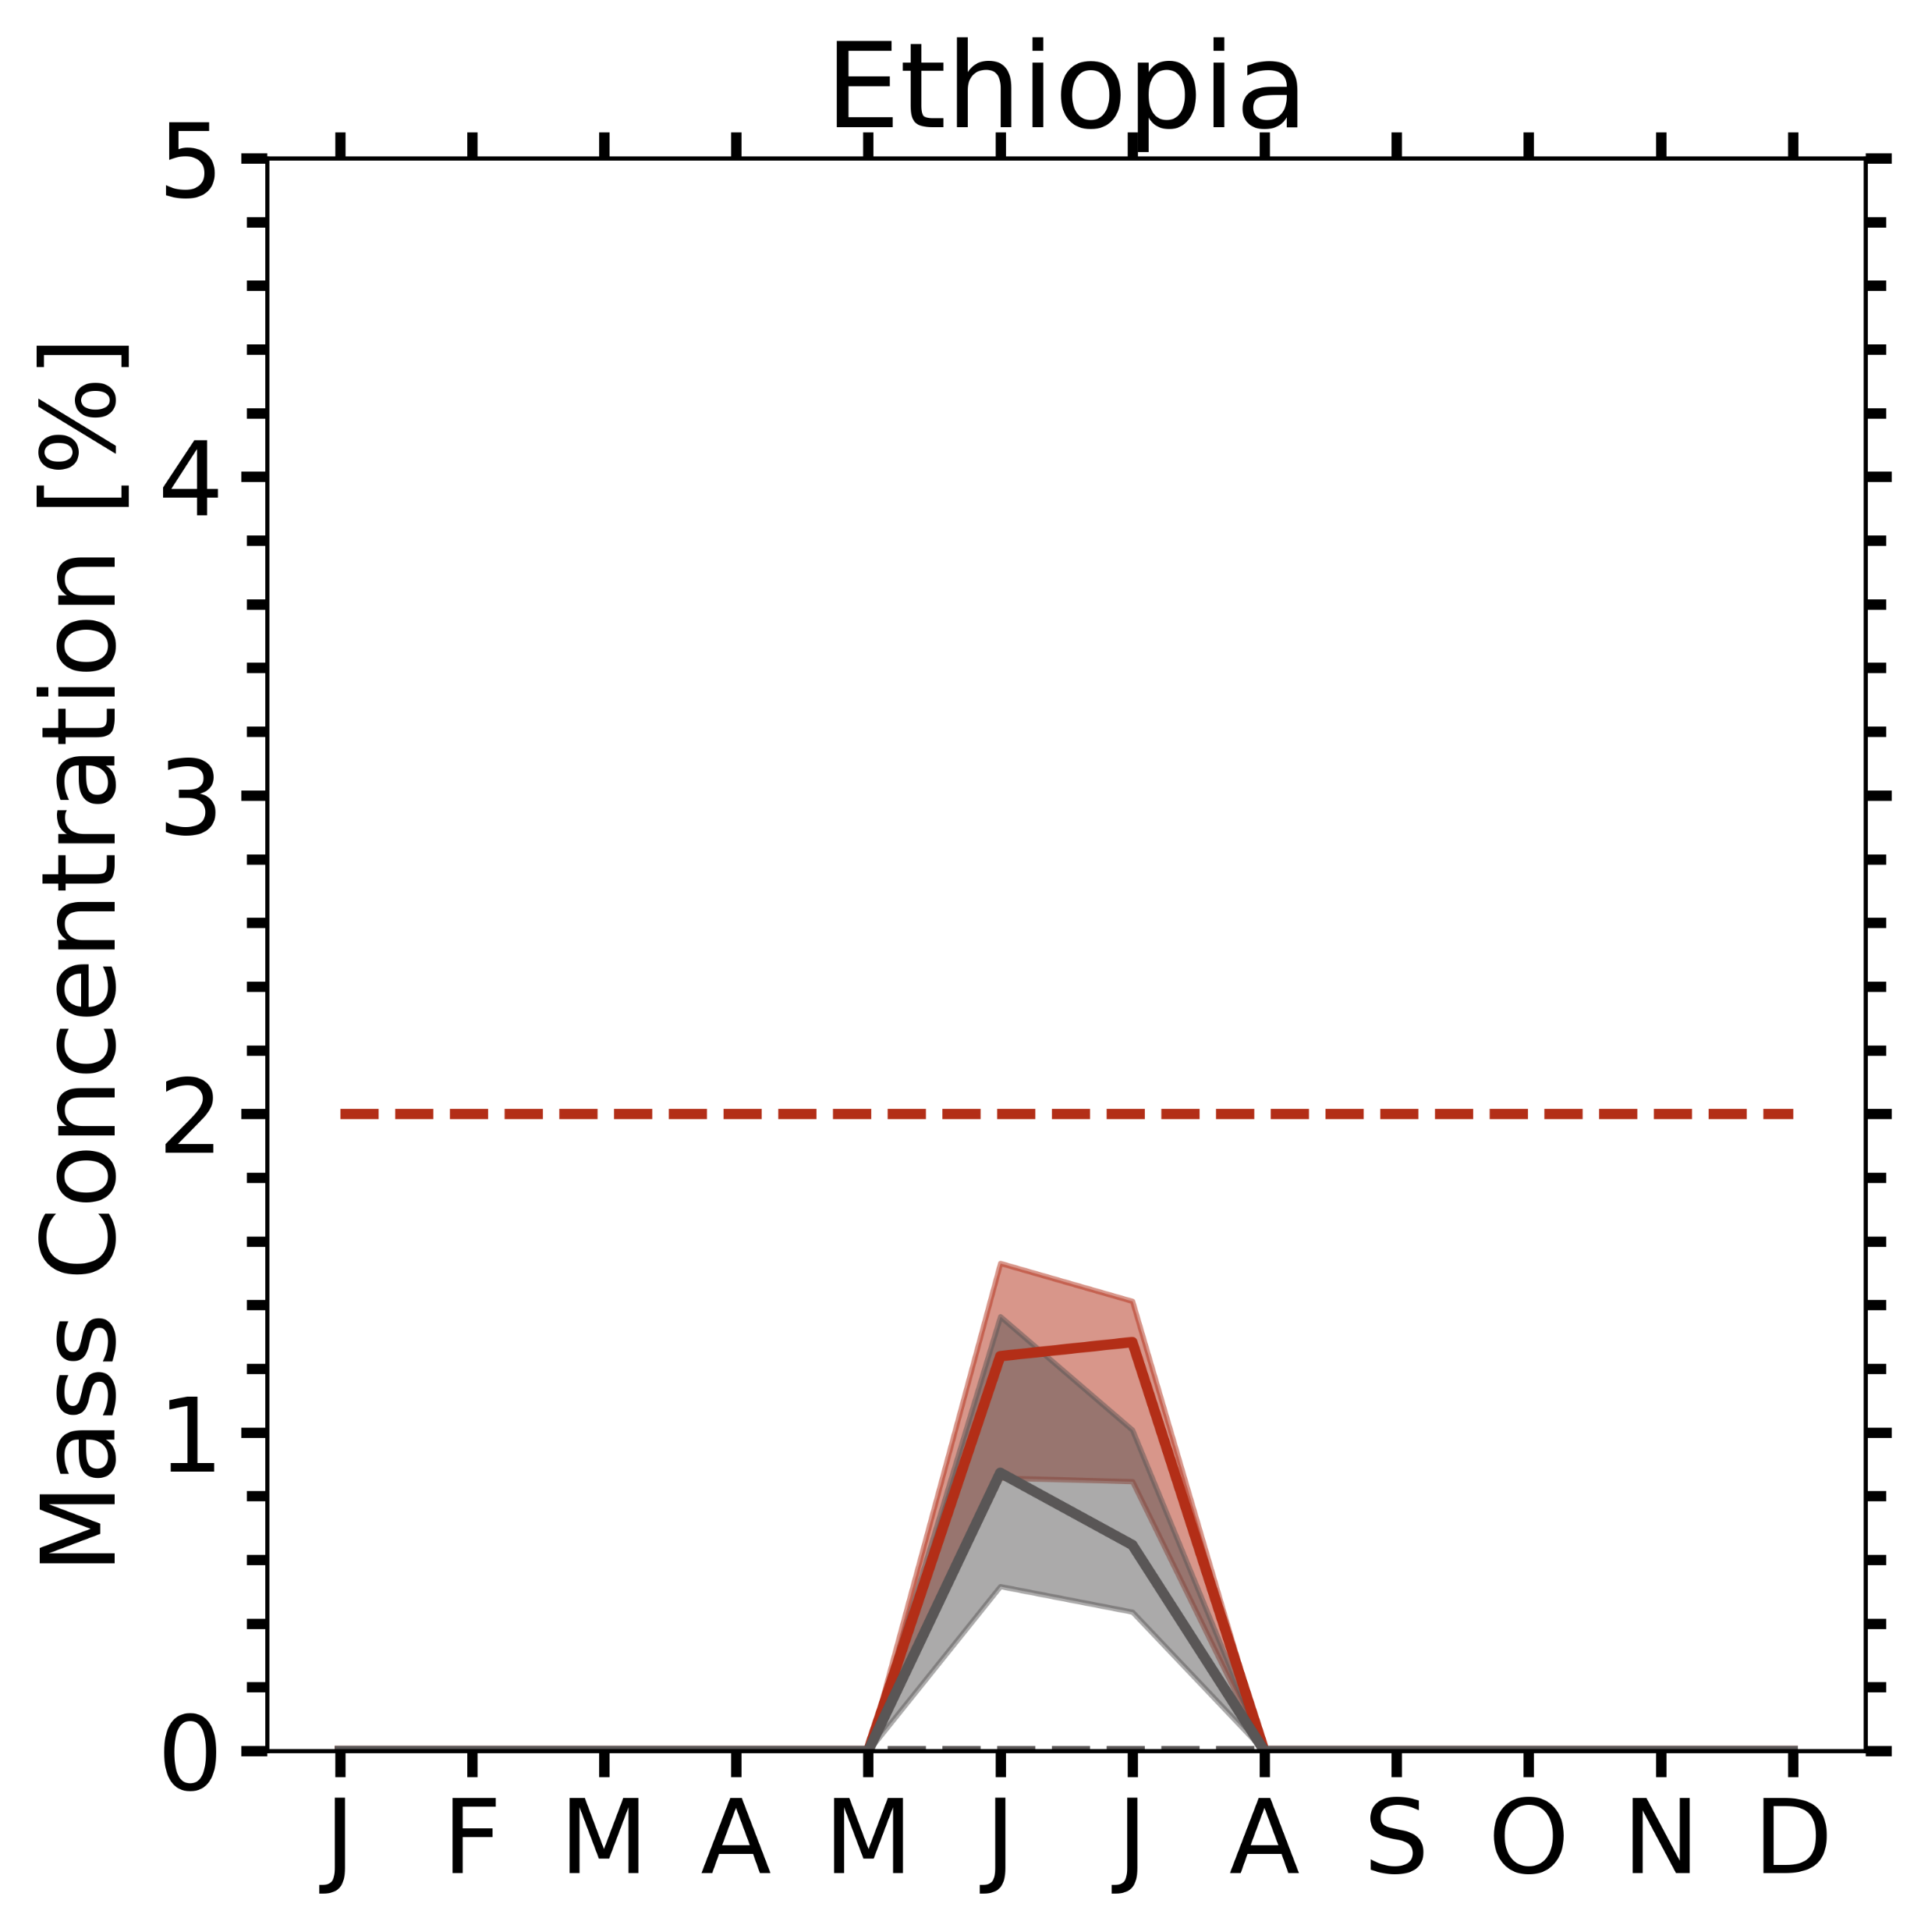
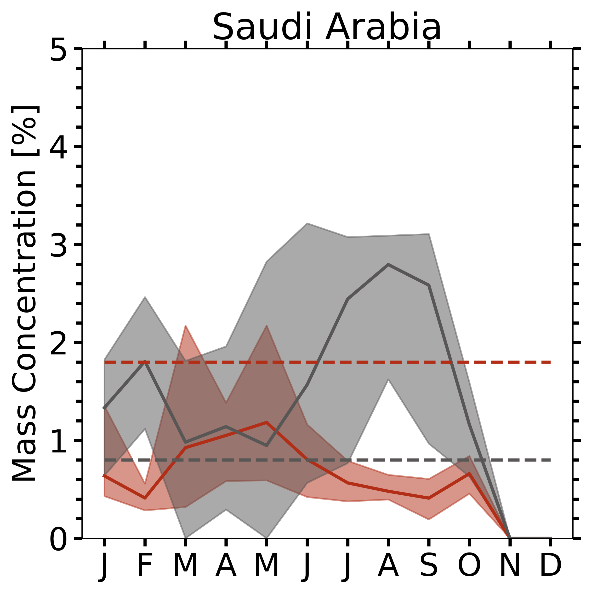
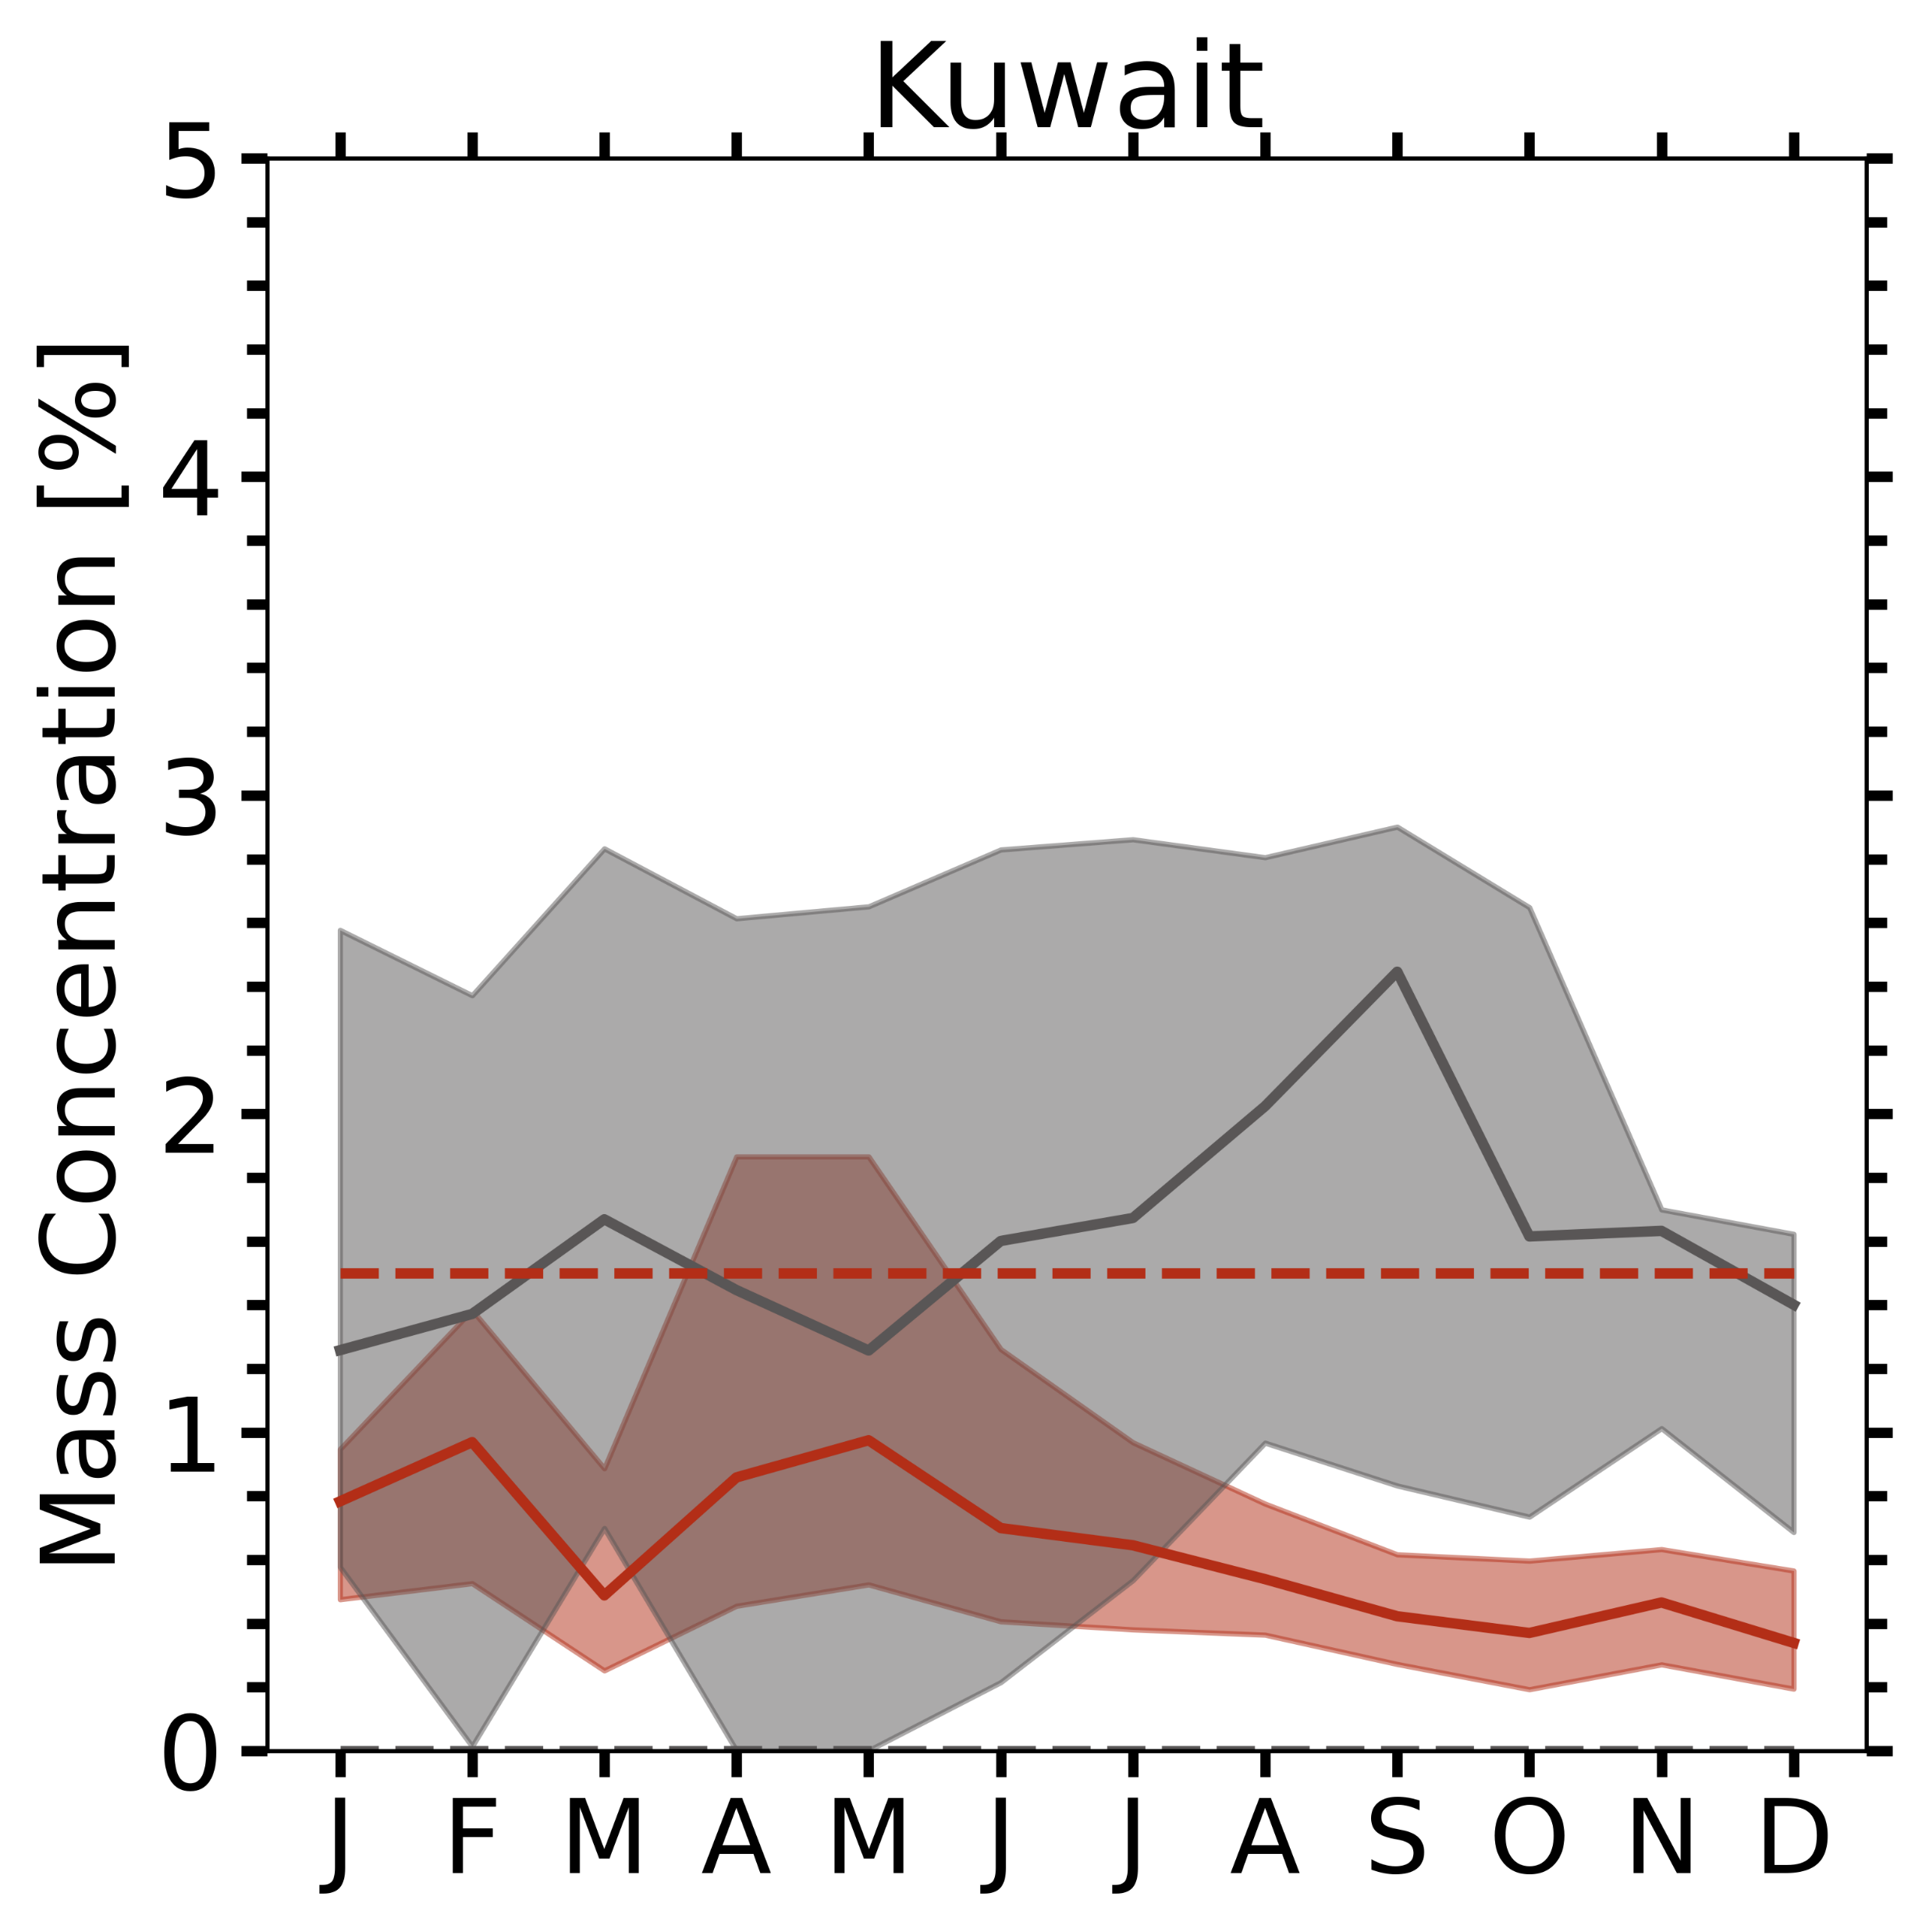
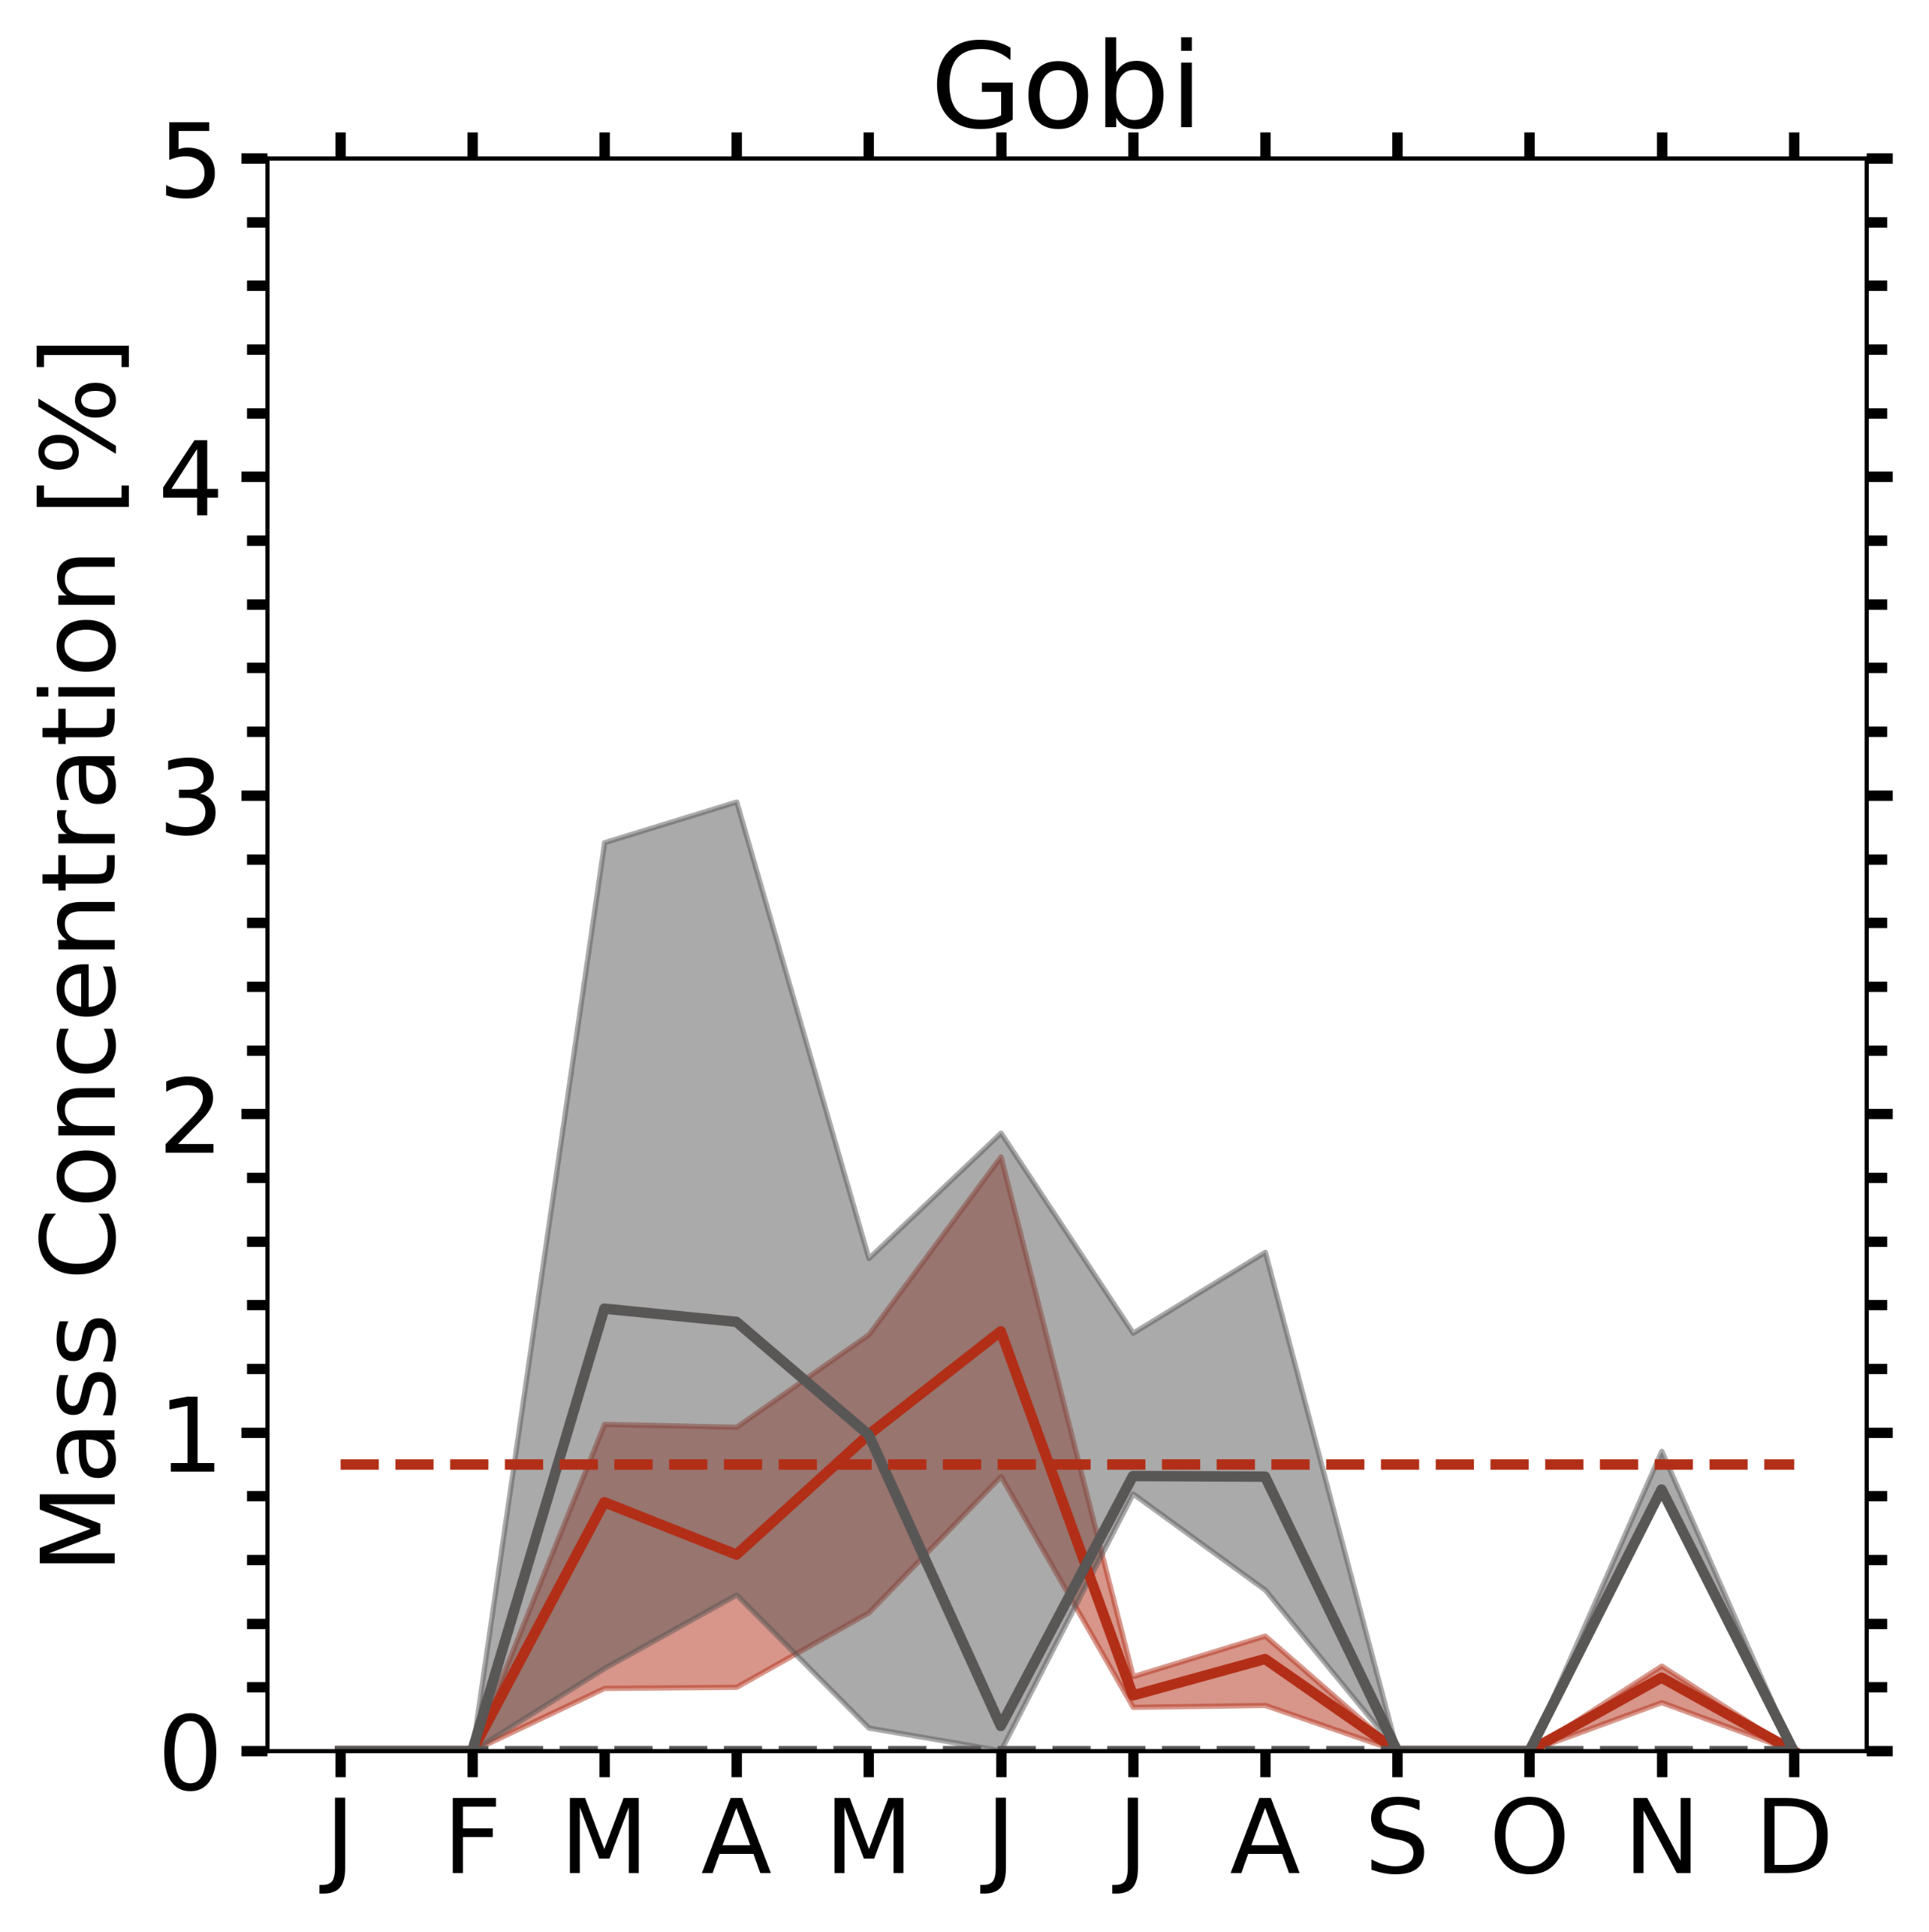
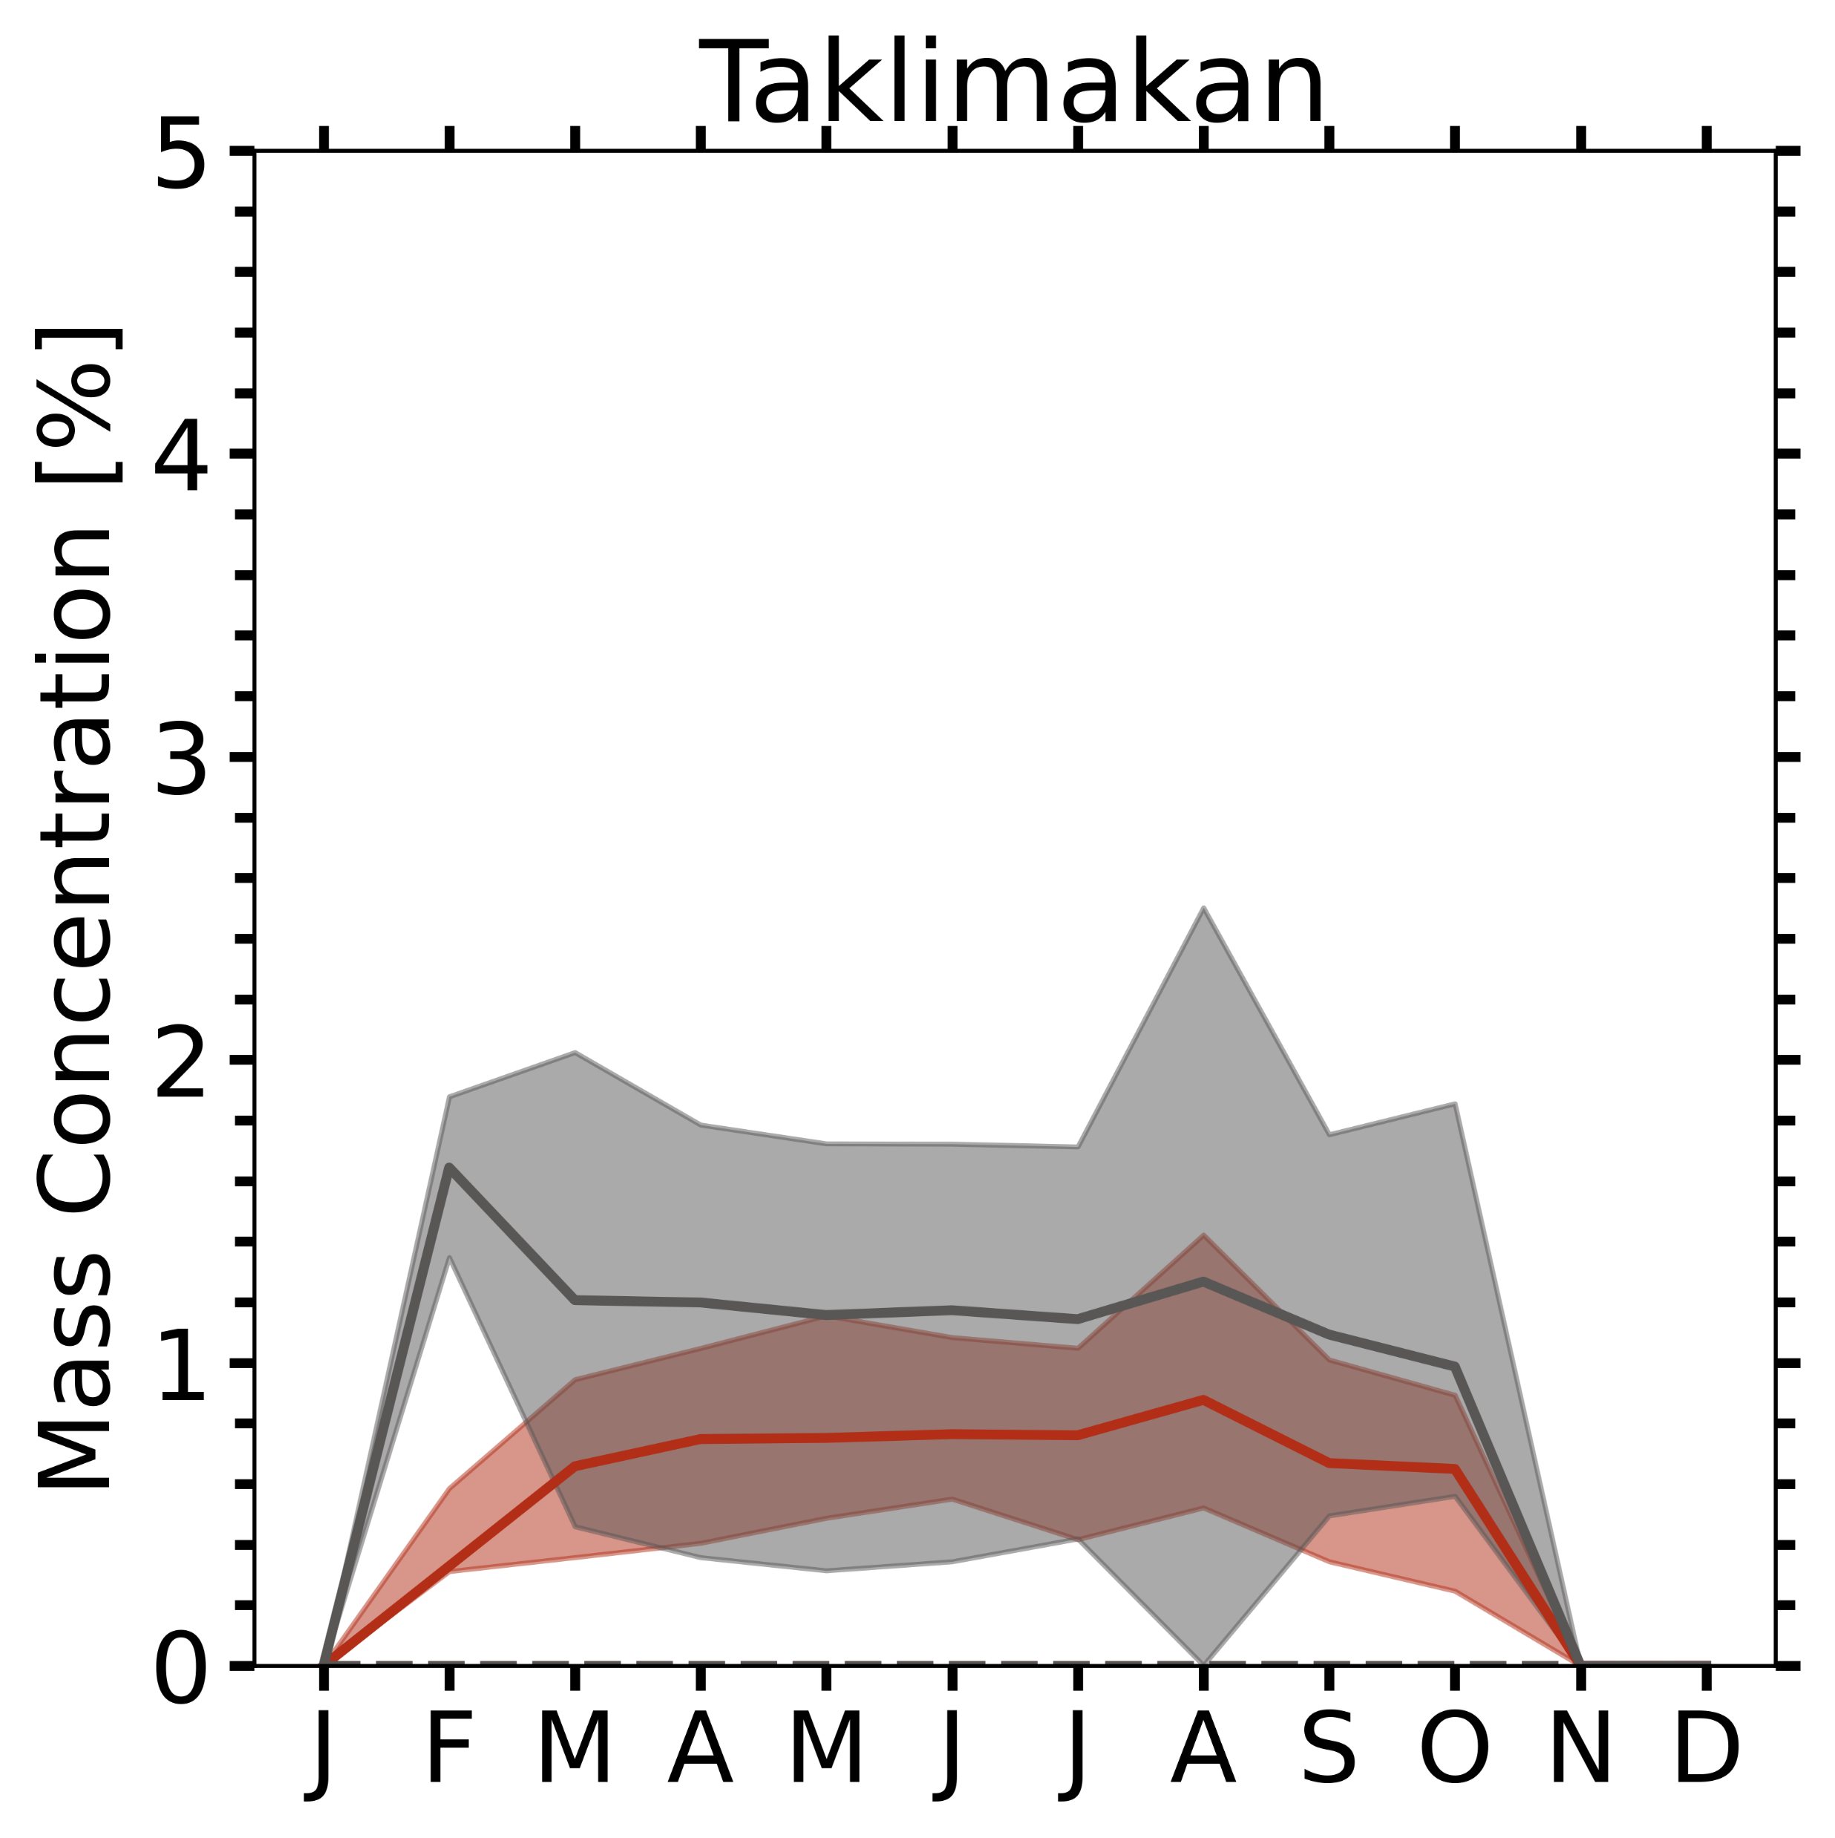
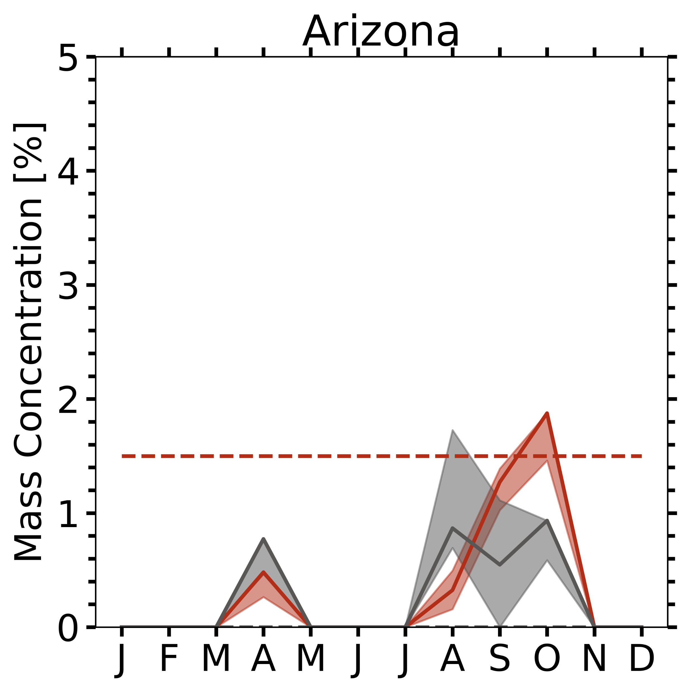
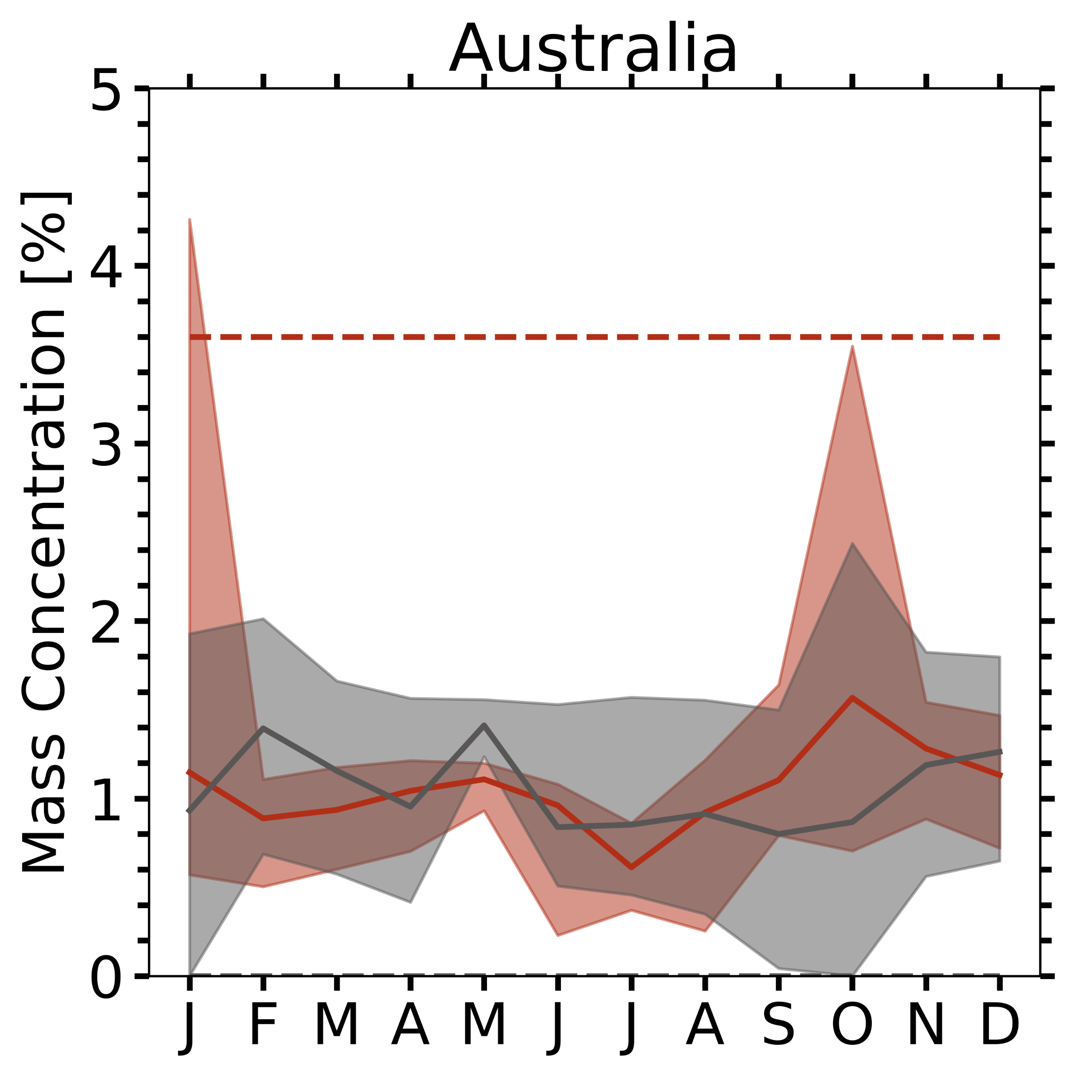
Comparison with
Di Biagio et al. (2019)
means no EPIC data
Hematite = Goethite
Shaded area : EPIC retrieved
  Monthly composite of Hematite / Goethite (5th, median, 95th)
  With pixels of AOD>1.0 used only
  ± 1 degree box pixels collected (Monthly)
  01/01/2018 – 12/31/2018 (1 year)
  Soil content + affected by transport due to different source regions
Dashed line : Di Biagio et al. (2019)
  ± 10% uncertainty
  Simulation chamber study (with X-ray absorption near edge structure (XANES) method), from soil samples and sediments collected from each desert area
  Refer to the bulk composition of pure dust aerosol in dry condition with a size range of 2-6day transport.
  Soil content only
* Invisible dashed line of Goethite = 0.0
Shaded (EPIC)
Dashed (Di Biagio)
Hematite, Goethite
Notes:
This is another comparison results with Di Biagio paper at the site level.
It is monthly mass concentration over 15 sites.
Shaded area is the EPIC retrieved data, and Dashed line is soil measurement data presented by Di Biagio paper.
The soild line is our median value of monthly composite, and Bottom and Top of shaded area are from 5th (BOTTOM) to 95th (TOP) of the (monthly) composite data.
We should keep in mind that, the dashed line is representative of soil content only, but the EPIC retrieval may be additionally affected by transport due to different source regions. // 9.30

Slide 13
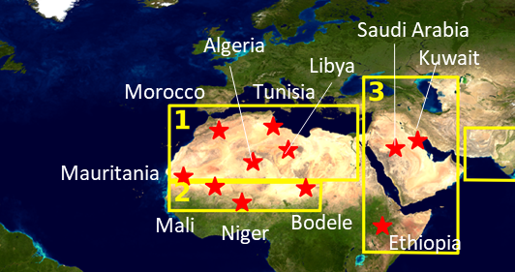
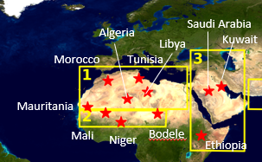
means no EPIC data
Hematite = Goethite
Sahara, Sahel, Middle East → large variability
Sahel line (~20°N) hematite tendency
  EPIC: Mauritania > Niger > Mali > Bodélé
  Di Biagio: (3.3%) > (2.3%) > (2.0%) > (0.7%)
Niger (Lafon et al., 2004)
  Harmattan (11-3): 2.8% iron oxide → agrees
  Local erosion (5-7): 5.0% (±0.4) iron oxide
    → Possibly due to rain, MAIAC did not catch
Bodélé:
  EPIC: consistently low hematite (<1.4%)
  Di Biagio: 0.7% hematite
Saudi Arabia, Kuwait:
  Shamal season (6-9): northwesterly wind
    → hematite, goethite reversed
Gobi, Taklimakan:
  Hm/Gt ratio ~ 0.55 observed (Shen et al., 2006)
Arizona, Australia: may contain smoke cases, but case study agreed with dashed line range.
* Invisible dashed line of Goethite = 0.0
Shaded (EPIC)
Dashed (Di Biagio)
Hematite, Goethite
Notes:
So, we overall seems to cover (tend to cover) the soil measurement data.
To be more exact, 8 sites located over the Sahara, Sahel and Middle East (가리키면서), showed large variability of iron oxides.
Mauritania, Niger, Mali, and Bodele are located over Sahel latitude line close to 20 degree North.
Their hematite tendency was higher for Mauritania, lowest over Bodele, and those tendency (or relative magnitude) was similar to Di Biagio data.
At the Niger site, Lafon paper mentioned about 2.8% of iron oxides over Harmattan season, which is between November to March. We generally agreed well with those value,
However, on the Local erosion season, our retrieval did not reach to 5% of iron oxides, possibly due to rainly season over Niger.
Over Saudi Arabia and Kuwait, it was interesting that the goethite tend to surge With the beginning of the Shamal Season.
Over Gobi and Taklimakan, previous research (Shen et al., 2006) observed the Hm to Gt ratio of 0.55, and we were in line with those value. //11.12

Slide 14
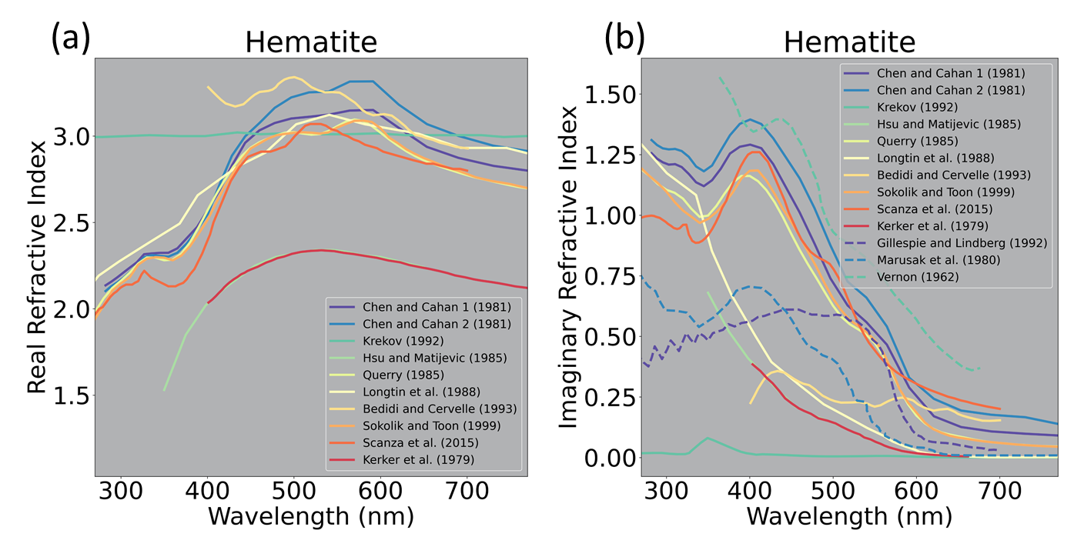
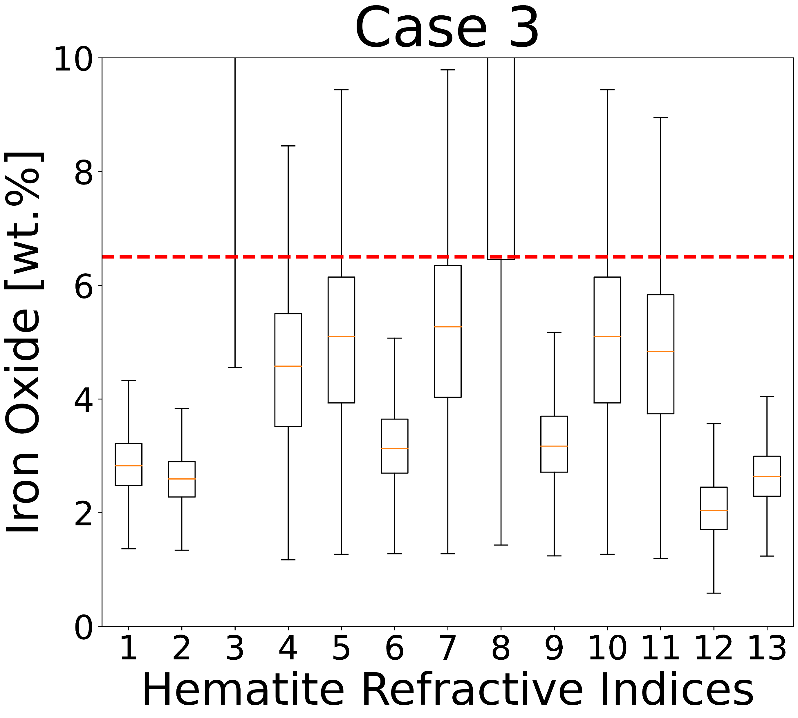
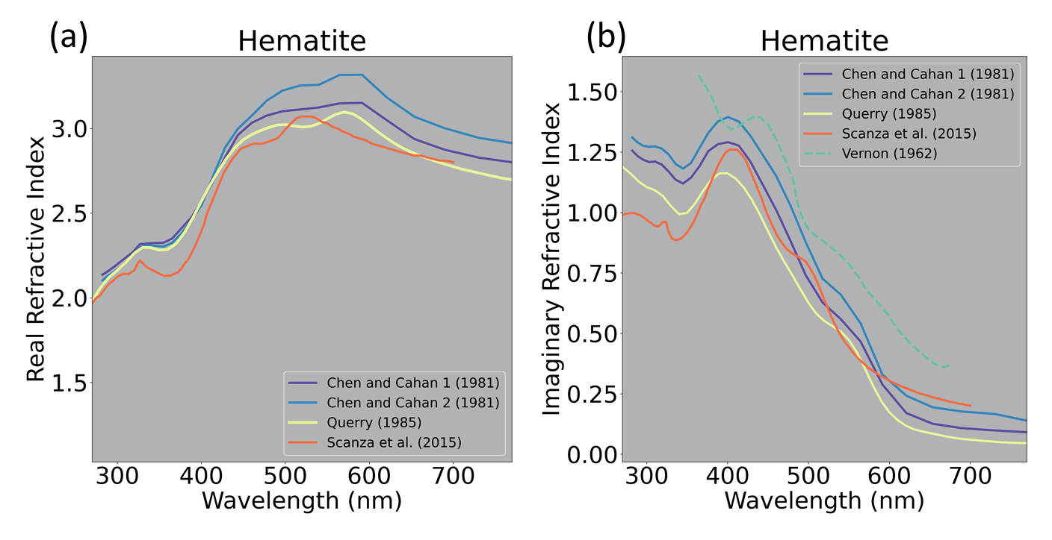
Hematite refractive indices exhibit a large range in the literature
13 different hematite refractive indices
Same dust event but with
13 different models of hematite refractive index
maximum expected iron-oxide content (6.5 wt.%) based on in situ measurements
After exclude: Most suitable hematite refractive index
1. Chen and Cahan 1 (1981)
2. Chen and Cahan 2 (1981)
3. Krekov (1992)
4. Gillespig and Lindberg (1992)
5. Hsu and Matijevic (1985)
6. Querry (1985)
7. Longtin (1988)
8. Bedidi and Cerville (1993)
9. Sokolik and Toon (1999)
10. Kerker (1979)
11. Marusak (1980)
12. Vernon (1962)
13. Scanza (2015) – this study
3,4,5,7,8,10,11 are not viable for our approach
Notes:
One of the issues regarding hematite is that, ~~
This figure shows 13 different kinds of hematite refractive indices gleaned from published paper.
We can see that their range are very different
The right figure shows the Box and whisker plot of iron-oxide content for same dust cases but with 13 different models of hematite refractive index.
Given that maximum expected iron-oxide contents based on in situ measurements are 6.5 %, some of the refractive indices are not viable for our approach.
When excluding the blue colored refractive indices, we could get the most suitable hematite refractive indices.
And, this could be an important constraint for the climate models.

Slide 15
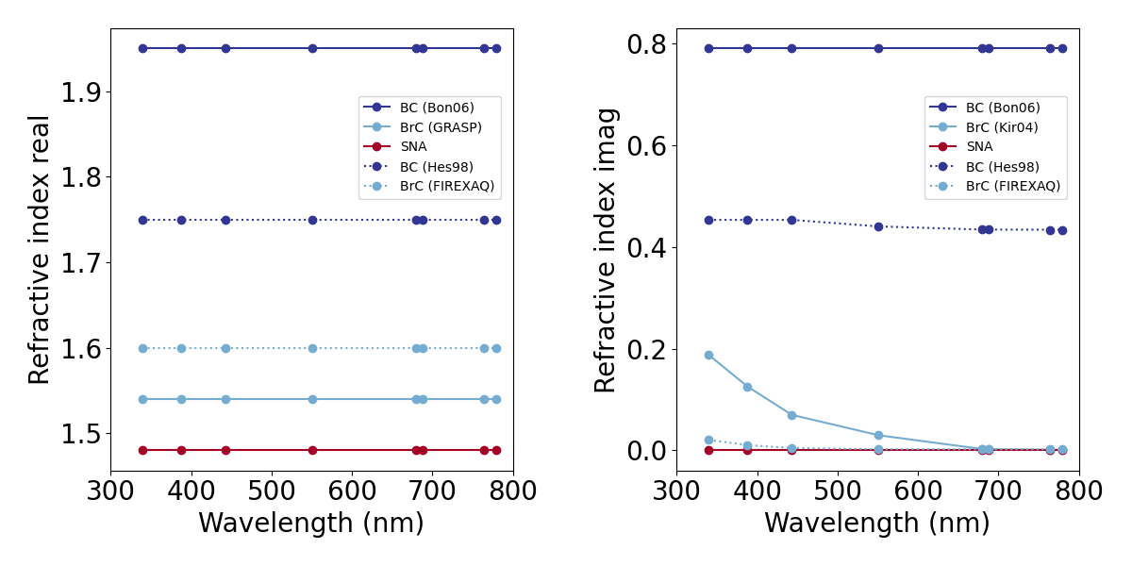


From EPIC AOD to composition mass concentration for smoke
Smoke aerosol = composed of a host of sulfate-nitrate-ammonium (SNA) and two absorbing inclusions BC and BrC
Step 1: calculate total (fine + coarse) volume concentration of smoke (440 nm)
  $τ^{a}=τ_{f}^{a}+τ_{c}^{a}=C_{Vf}h_{f}+C_{Vc}h_{c}$
  $=C_{Vf}\left(h_{f}+h_{c }\left({C_{Vc}}/{C_{Vf}}\right)\right)=C_{Vf} \left(7.6461+ 0.7235 ∗1/2.5\right)=7.9355∗C_{Vf}$
  ${C_{V}=C}_{Vf}+C_{Vc}=C_{Vf}\left(1+{C_{Vc}}/{C_{Vf}}\right)=\frac{τ^{a}}{7.9355}\left(1+1/2.5\right)=0.1764 ∗τ^{a}$
  Unit of $C_{V}$: µm³/µm²
Step 2, Step 3 same as dust with $ρ_{BC}\text{= 1.8 }\text{g}\text{/}\text{cm}\text{3}$, $ρ_{BrC}$= 1.2 g/cm³
Vf_BC
Vf_BrC
Vf_SNA
Volume fraction range of (a) BC, (b) BrC, and (c) SNA according to k₆₈₀ and b
Notes:
We assumed that smoke aerosol is composed of a host of sulfate-nitrate-ammonium (SNA) and two absorbing inclusions BC and BrC with internal mixing based on Maxwell Garnett effective medium approximation (EMA)

Slide 16


Contrasting Regional Aerosol Properties – BC and BrC
TOA AI AOD_{Bkgr} AOD_{4D} SSA₄₄₃ SAE k₀ BC BrC[mg/m²]
Mar. 4, 2018
Aug. 9, 2020
Aug. 24, 2018
2 6
0 6
0.85 1
0 4
0. 0.016
0 7
0 60
USA: Forest wildfires: moderate abs., SSA~0.9-0.94, high BrC (SAE), low-moderate BC (k₀), ALH can be very high.
India, South Africa biomass burning: bush- and grasslands, agriculture crop residue etc. (low energy fast burning):
high absorption, SSA~0.85-0.88, low-moderate BrC (SAE), high BC (k₀), ALH is low (<1-1.5km).
Notes:
1)

Slide 17
Conclusion
Information of iron oxides content and their apportionment between hematite (α-Fe₂O₃) and goethite (α-FeOOH) species are key determinants of quantifying shortwave dust DRE estimate in Earth system model. Here, contents of hematite (α-Fe2O3) / goethite (α-FeOOH) column are inferred from single-viewing satellite EPIC at ultraviolet–visible (UV-Vis) channels globally over major global dust source regions using MG EMA internal mixing rule.
Retrieved iron oxides enveloped the overall range of Di Biagio et al. (2019) soil measurement data of iron oxides 0.7-5.8% and were in line with the previous published results generally. The ratio between hematite and goethite over Sahel was different between Harmattan and summer season, thereby implying considerable seasonal and temporal variation attributed to different source regions. Likewise, the ratio between hematite and goethite over the Middle East tends to change before and after shamal season. Globally, the Sahel region represented higher iron oxides than Sahara especially in April. Lower iron oxide content over Bodélé due to its diatomic sediments with high AOD were clearly observed throughout the year.
Combining the VIIRS fire detection and the EPIC MAIAC smoke aerosol products, including BC and BrC, confirmed that freshly emitted smoke aerosols from North America wildfires exhibited high fractions of BC and BrC near sources and the absorption decreased as transported to surroundings.
The algorithm can be applied for other nadir-viewing instruments having UV-Vis channels, thereby will be beneficial for dust/smoke DRE related climate change (e.g., input for climate models) / air quality (e.g., epidemiology) study.

Slide 18



Hematite exhibit the large range of refractive indices in the literature (Preliminary)
Same event but with different hematite refractive index
AOD
SSA
Vf_Hm
Vf_Gt
[Hm]
[Gt]
cost
1.
2.
3.
4.
5.
6.
7.
8.
9.
1. Chen and Cahan 1 (1981)
2. Chen and Cahan 2 (1981)
3. Krekov (1992)
4. Gillespig and Lindberg (1992)
5. Hsu and Matijevic (1985)
6. Querry (1985)
7. Longtin (1988)
8. Bedidi and Cerville (1993)
9. Sokolik and Toon (1999)
10. Kerker (1979)
11. Marusak (1980)
12. Vernon (1962)
13. Scanza (2015) – this study
10.
11.
12.
→ Which one is the most suitable a priori hematite refractive index??
13.
Notes:
Finally, one of the issues regarding hematite is that, Hematite exhibit the large range of refractive indices in the literature
This figure shows 13 different kinds of hematite refractive indices gleaned from published paper.
We can see that their range are very different
We need one of this information as an a priori on our retrieval, and therefore, need to figure it out which is the most suitable.
(RIGHT) This is the same dust case but results with different kinds of hematite.
We can see that the retrieved hematite/goethite contents vary significantly depending on which refractive index we use.

Slide 19



Hematite exhibit the large range of refractive indices in the literature (Preliminary)
Same dust event but with different hematite refractive index
Most plausible hematite refractive indices
Not likely to be true
Maximum of
Iron oxide in literature (~6.5%)
1. Chen and Cahan 1 (1981)
2. Chen and Cahan 2 (1981)
3. Krekov (1992)
4. Gillespig and Lindberg (1992)
5. Hsu and Matijevic (1985)
6. Querry (1985)
7. Longtin et al. (1988)
8. Bedidi and Cerville (1993)
9. Sokolik and Toon (1999)
10. Kerker et al. (1979)
11. Marusak et al. (1980)
12. Vernon (1962)
13. Scanza et al. (2015) – this study
Iron oxide wt% maximum ~ 6.5%.
  2-5% of wt% (Linke et al., 2006; Formenti et al., 2014)
  2.8-5% (Lafon et al., 2004), 2.4-4.5% (Formenti et al., 2008)
  0.7-5.8% (Di Biagio et al., 2019), 2.8-6.5% (Schuster et al., 2016)
2.8–6.5 % of mineral dust by mass corresponds to 1.4–3.25 % by volume (Schuster et al., 2016)
Notes:
However, when we go with (When I converted it to the) iron Oxide Mass fraction (in %),
Here the x-axis correspond to the each one of the cases at the previous slide / each refractive indices
The maximum of iron oxide in literature is about 6.5%, therefore,
Number 3, and 8 are never likely to happen, their minimum range is too high.
For the similar reason, 4,5,7,10,11 (of refractive index) are not likely to be true.
Therefore, it seems the rest of // 5 to 6 number of refractive index are most plausible. //13.19
Those are Chen and Cahan, Querry, Sokolik and Toon, Vernon, and Scanza.
It’s a small data set looking at (the effect of refractive index?), it does give evidence that
therefore more research needs to be done.

Slide 20





Distribution of iron oxide minerals in soil mineralogical map
Hematite in Clay fraction
Goethite in Clay fraction
Goethite in Silt fraction
Hematite in Clay fraction
Goethite in Clay fraction
Goethite in Silt fraction
Log scale
(Journet et al., 2014)
Journet, E., Balkanski, Y., & Harrison, S. P. (2014). A new data set of soil mineralogy for dust-cycle modeling. Atmospheric Chemistry and Physics, 14(8), 3801-3816.
Specifically, for example in CAM5, dust aerosol mineralogy emission of two particle mode (accumulation mode Dp (µm): 0.1-1µm, coarse mode Dp (µm): 1-10µm) are transformed from soil mineralogy (clay-sized soil (Dp, 0-2µm), silt-sized soil (Dp, 2-50µm)) by brittle fragmentation theory of dust emission (Kok, 2011) (Scanza et al., 2015; Liu et al., 2012).
Then, dust aerosol refractive index is calculated from volume-weighted mixing rule of all mineral components including water and used as input of RTM in CAM5. Here, mineral components are internally mixed within each particle mode, and externally mixed between different particle mode (Liu et al., 2012, 2016).
Notes:
Before we (get into) the methodology, I would like to show you the soil mineralogical map of the iron oxide minerals.
In Earth system models, such as CAM5, these soil mineralogy are converted to the dust aerosol mineralogy by the brittle fragmentation theory.
And, (In Earth system models, ), these mineral components are internally mixed within each particle mode, and externally mixed between different particle mode.
(For example over Africa)
We can see that the some of the spots with the red color here is dominated by hematite but majority of the areas are dominated by goethite.
;;--------------------------------------------------------------------------------
They collected the map of the soil type, with their mineralogical content based on previous measurement data and created the Mean Mineralogical Table (MMT).

Slide 21









Climatology of iron oxides species
Pixels of AOD>1.0 used only
01/01/2018 – 12/31/2018 (1 year)
MAM
JJA
SON
DJF
MAM
JJA
SON
DJF
(April)
(Dec.)
High Iron oxide over Sahel
High AOD > 2.0 (left) with low iron oxides content ~1% (right) throughout the year captured over Bodélé.
Notes:
This slide shows the climatology of iron oxides species over the year in 2018. with AOD, SSA, and imaginary index at 680 nm of MAIAC.
Currently MAIAC EPIC cannot differentiate between the dust and the smoke,
(AOD가리키며) And, the aerosol is mostly BB smoke in the Indo-Gangetic plane, although there is also a dust from Thar desert.
Therefore, the results in this region should not be considered as accurate.
This is partly true for the North America (JJA) in Summer and Australia (SON) too.
Nevertheless,
We clearly had high iron oxide over Sahel than Sahara, except in Summer.
Also, High AOD with low iron oxides content through out the year captured over Bodele region.
;;----------------------------------------------------------------------------------------------------------------------------------------------------------------------------------
(Alexei comment)
It is mostly BB smoke In the Indo-Gangetic plane, although there is also a dust from Thar desert.
I suggest you say that because EPIC currently cannot differentiate between the dust and the smoke, the results in this region should not be considered as quantitative (or accurate).

